Slide 1


THE
CIRCULARITY AND EMISSIONS GAP
THE ROLE OF CIRCULAR ECONOMY IN ADDRESSING CLIMATE CHANGE
Matthew Fraser | Circle Economy | June 2021

Slide 2
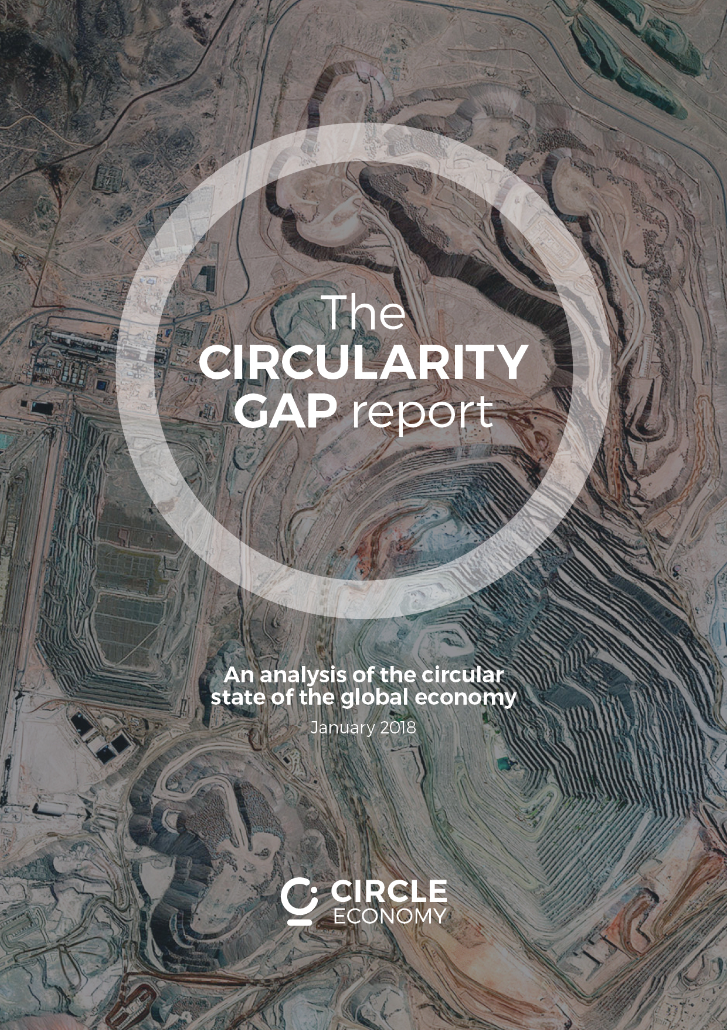
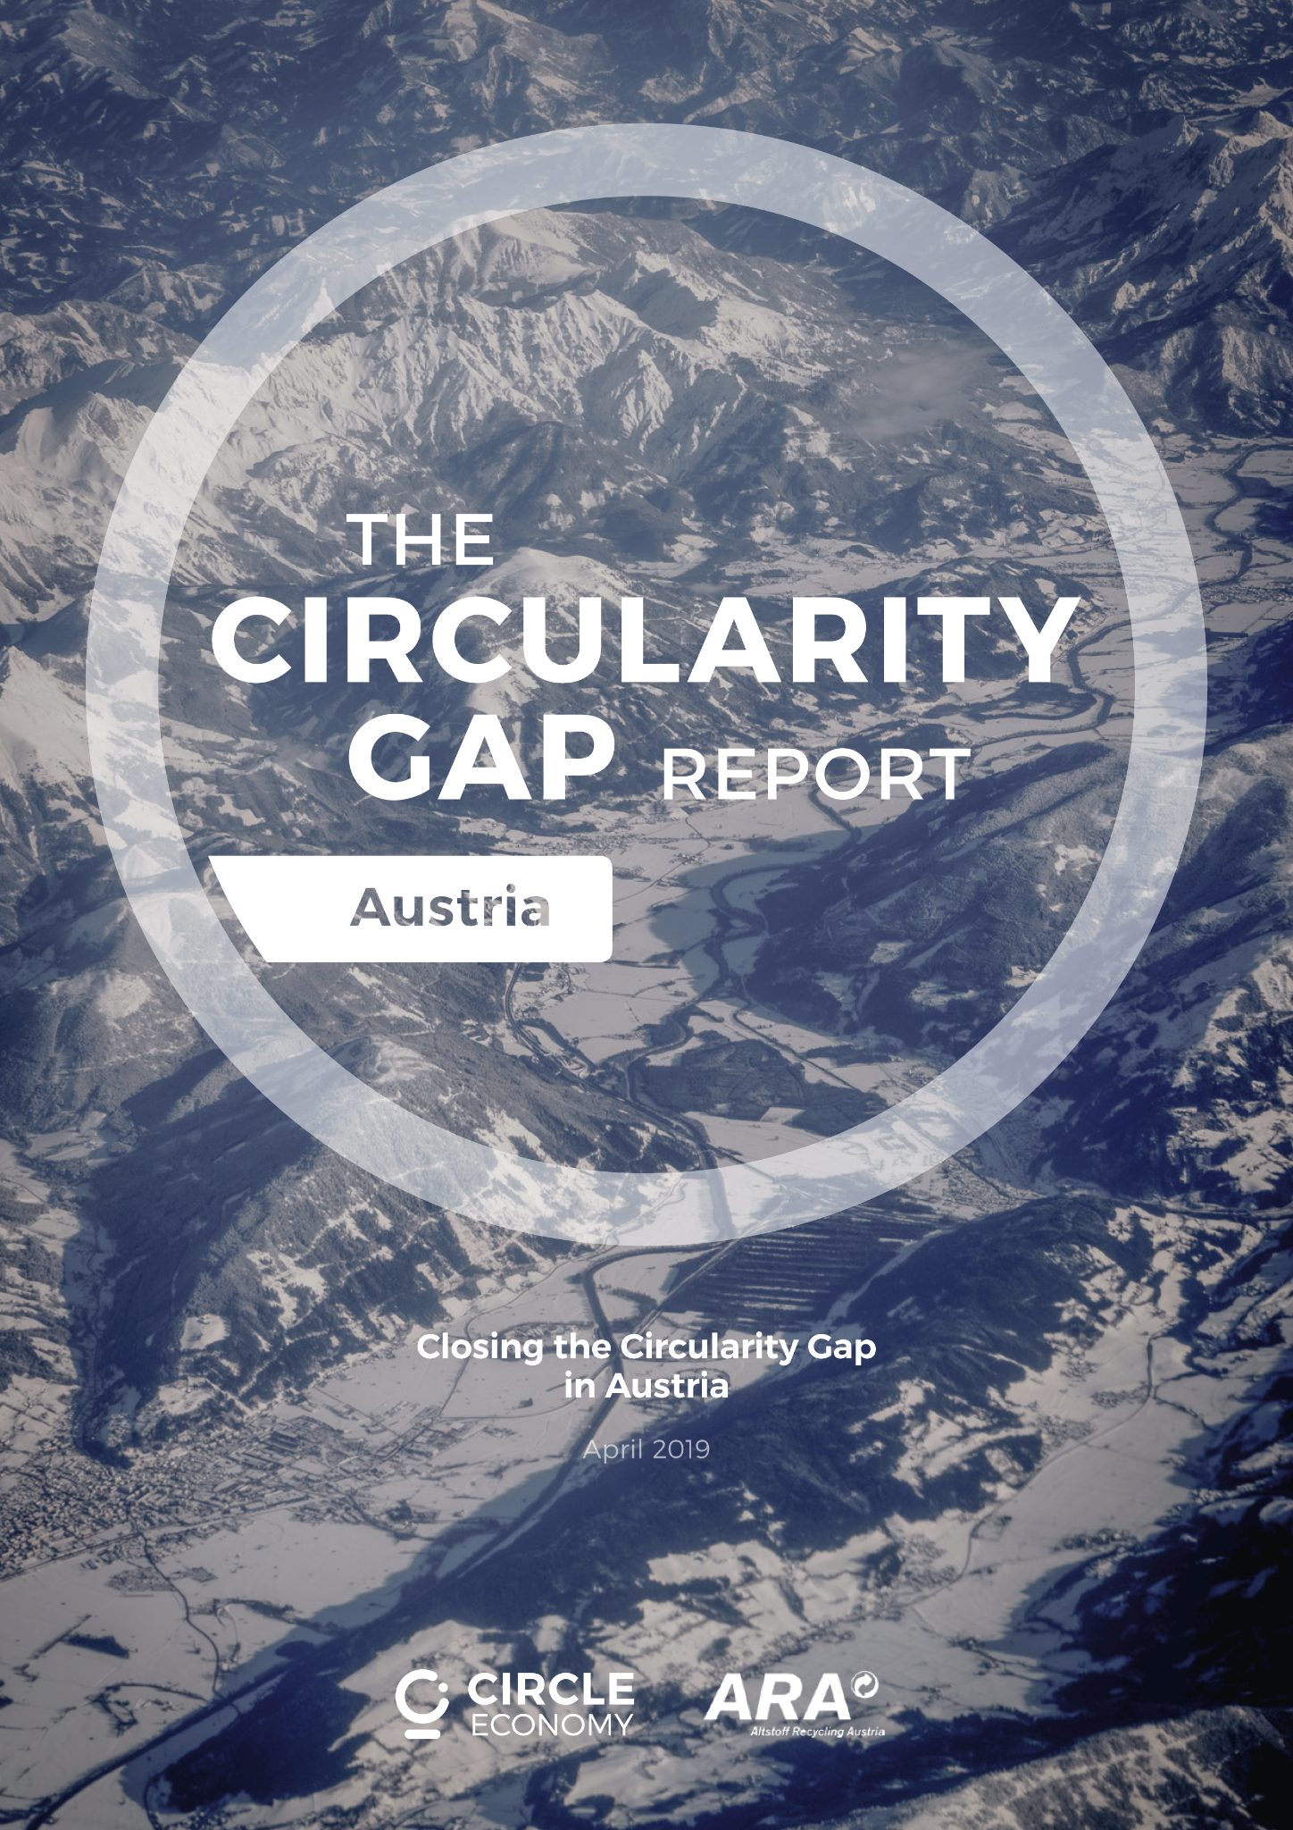
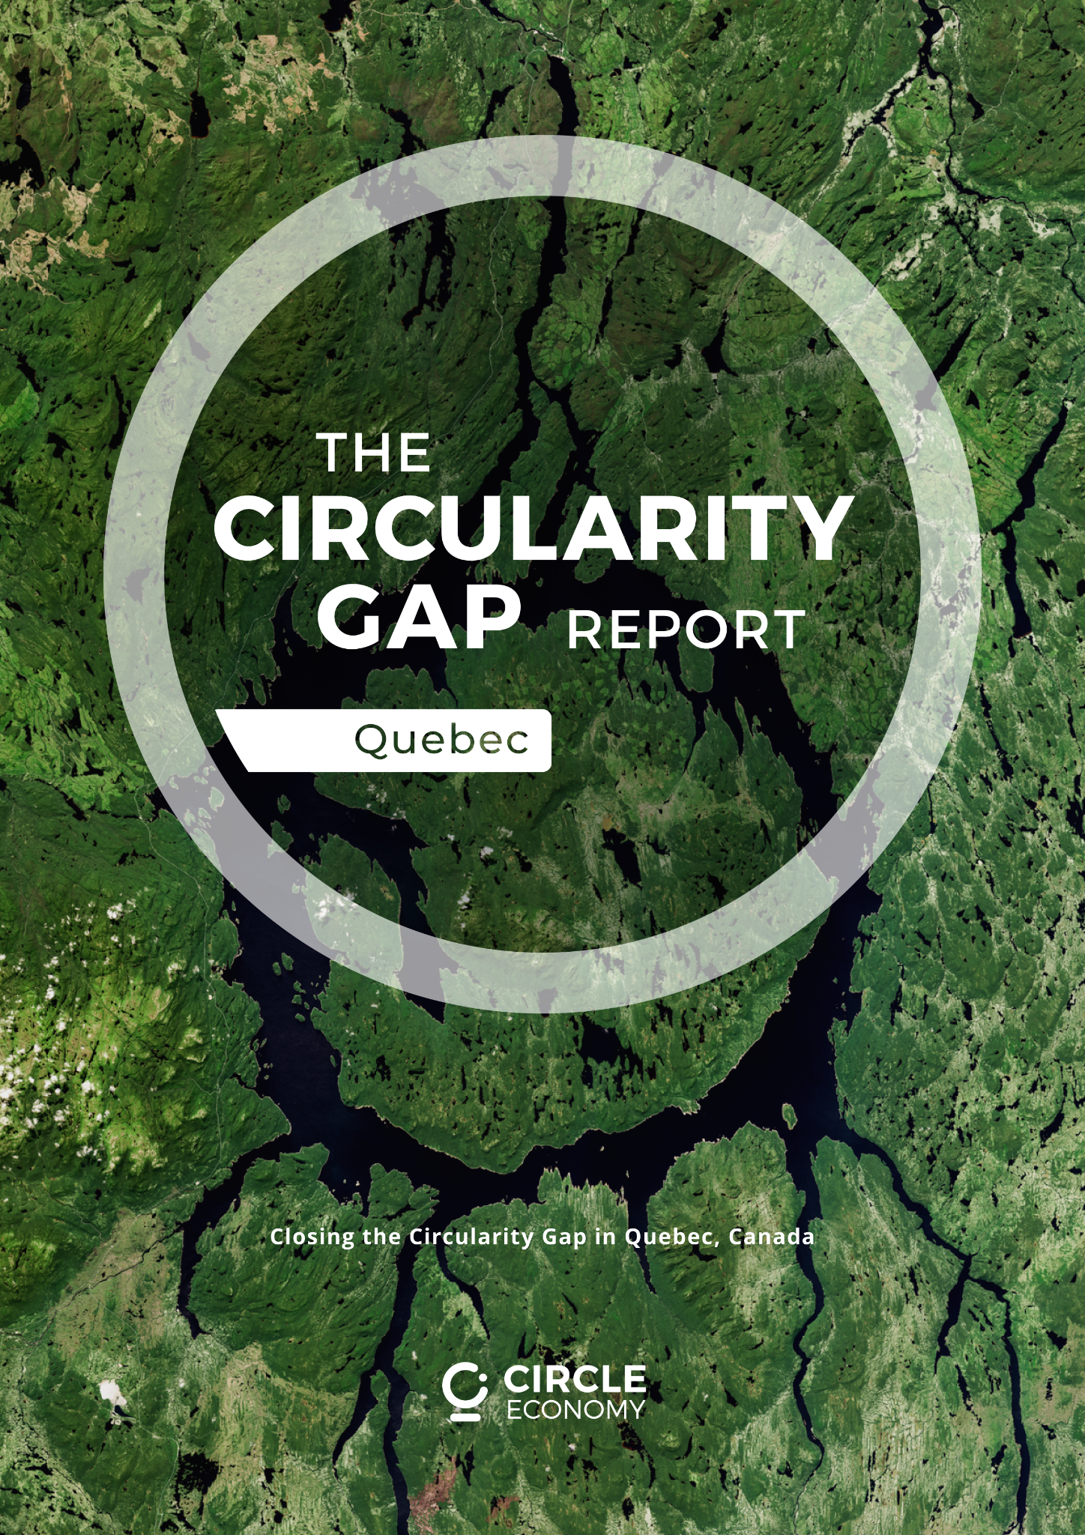
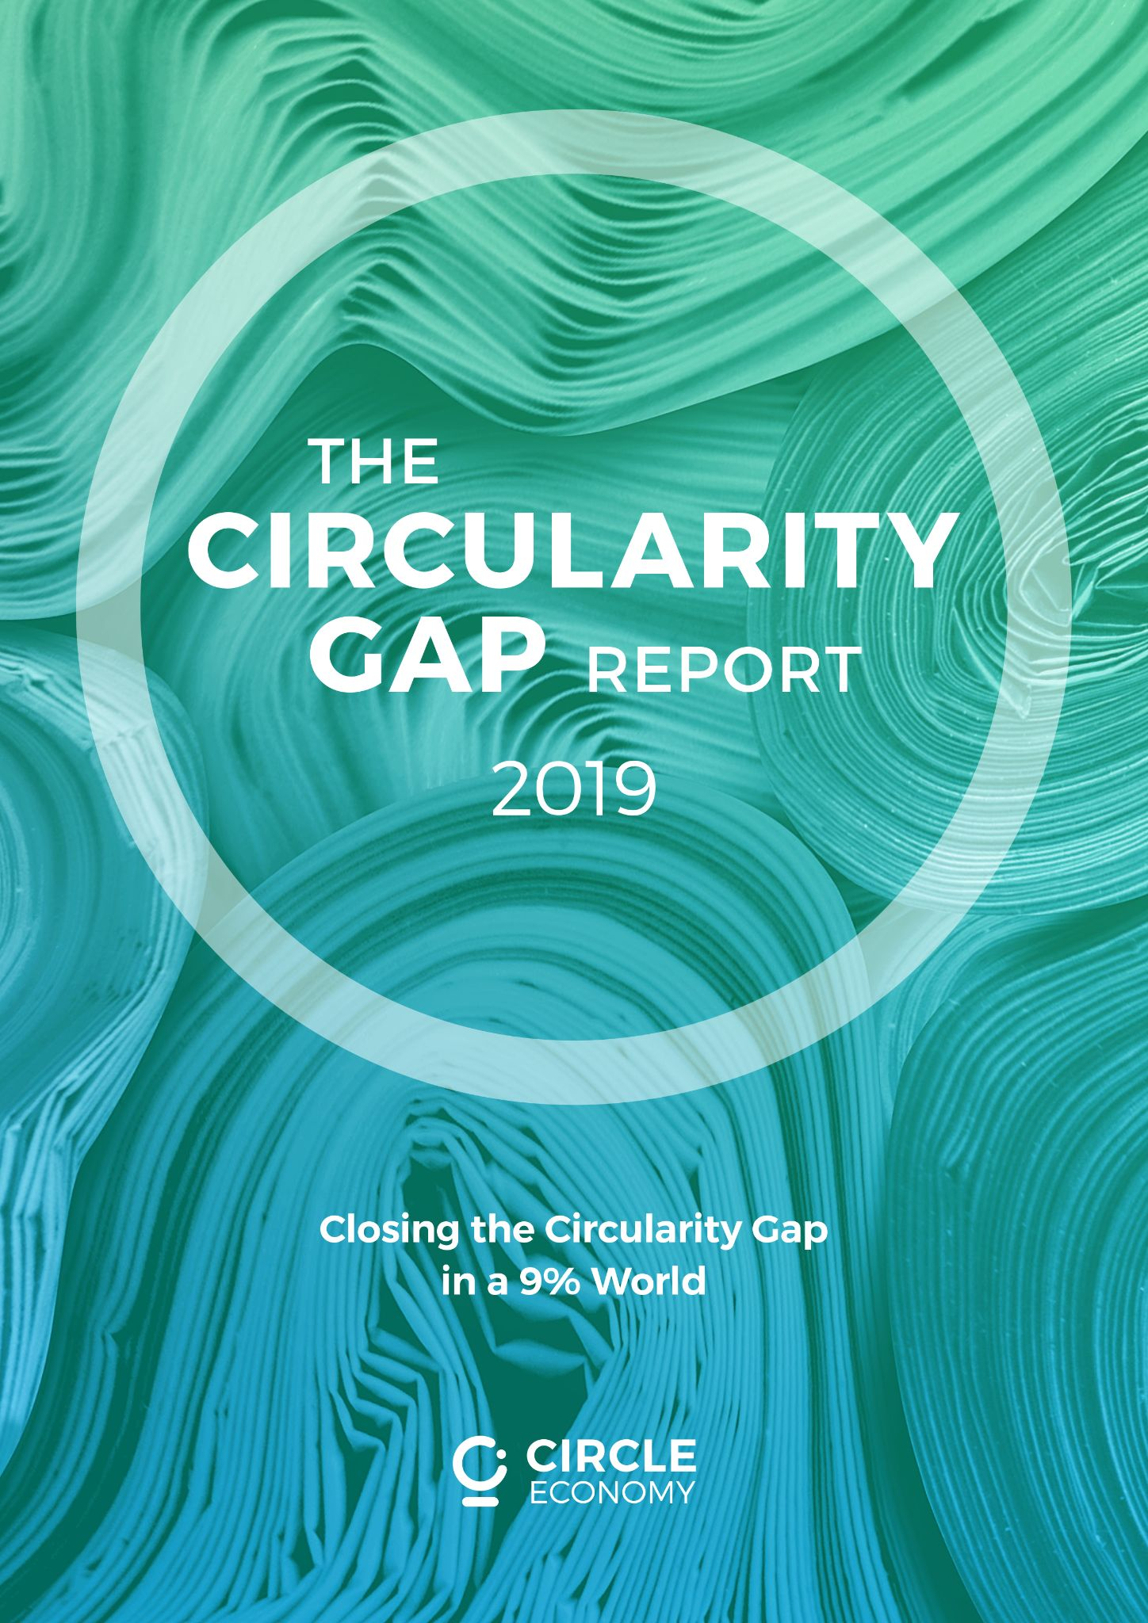
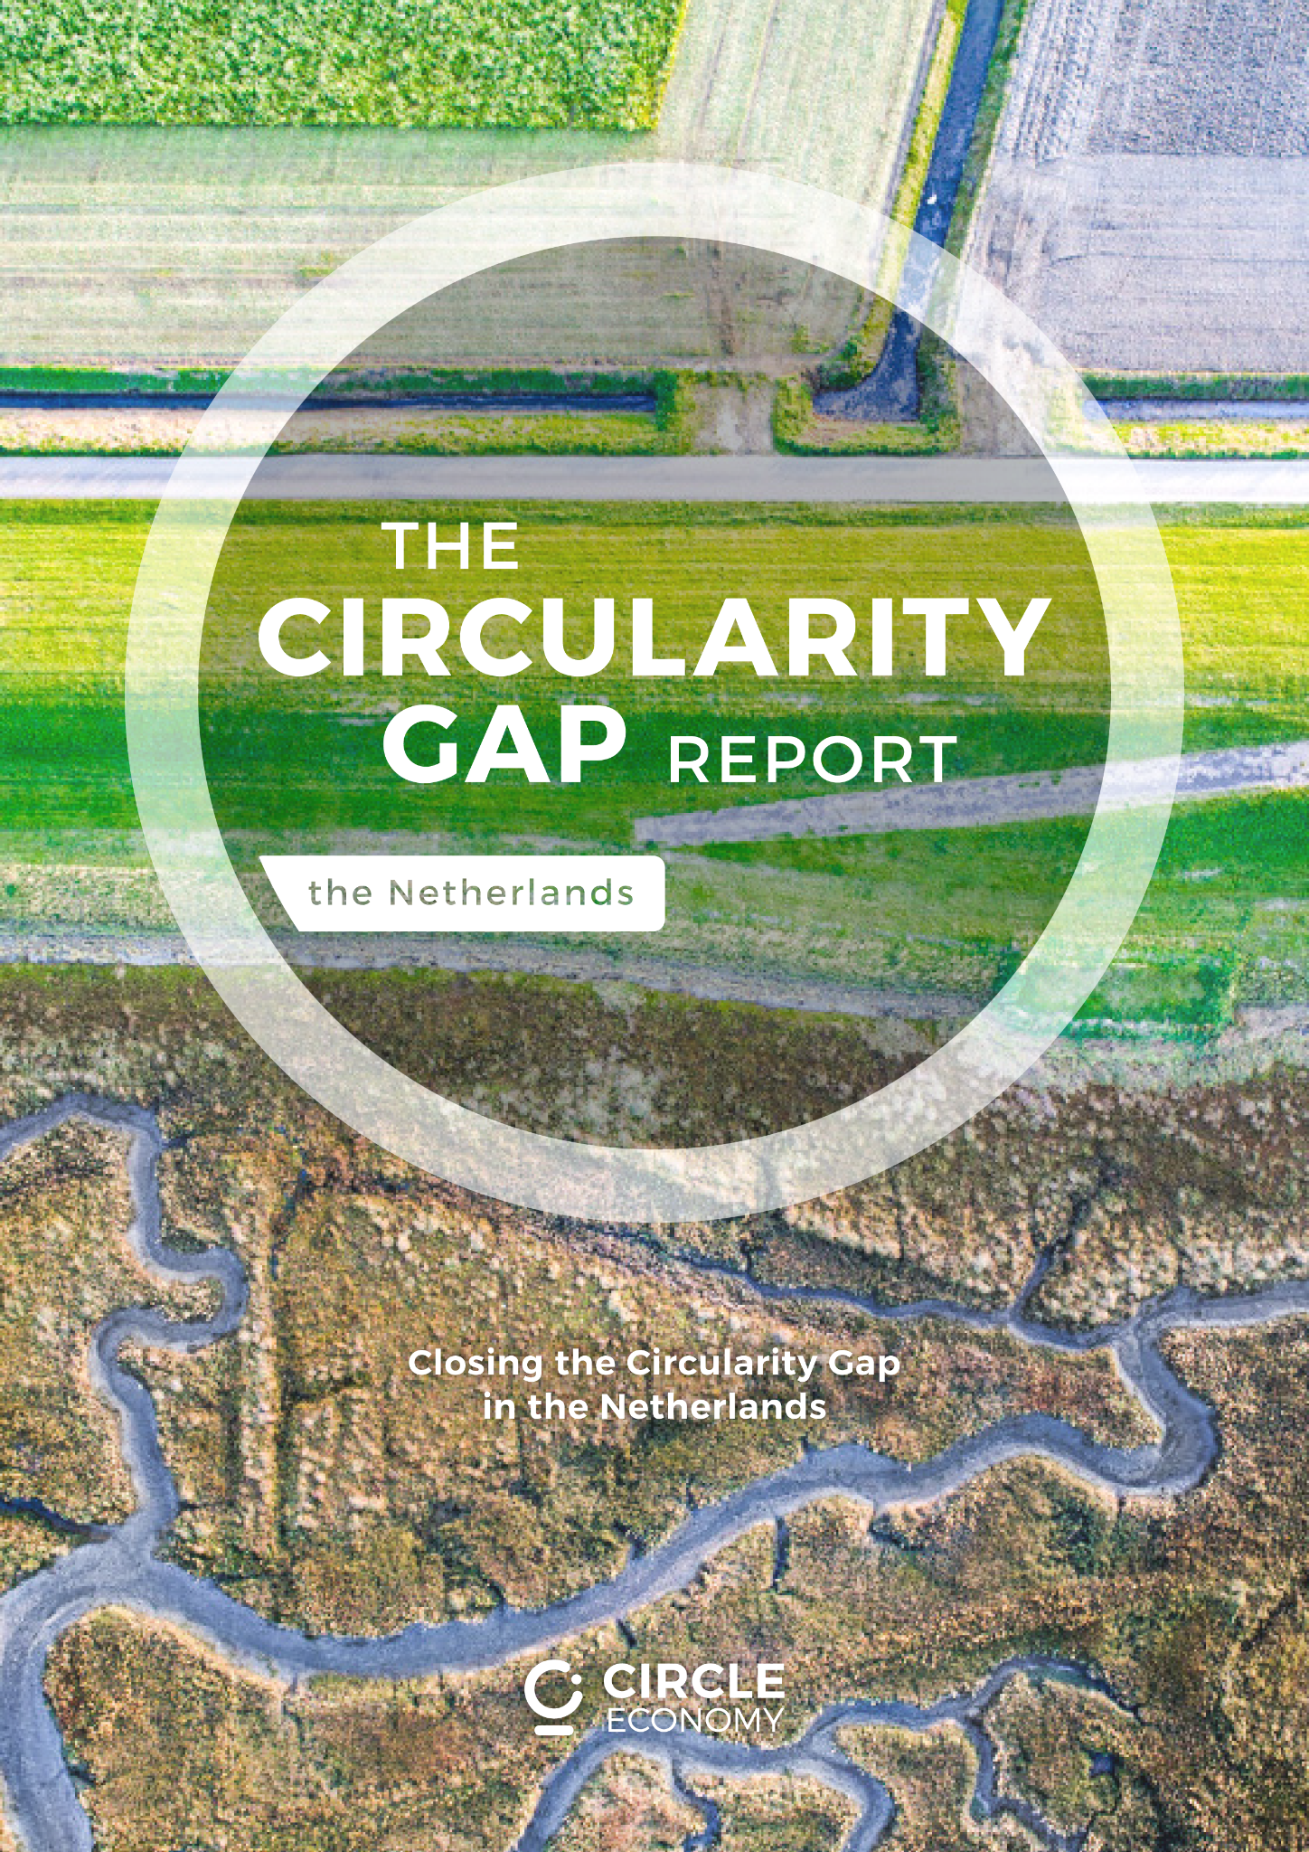
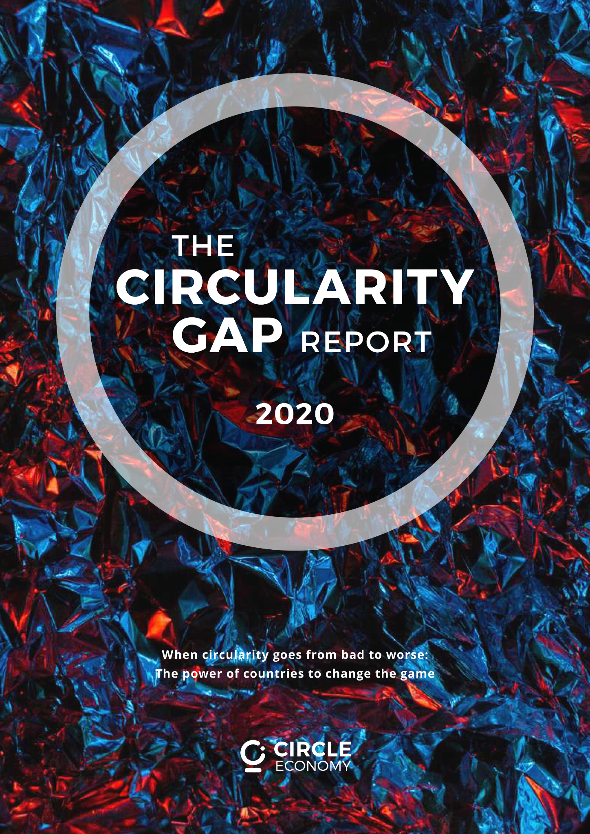
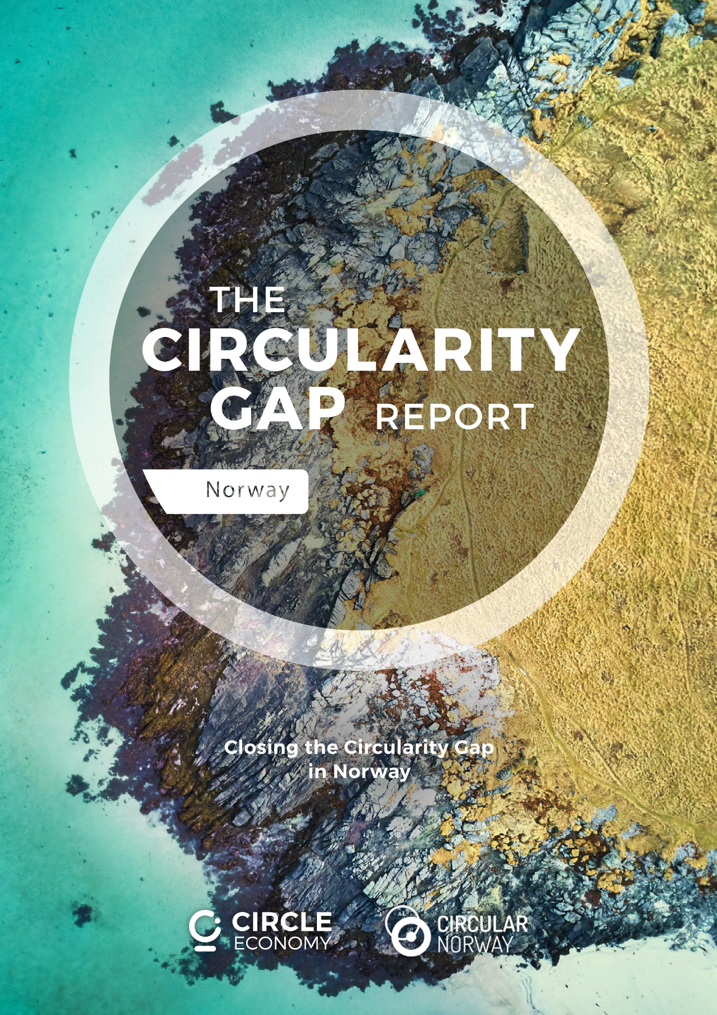
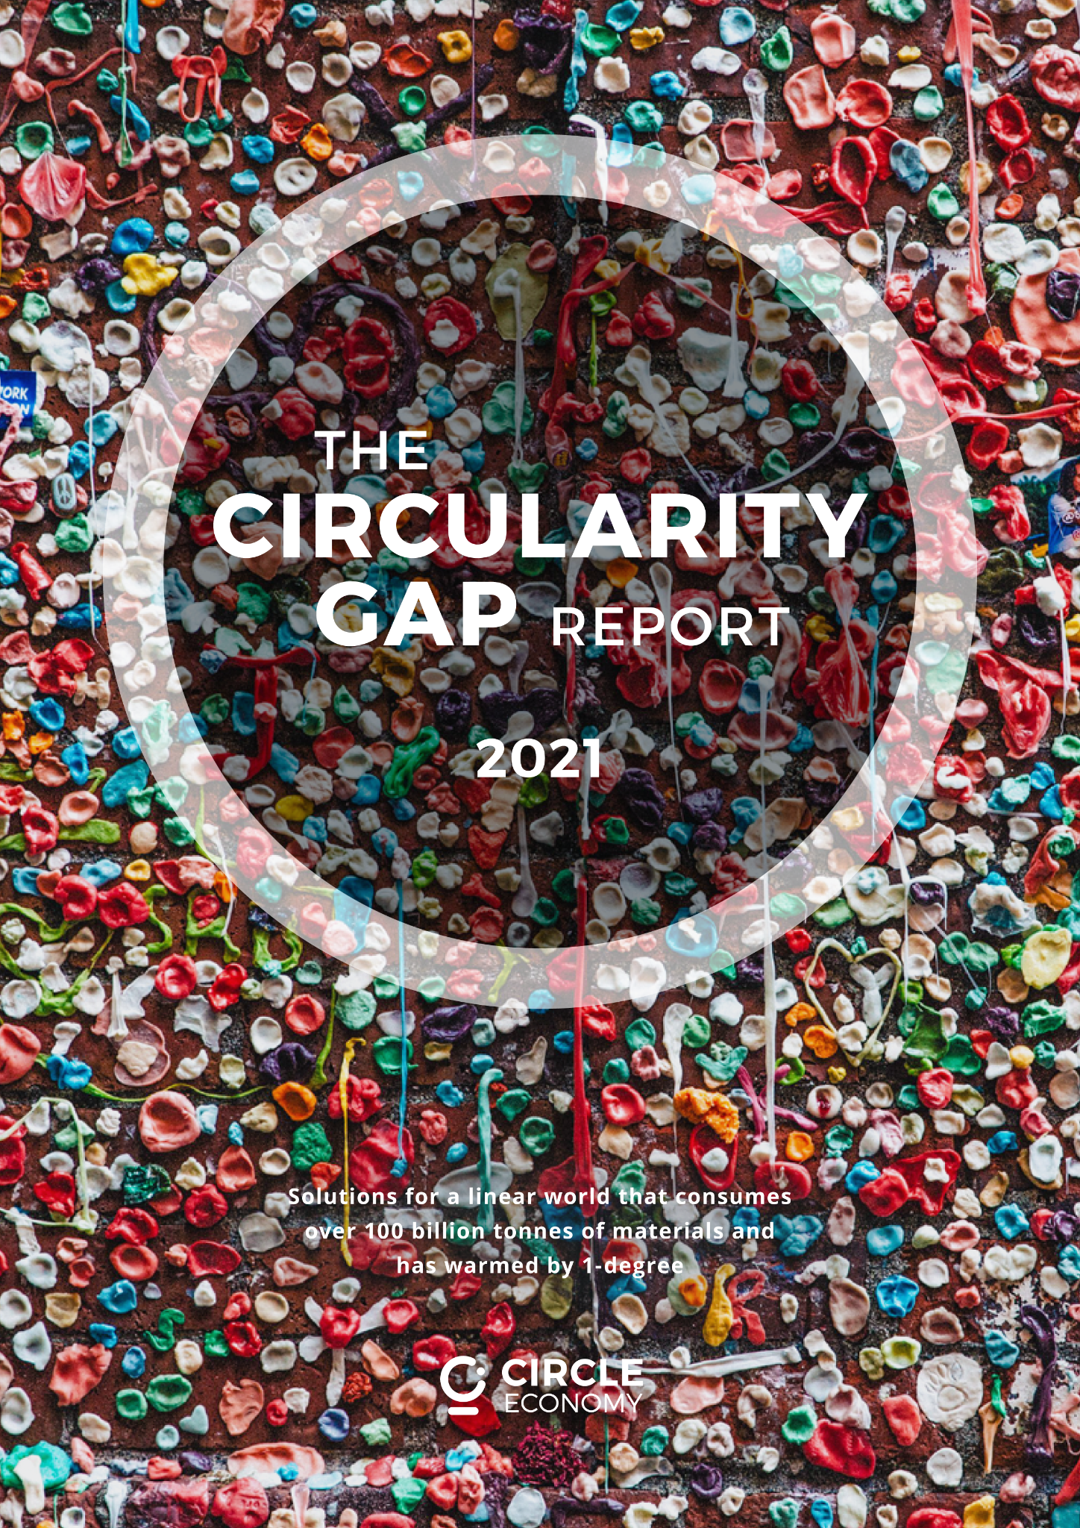
We anchor circularity in the global debate and translate insights to action at the national and regional level
GLOBAL
NATIONAL
REGIONAL
Launched at Davos
January 2018 - 2021
Austria, The Netherlands, Norway
2019 - 2021
Quebec
2021
Notes:
Speaking points:
We started with a simple question “how circular is the world” back in 2018. We recently released our 4th Global report on the topic of CE and Climate Change
Goals of the CGRi - establish a highly comparable baseline metric on circularity, but also to inspire action and support decision making
Our analysis is really well suited to nations - understanding how the metabolism of materials works, and where the levers are for change

Slide 3
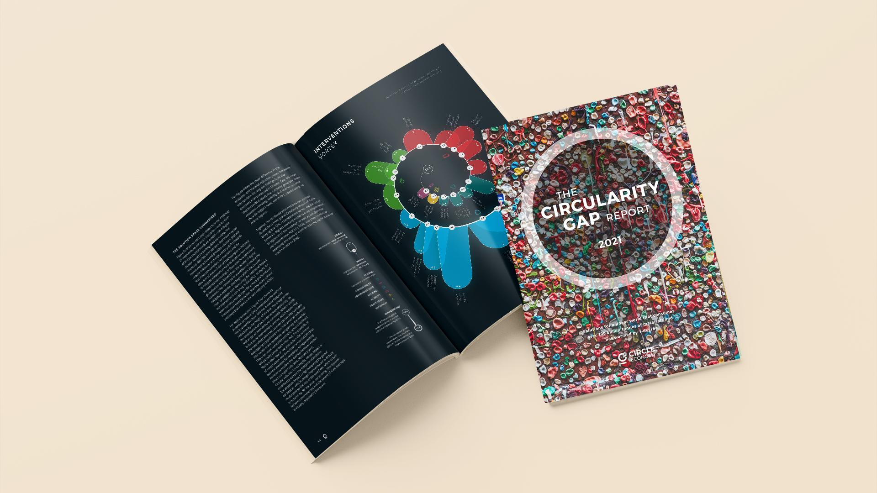

Notes:
In our latest circularity gap report (launched January this year), we explored the nexus between the “circularity gap” and the “emissions gap”
In other words, what if we look beyond renewable energy and energy efficiency to consider the broader systemic picture of how we produce, manage, and interact with materials. How much further could we mitigate climate change by reimagining our relationship to “stuff”?
In many ways this report really gets to the core of circular economy: we are trying to figure out how we can design a system that delivers individual and societal benefits without transgressing key planetary boundaries. Climate change being the most urgent

Slide 4
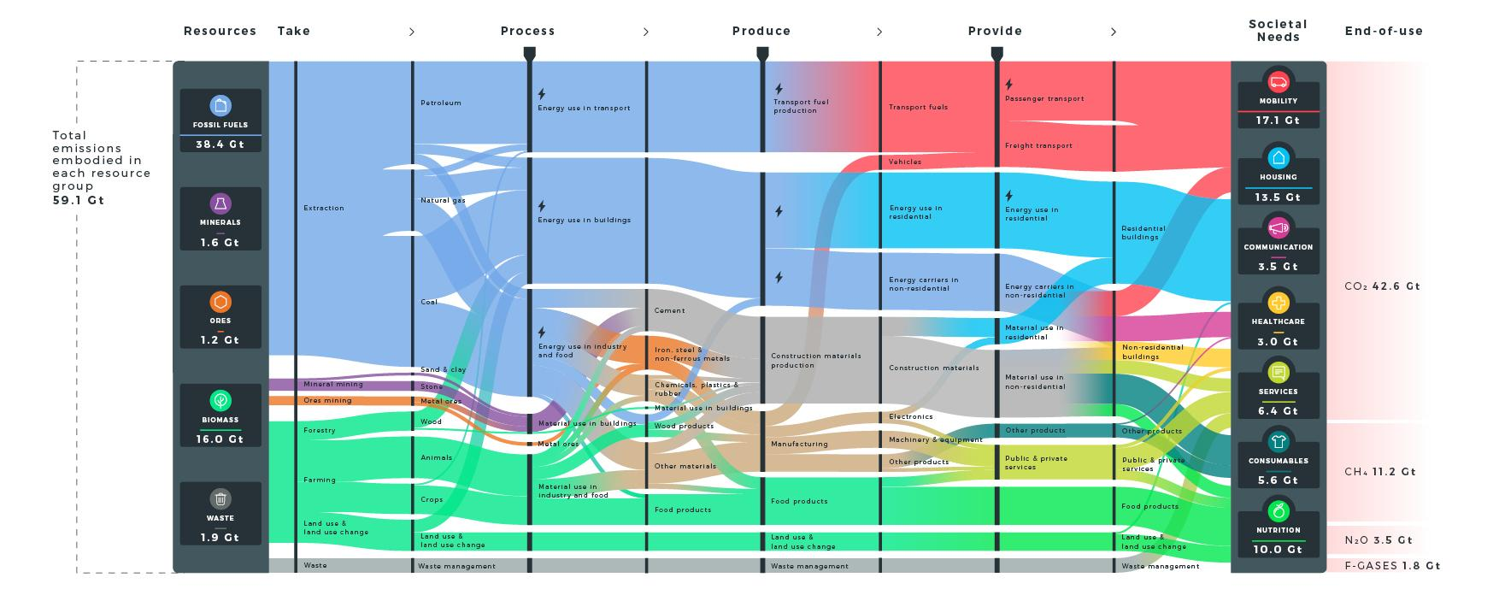
EXPLORING THE RESOURCE-EMISSIONS NEXUS
Notes:
Similar to previous reports, we mapped the flow of materials at a global level - this time rather than sizing the flows according to the weight of them, we size them according to the associated emissions (lets follow this for a minute, from left to right)
what we can see is that even though a big part of emissions relate to the burning of fossil fuels for energy (look at the little lightning bolts on the left blue flows), the vast majority of these emissions are deeply entangled with the use of materials as we move through the economy, for instance in freight transport - the moving of goods; or the production of construction materials used in housing.
By the time we reach the right hand side, we see those little lightning bolts (burning of fossil fuels for energy) only make up about 1/3 rd of the total. The vast majority at this stage is embodied in the materials that we use to satisfy our societal needs
So this begs the question: how could we apply circular economy strategies to address these emissions?

Slide 5
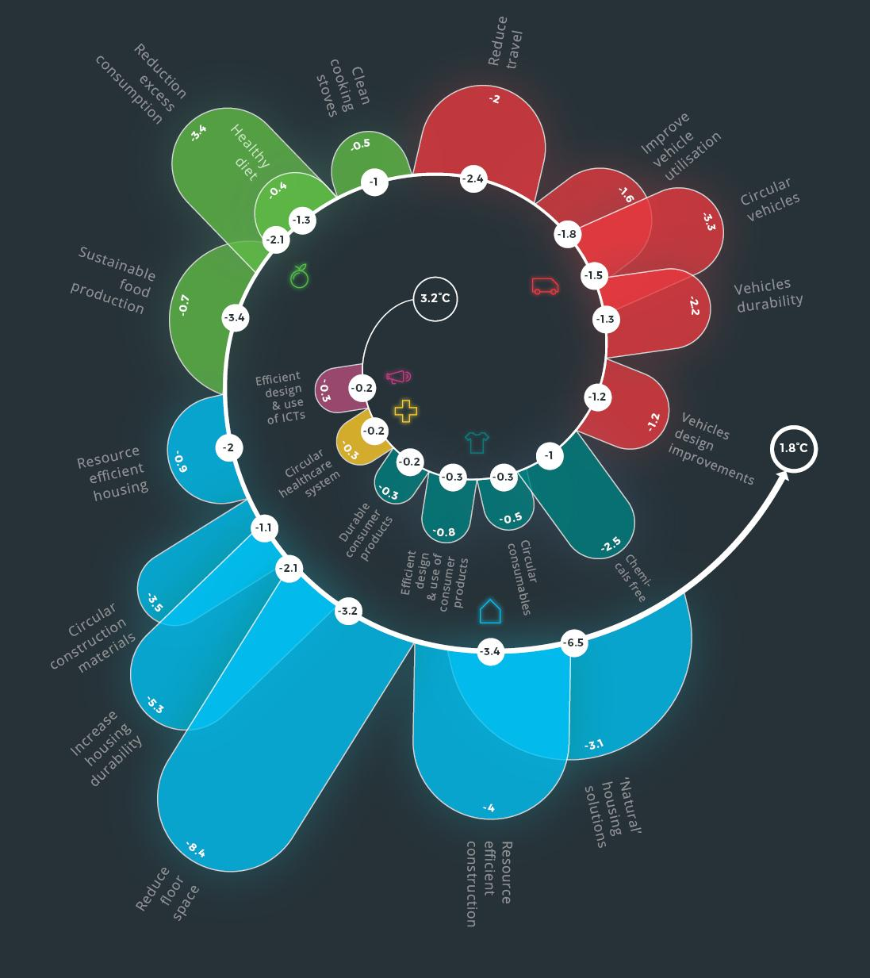
21 solutions to prevent climate breakdown
Notes:
In the report, we go on to model 21 strategies
By applying these solutions, and we can reduce material input by 28% can shrink global emissions by 39%.
Which, when added to the existing commitments of countries as described in nationally determined contributions, puts us back on track for achieving a well-below 2.0°C of warming as defined in the Paris agreement.

Slide 6
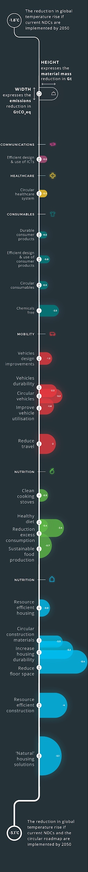
Solutions across housing, mobility and nutrition deliver 70% of the required emissions cut
Notes:
Housing – including commercial and industrial buildings - generates 13.5Gt of emissions every year. It consumes vast amounts of virgin resources, it makes abundant use of carbon-intensive materials such as cement and steel, it creates significant emissions from heating and cooling, and it generates huge amounts of waste.
With circular strategies, 9.5Gt of construction and demolition waste could be diverted from landfill and reused, reducing the need for virgin materials; cement and steel could be substituted for more lightweight, regenerative materials; and a shift to renewable energy would reduce emissions from heating and cooling. Together these would cut emissions by 11.8Gt and reduce demand for materials by 13.6Gt.

Slide 7
Solutions across housing, mobility and nutrition deliver 70% of the required emissions cut
Notes:
Mobility generates 17.1Gt of emissions a year, primarily from burning fossil fuels for passenger and freight transport. New design approaches to make vehicles lighter will reduce consumption and strategies like car sharing can make their use more efficient. Circular strategies can cut emissions by 5.6Gt and material use by 5.3Gt.

Slide 8
Solutions across housing, mobility and nutrition deliver 70% of the required emissions cut
Notes:
Nutrition generates around 10Gt of emissions a year, including 4Gt of emissions a year from land use alone. As global populations and increase and more people adopt western diets more land is needed to grow crops - especially for animal feed - and for pasture, and this drives deforestation. Regenerative agriculture and aquaculture can reduce the environmental impact of fish, cattle and crop farming while producing good yields. Switching to more plant-based diets will have a lower footprint. Circular strategies can cut emissions by 4.3Gt and material use by 4.5Gt.

Slide 9
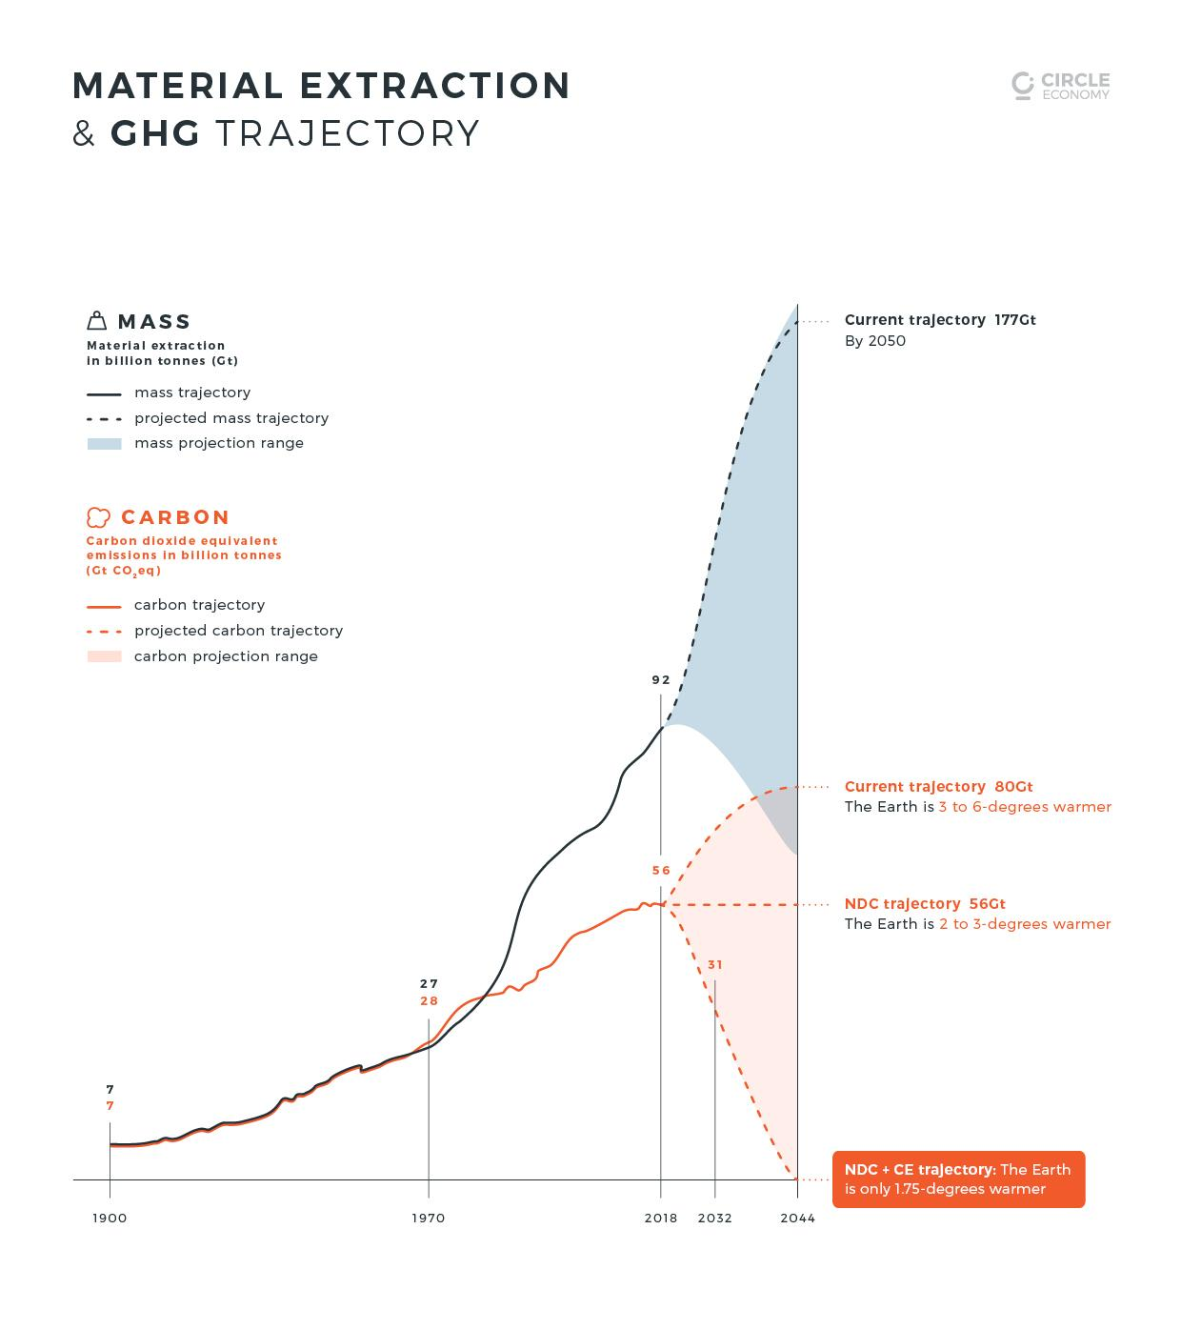

A global agenda packed with circular economy strategies can close the emissions gap and bring us on a “well below 2 degree” pathway.
Notes:
A global agenda packed with CE strategies a circular economy has the power to get us on a path to a well below 2-degrees world by 2032.
The circular strategies that we propose are so exciting because they build on top of current policies and national climate pledges!
Just to give you a sense of how important a circular economy can be to the climate agenda, current commitments made by nations today will only bring us 15% of the way to achieving a well below 2-degree pathway; the circular economy delivers the other 85%.
this years emissions gap report expresses dire urgency about the state of our planet and talks about the commitment gap between what we say we can do, and what we need to do. A Circular economy is practical concept with a global scope, and should be the missing piece to close the commitment gap.

Slide 10

w w w . c i r c u l a r i t y - g a p . w o r l d
CONTACT US
Matthew Fraser
matthew@circle-economy.com
www.facebook.com/Circleeconomy/
www.twitter.com/circleeconomy
www.linkedin.com/company/circle-economy/

