Slide 1

The link between carbon emissions and raw material use
John Barrett

Slide 2
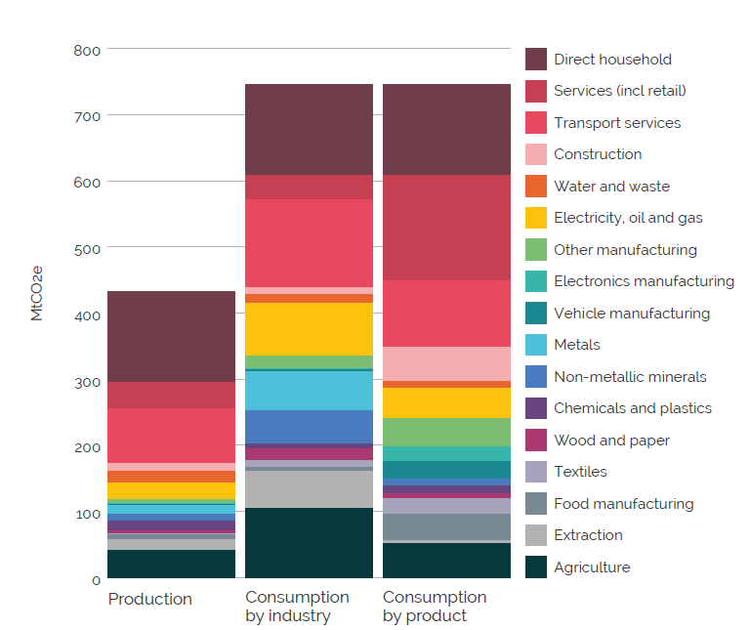
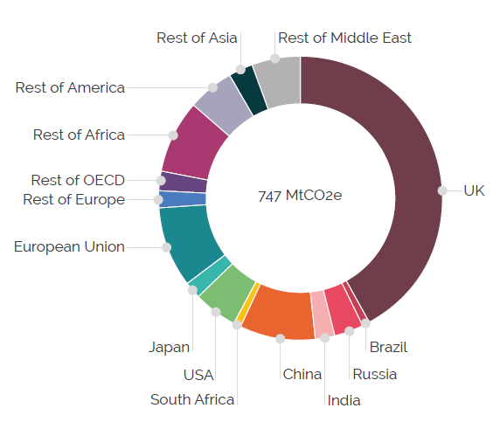
Current Policy Pathway
Notes:
remember to mention policy etc will be second workshop

Slide 3

Resource efficiency strategies

Slide 4
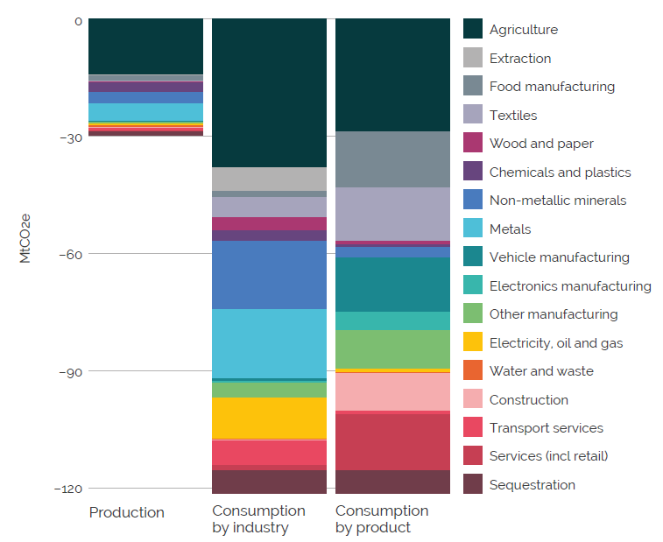
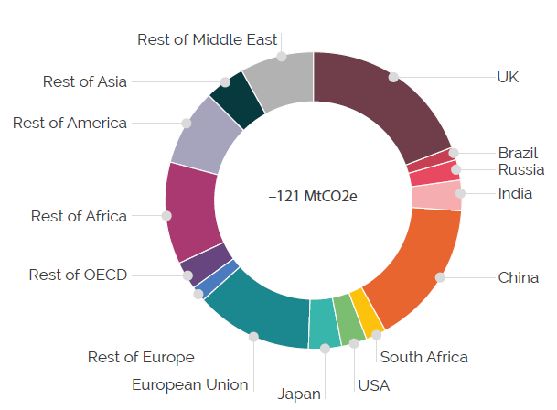
Role of resource efficiency by products
Notes:
remember to mention policy etc will be second workshop

Slide 5
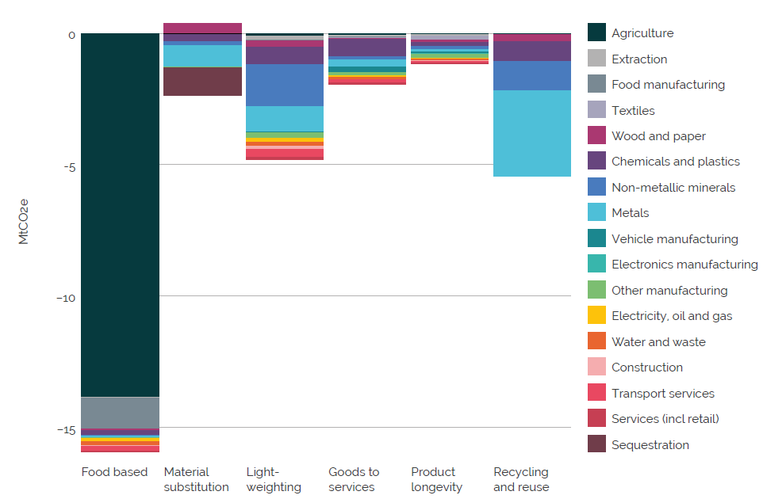
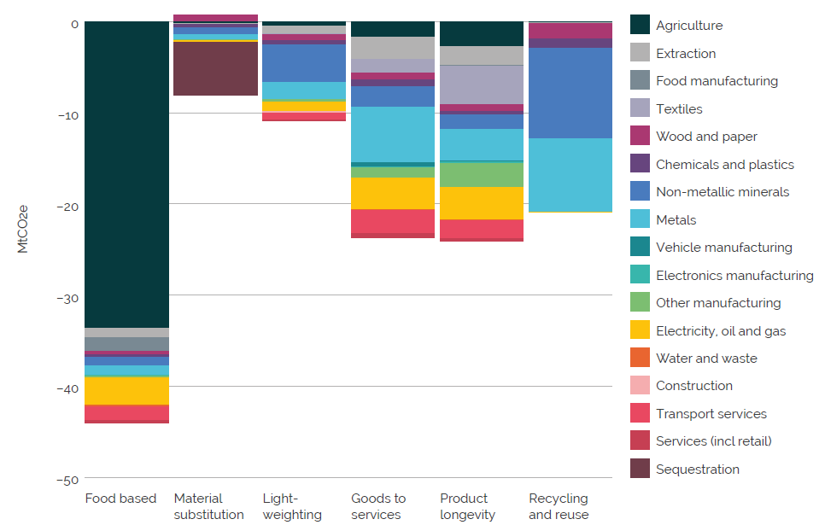
Resource efficiency saving by strategies
Production Consumption

Slide 6






Cross-sector linkages
Demand for land, & forestry potential
Nutrition
Land use
Shelter
Mobility demand & vehicle ownership with changes to work patterns
Changes to production impact F&D sector
Mobility
Repurposing floor space from changes to retail & storage
New build demand for construction materials
Derived demand for Infrastructure and construction materials
Shifts in office working patterns
Derived demand for freight
Non-domestic
Materials & products
Floor space repurposing & new build demand for materials

Slide 7
Conclusions
Incentivise and enable social change
Optimisation of carbon intensive products
Government wide approach
Focus on business models
Remain focused on the goal

Slide 8

More resources
Technical report:
https://www.creds.ac.uk/publications/resource-efficiency-scenarios-for-the-uk-technical-report/
Non-technical report:
https://wrap.org.uk/resources/report/net-zero-why-resource-efficiency-holds-answers
www.creds.ac.uk: regular updates with news, blogs and project information
Twitter: @CREDS_UK

