Slide 1

Scotland's material footprint
Kimberley Pratt, Environmental Analyst
June 2021
zerowastescotland.org.uk
@zerowastescot
Notes:
Hi everyone, I’m KP and I’m an EA with ZWS
Zero Waste Scotland is funded by the Scottish Government to lead Scotland’s transition to a circular economy.
I’m going to be talking about Scotland’s newly published Material Flow Accounts and what this tells us about our material consumption in Scotland

Slide 2
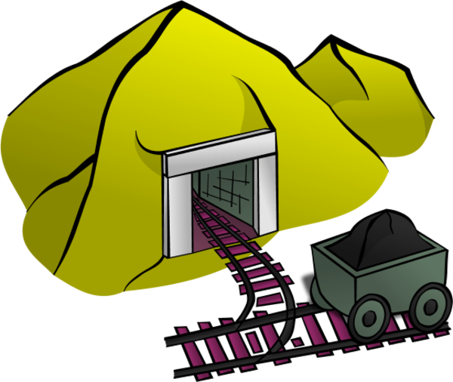
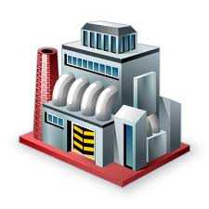


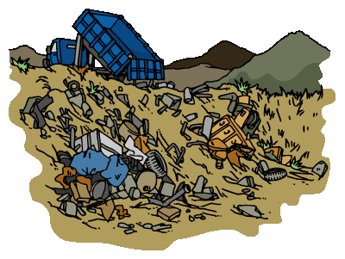

Material consumption
82% of Scotland’s carbon footprint come from the things we buy.¹
Raw material extraction is the most carbon intensive part of the life cycle for most products.
We must understand where our materials are coming from to reduce our carbon footprint.
Take
Make
Dispose
¹ Scottish Government (2021) Scotland’s carbon footprint: 1998-2017
Notes:
The consumption of goods and services underlies all our economic activity. Even digital services use servers, computers, monitors, we all need places to live and work in and food to eat.
This consumption of goods and services is also driving the CC emergency
Scotland’s carbon footprint, published annually by SG shows 82% of our emissions come from the things we buy.
In environmental research, we can look at the life cycle of the products to make decisions about where to prioritise actions – should we focus on energy use? Or the way we dispose of products? What we find is that the extraction of the materials used to make products which are the most carbon intensive part of the life cycle.
So, understanding what materials we are consuming and where they come from is vital to prioritise actions towards meeting CC goals. A good example is the electric car – if all we do is switch from fossil fuel-based cars to electric cars, direct carbon emission may reduce but we are still using huge amounts of materials and global emissions will remain high. More sustainable transport solutions, such as improvements in public transport, cut materials as well as carbon.

Slide 3
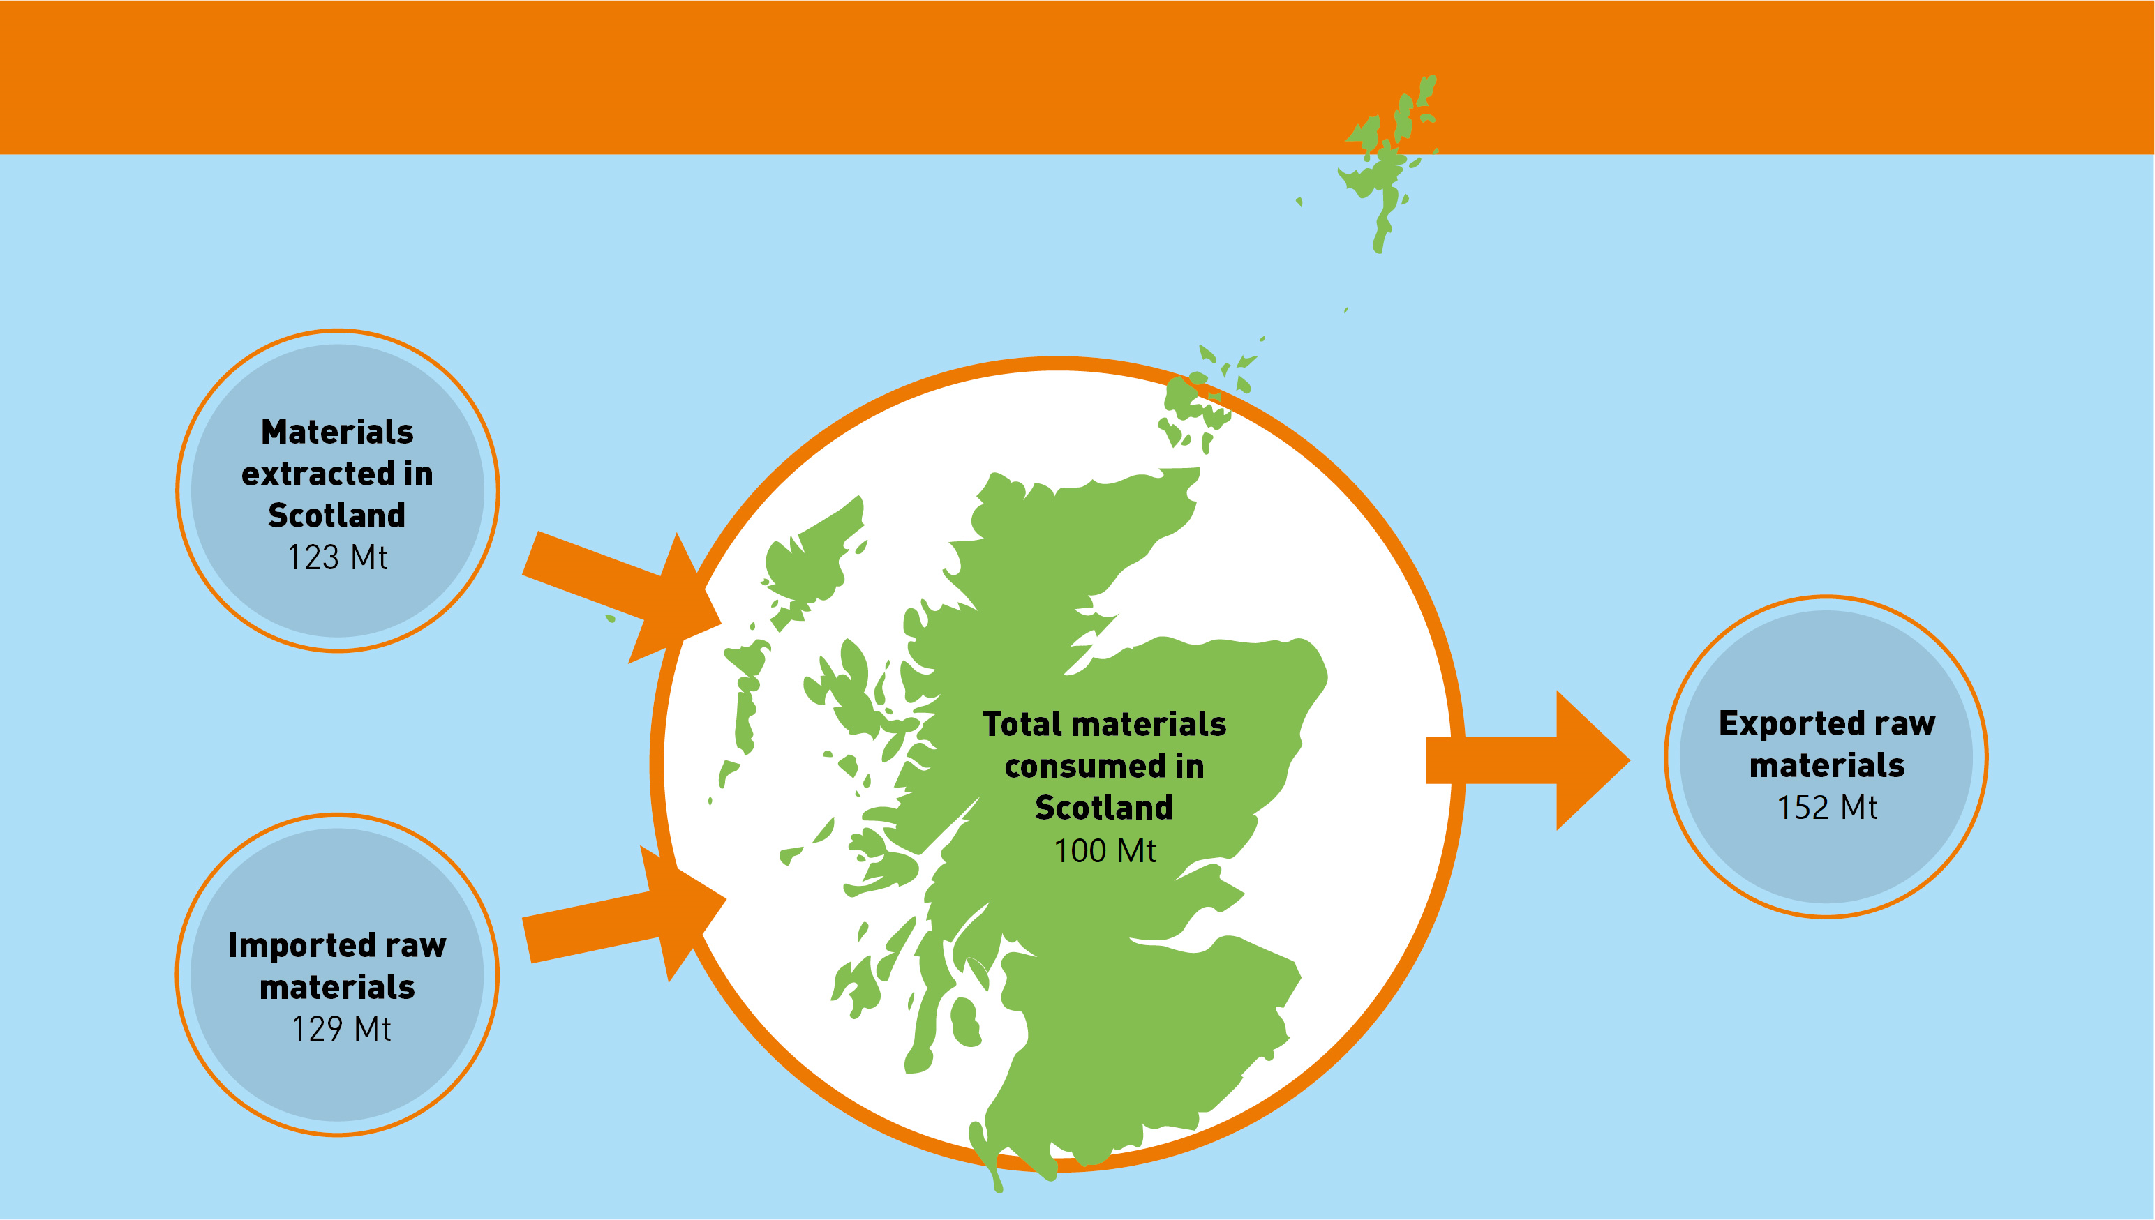


Scottish Material Flow Accounts
2017 Scottish material flows
Notes:
This week, Zero Waste Scotland have published Material Flow Accounts for Scotland for the first time. MFAs are used across the world to understand how materials are flowing in and out of economies.
We can see what materials we are using annually and how this is changing over time.
This diagram shows you that in 2017, Scotland extracted 123 Mt of materials from our own natural environment. We imported even more. In Scotland we used or consumed 100Mt of materials. Our exports include raw materials such as O&G and finished products like food and drink. We are in fact a net exporter by material weight as our exports exceed our imports.
These figures show us our basic material flows in Scotland for the first time.

Slide 4
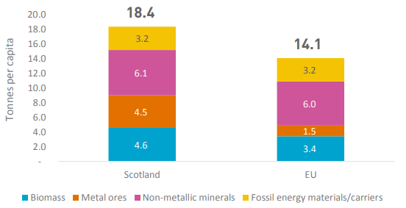
Scotland’s material footprint
Sustainable target
8 tonnes per person per year
Scotland’s material footprint is higher than the EU average…
And even higher than the sustainable threshold.
On average, each person in Scotland consumes 50kg of materials a week.
Notes:
One of the key indicators calculated in our research is an estimation of the Scottish material footprint – the amount of materials each person in Scotland is using every year.
In 2017, Scotland used 18.4t materials per person. This was higher than the EU average and even higher than the sustainable threshold experts believe we should be aiming for. Research indicates that people could live a sustainable, high quality life on 8t/person/year.
Another way of considering our material footprint is to say that on average each person in Scotland is using 50kg of materials a week. This may seem like a lot but remember that most of these materials are invisible to the consumer – they are embedded in the production of the things you buy so most of them don’t make it to your door. Some of them don’t make it to Scotland. For example, a car made from about 1 tonne of steel will require the extraction of more than 25t of iron ore. All of these materials become part of the material footprint for Scotland, if that car is brought in Scotland.
If we are going to reduce our material impacts and the CC emissions associated with them, we have to pay attention to where our materials are coming from, our MFA is the start of this process

Slide 5
Circular solutions
820,000t Scottish scrap steel is exported for reprocessing every year (£110M)
An Electric Arc Furnace in Scotland would have material, energy and transport savings
56% reduction in GHGs compared to BAU:
784,000 tCO2e per year
180 direct long-term jobs and 1,000 indirect jobs
Increase direct gross value added by £10-25M per year
Zero Waste Scotland (2014) Maximising the value of steel in Scotland
Notes:
The CE offers a solution to reducing our material and carbon footprints together.
I want to illustrate this with an example based on one of the world’s most important materials – steel.
Today we export 820,000t Scottish scrap steel for reprocessing every year, with a commodity value of £110M. This process comes at a carbon cost – traditional steel reprocessing relies on coal.
More modern Electric Arc Furnaces, use electricity rather than coal to melt scrap. By building such plants in Scotland, which has an extremely low-carbon electricity grid, we could be reprocessing the some of the greenest steel in the world. We would be saving materials too, as EAFs can take more scrap than traditional routes.
The potential benefits are huge – 56% savings of carbon emissions compared with our current reprocessing activities. 180 direct jobs and 1,000 indirect jobs. And an increase in Direct Gross Value to the Scottish Economy by adding £10-25M per year by 2025.
This is just one example where circular economy solutions can offer us carbon, material and economic benefits.

Slide 6
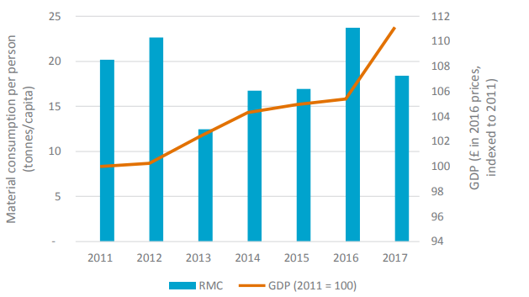
Setting goals beyond net zero
There are no clear trends in our past consumption
In January 2021, MEPs voted for science-based, binding EU targets for material footprints²
² European Parliament (2021) press release
Notes:
The Scottish MFA research calculated our material flows in Scotland from 2011-2017, and we intend to add to this annually as new data becomes available.
This graph shows changes in the Scottish material footprint and GDP. There is no clear link between these two indicators. Greater understanding of what is driving our material consumption is needed. But it is clear we are not moving in the right direction yet.
The Scottish MFA is based on the European MFA approach, and in January 2021, MEPs voted for science-based binding targets for material consumption as a clear policy objective to achieve a circular economy by 2050.
Scotland has always been a climate leader. We need a clear goal on material consumption too.

Slide 7
Summary
Material consumption is driving most of Scotland’s carbon emissions
Scotland’s material footprint was 18t per person in 2017
Sustainable levels of material consumption are about 8t per person
The circular economy offers solutions which can benefit our economy as well as reduce our carbon impacts
Achieving material sustainability means we have to look beyond net zero targets
Notes:
In summary…
In the year of COP26 there has never been a better time to do so.

Slide 8
Scottish Material Flow Accounts
www.zerowastescotland.org.uk/mfa
Notes:
Thank you for listening
More information on the Scottish Material Flow Accounts can be found on the ZWS website

