Slide 1
Materials matter A circular economy for Scotland Have your say
Scottish Environment LINK and Friends of the Earth Scotland
Thursday 23rd June 2022

Slide 2
Welcome
09.30 Welcome from Dr Phoebe Cochrane, ScotLINK
09.35 Introduction to the consultations from Scottish Government
10.00 Lorna Slater, Minister for Green Skills, Circular Economy and Biodiversity
10.10 Guest speakers: Janek Vahk, Robert Höglund, Kim Pratt
10.30 Q & A
11.00 Coffee break
11.30 Discussion groups (online and in person)
12.30 Feedback to main group
12.45 Summary and close

Slide 3
An introduction to the Circular Economy bill and Route Map Janet McVea and Gareth Heavisides Scottish Government

Slide 4
Route Map and Circular Economy Bill Consultations
Circular Economy and Zero Waste Units, Scottish Government

Slide 5
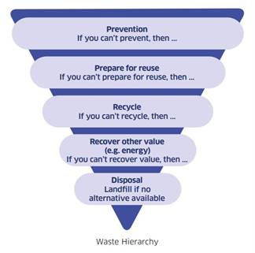
Responsible consumption
Responsible production
Maximising value
Context
Four-fifths of Scotland’s carbon footprint comes from the products and services we manufacture, use and throw away
90% of global biodiversity loss and water stress is caused by extraction and processing
A more circular economy is also more self-sufficient - reducing reliance on raw materials provides increased material security and economic resilience
We will work in collaboration with industry, local government and environmental groups to develop a route map to achieving our targets to 2025 and beyond.
To ensure the necessary legislation is in place, we will bring forward a Circular Economy Bill, later in this parliamentary session
Notes:
I’m sure you will already be familiar with a circular economy approach, where sustainable consumption of resources is the primary goal.
Resources are kept in use for as long as possible, the maximum value is extracted from them whilst in use and then products and materials are recovered and regenerated at the end of each product’s viable life cycle.
We see many good reasons for taking this approach:
Circular economy is a key mechanism to tackle the twin crises of climate change and biodiversity loss (see stats on slide)
A more circular economy supports the wider economy, by improving productivity and opening up new markets;
A circular economy benefits communities, by providing local employment opportunities and lower cost options to access the goods we need.
A more circular economy is also more self-sufficient – it reduces
our reliance on imported goods and materials, and provides increased economic
resilience.
Our 2020 Climate Change Plan update set out our vision for a fully circular economy by 2045, driven by a focus on:
Responsible Consumption, where people and businesses demand products and services which respect the limits of our natural resources. Unnecessary waste, in particular food waste, will be unacceptable in Scotland.
Responsible Production, where a circular economy is embraced by the businesses and organisations that supply products, ensuring the maximum life and value from the natural resources used
Maximising Value from Waste and Energy, where the environmental and economic value of wasted resources and energy is harnessed efficiently
[change slide]

Slide 6
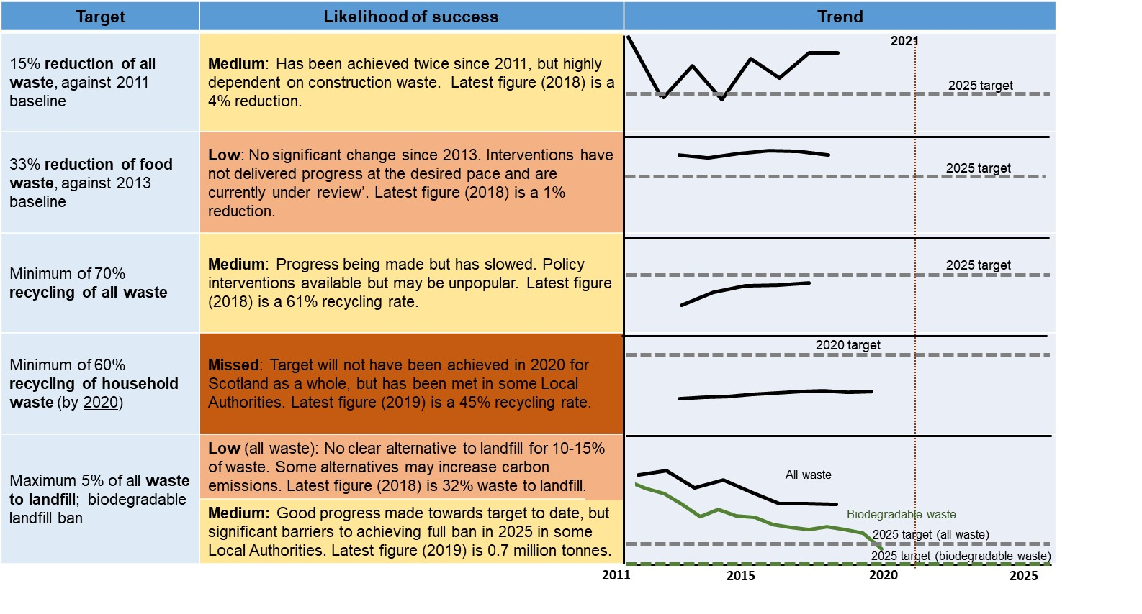
Progress on targets

Slide 7
Route Map: Seven packages, 39 proposals
1. Promote responsible production, consumption and re-use. | Powers for environmental charges, coffee cup charge, approach to future charges & bans, product stewardship plan, consumption reduction targets, reuse targets, support for new business models, keep pace with the EU Sustainable Product Initiative, improve the re-use experience, national communications campaign.
2. Reduce food waste | Mandatory public reporting of food surplus and waste, sector food waste action plans, household behaviour strategy, business and bioeconomy support, support for redistribution.
3. Improve recycling from households | Recycling service co-design, strengthen local authority monitoring and reporting framework, (including end destination reporting), statutory guidance for household collection services, statutory local performance recycling targets, review of waste and recycling service charging and consideration of whether further powers should be considered.
4. Improve recycling from commercial businesses | National compositional study, review compliance with recycling requirements, co-design measures to improve commercial waste service provision, pilot commercial waste zoning.
5. Embed circular construction practices | Best practice standards (inc potential mandatory compliance), incentivise refurbishment of buildings, Programme for Reuse of Construction Materials and Assets, recycling bonds, use of devolved taxes, reduce soil and stones going to landfill, soil symbiosis programme.
6. Maximise value from residual waste | Residual Waste Plan, sector-led plan for incineration, fiscal measures to incentivise low-carbon disposal.
7. Cross-cutting measures | Circular Economy Strategy, Circular Economy monitoring framework and targets, research programme, support sustainable procurement, uptake and development of green skills.

Slide 8
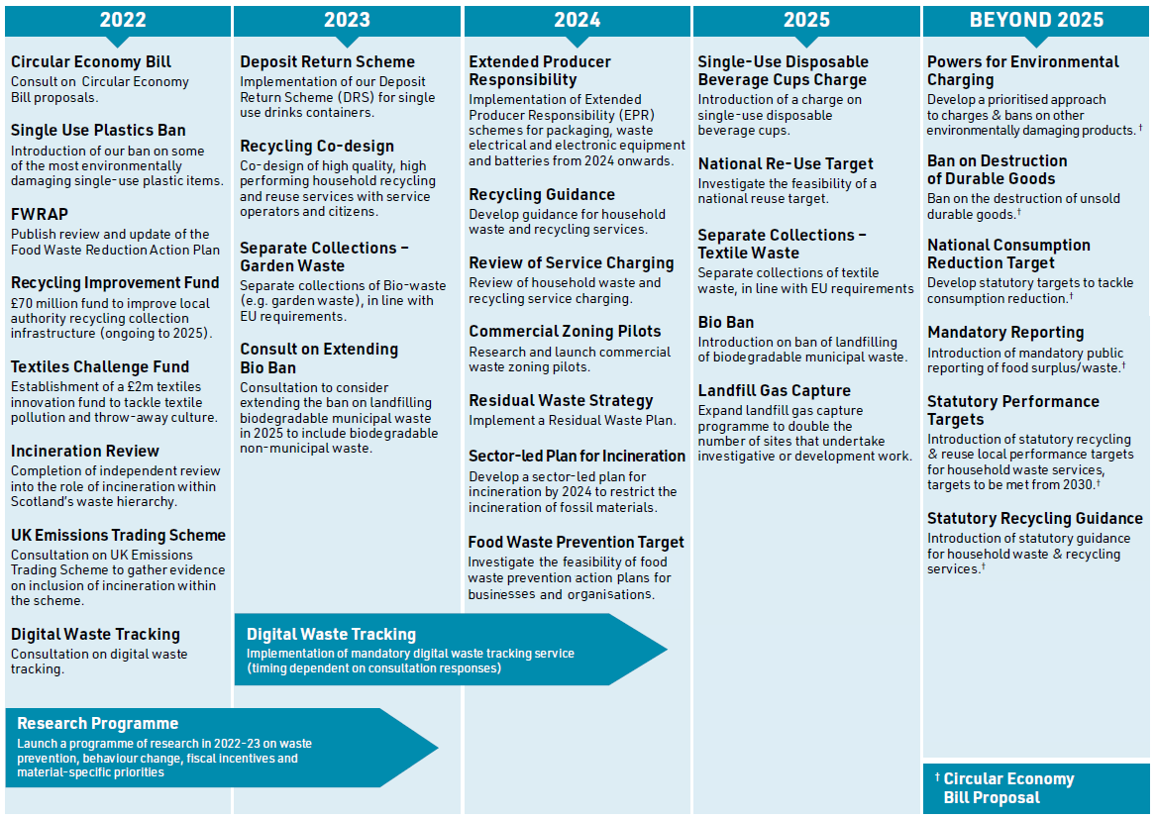
Existing & proposed new measures

Slide 9
Promote responsible consumption, production and re-use
What we are proposing
We will take powers to introduce charges for environmentally damaging items†
We will introduce a charge for single-use disposable cups by 2025†
We will develop a prioritised approach to charges and bans on other environmentally damaging products from 2025
We will publish a prioritised approach to product stewardship by 2024†
We will take powers to set statutory consumption reduction targets†
We will investigate the feasibility of setting reuse targets by 2025†
We will identify ways to expand business models that prolong product lifespan by 2025.
We will keep pace with the EU Sustainable Product Initiative†
We will develop support measures to further improve the reuse experience for consumers
We will run a national communications campaign focused on sustainable consumption

Slide 10
Reduce food waste
What we are proposing
We will take powers to introduce mandatory public reporting of food surplus and waste†
We will investigate the feasibility of food waste action plans by 2024
We will intensify action to tackle household food waste, developing a behaviour change strategy by the end of 2022 and enhancing support for Scottish households to reduce food waste
We will enhance support for Scottish businesses and organisations to reduce food waste and engage with the circular bioeconomy
We will continue to support food redistribution in Scotland in 2022 and focus on actions to best move food up the waste hierarchy

Slide 11
Improve recycling from households
What we are proposing
We will facilitate a process to co-design high quality, high performing household recycling and reuse services by the end of 2023, working with service operators and users
We will strengthen the monitoring and reporting framework for local authority waste services by 2025, and explore introducing a requirement on local authorities to report publicly on the end destination of household recycling collected†
We will take powers to place additional requirements on local authorities regarding household collection services and develop statutory guidance for household waste services†
We will take powers to introduce statutory recycling local performance targets for household waste services, with targets to be met from 2030†
We will undertake a review of waste and recycling service charging by 2024, and are seeking views on what further powers, if any, should be considered to support households to reduce waste and recycle more, by 2028†

Slide 12
Improve recycling from commercial businesses
What we are proposing
We will conduct a national compositional study of waste from commercial premises by 2024
We will review compliance with recycling requirements by 2024
We will co-design measures to improve commercial waste service provisions that drive waste prevention and reuse by 2025
We will research and pilot commercial waste zoning approaches by 2024†

Slide 13
Minimise the impact of disposal
What we are proposing
We will develop a Residual Waste Plan by 2024 to ensure the best environmental outcome for materials and set the strategic direction for management of residual waste to 2045, and to bring this area in-line with net zero targets
We will facilitate the development of a sector-led plan by 2024 to restrict the carbon impacts of incineration
Investigate further fiscal measures to incentivise low-carbon disposal

Slide 14
Embed circular construction practices
What we are proposing
We will work with industry to accelerate the adoption of best practice standards and explore options for mandatory compliance
We will investigate options to incentivise refurbishment of buildings by 2023
We will coordinate a Scottish Programme for Reuse of Construction Materials and Assets by 2025
We will investigate the potential use of recycling bonds to divert material from landfill
We will consider how devolved taxes can incentivise the use of secondary aggregates and support circular economy practices
We will work with industry to identify ways to reduce soil and stones going to landfill by 2023
We will facilitate the development of a soil symbiosis programme by 2025

Slide 15
Ensure the right structures and support are in place to enable action across the circular economy
Strategic Interventions
1. We will put a duty on Scottish Ministers to produce a Circular Economy Strategy†
2. We will develop a monitoring framework and associated targets†
Research, data and evidence
3. We will undertake a programme of research in 2022 and 2023 on waste prevention, behaviour change, fiscal incentives and material-specific priorities
Sustainable procurement
4. We will develop public procurement opportunities to reduce the environmental impact of public spending
Skills and training
5. We will develop new measures to support greater uptake and development of green skills, training, and development opportunities by 2025

Slide 16
Beyond 2025
Development of future targets
We propose to set new circular economy targets for the period to 2030. We propose to go beyond weight-based criteria and ensure that any future targets correspond to our Environment Strategy and overall vision for a circular economy, accounting for the four principles set out below.
Achieve net zero by 2045
Reduce the material footprint of our resources and waste
Maximise the value of our circular economy
Align with the EU

Slide 17
Circular Economy Bill: Overview
Waste Hierarchy | Provision
Strategic (cross-cutting) | CE Strategy Duty Resource Reduction Plans Monitoring Framework Power to set targets Including consumption reduction Establishment of circular economy public body
Prevention | Measures to ban destruction of unsold durable goods Environmental charging for items Reporting of waste and surplus
Recycling | Strengthening approach to household recycling collections Targets to support recycling performance The Duty of Care for householders Incentivising waste reduction and recycling (households) Business recycling collection zoning
Littering and Improving Enforcement | Littering from vehicles Seizure of vehicles

Slide 18
Responding to the Consultation
Consultation is open until 22 August
Please respond on line if you can:
Route Map: Delivering Scotland’s circular economy: A Route Map to 2025 and beyond - Scottish Government - Citizen Space (consult.gov.scot)
Bill: Delivering Scotland’s circular economy: a consultation on proposals for a Circular Economy Bill - Scottish Government - Citizen Space
ZWS will also be developing series of webinars

Slide 19
Lorna Slater Minister for Green jobs, the Circular Economy and Biodiversity

Slide 20
Janek Vahk Climate, Energy and air Pollution Programme Coordinator, Zero Waste Europe

Slide 21
Delivering Scotland's circular economy - route map to 2025 and beyond
Janek Vahk – CEAP Coordinator at Zero Waste Europe

Slide 22
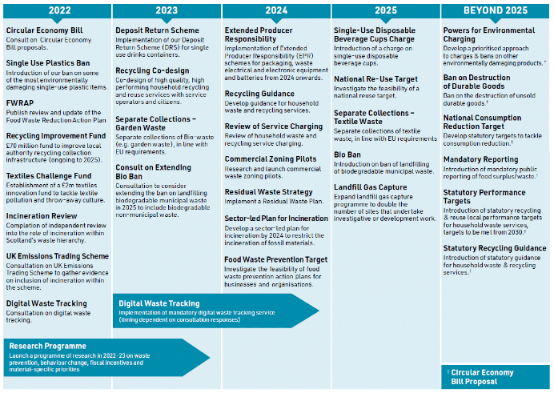
Scotland's Circular Economy Route Map

Slide 23
Challenges and Opportunities of the Route Map
The route map may include:
Targets to limit single–use plastic packaging
Charge for single-use disposable cups
Fund re-use projects, infrastructure and businesses
Some sort of food waste reduction target
What’s missing:
Set a cap on single-use packaging
Any single-use packaging should pay a minimum fee of 10p per unit.
Ambitious 50% food waste reduction target and garden waste collection target (80%)

Slide 24
Challenges and Opportunities of the Route Map
The route map may include:
Introduce extended producer responsibility schemes for packaging, waste electrical and electronic equipment (WEEE) and batteries
Deliver Scotland's Deposit Return Scheme on 16 August 2023
What’s missing:
Extend the scope of EPR to other products e.g textiles & waste prevention
Encourage deposit-return schemes for refill/reuse beyond beverage packaging.

Slide 25
Challenges and Opportunities of the Route Map
The route map may include:
Ban on biodegradable municipal waste going to landfill
Develop a Residual Waste Plan
Restrict the incineration of fossil materials
Investigate fiscal measures to incentivize low carbon disposal
What’s missing:
Ban on landfilling untreated municipal waste
Cap on residual waste generation
PAYS on mixed waste
Mandate mixed waste sorting
Include incinerators in the UK ETS

Slide 26
Thank you!
#zerowaste

Slide 27
Robert Höglund, Climate Advisor, Global Challenge

Slide 28
Kim Pratt Circular Economy Campaigner, Friends of the Earth Scotland

Slide 29
Priority issues
Strong carbon and material consumption targets
A new advisory public body for CE
Minimise household waste by investing in reuse and standardise recycling
Sector level resource plans

Slide 30
Proposed carbon targets

Slide 31
Next steps
Please respond to the consultation open until 22nd August
Support material on FoES website:
The case for consumption targets
CE briefing
Position paper on steel
Incineration review response
Sign the e-action now live on www.foe.scot

Slide 32
Q & A session

Slide 33
Break

Slide 34
Discussion groups

Slide 35
Feedback and close

Slide 36
Thanks for listening
Please respond to the consultation and get in touch if you have any comments or questions:
phoebe@scotlink.org
kpratt@foe.scot

