Slide 1
Beyond Diversity
Jo Yuen (they/them)
Founder, Anti-Oppression Trainer, JYP Consultancy

Slide 2
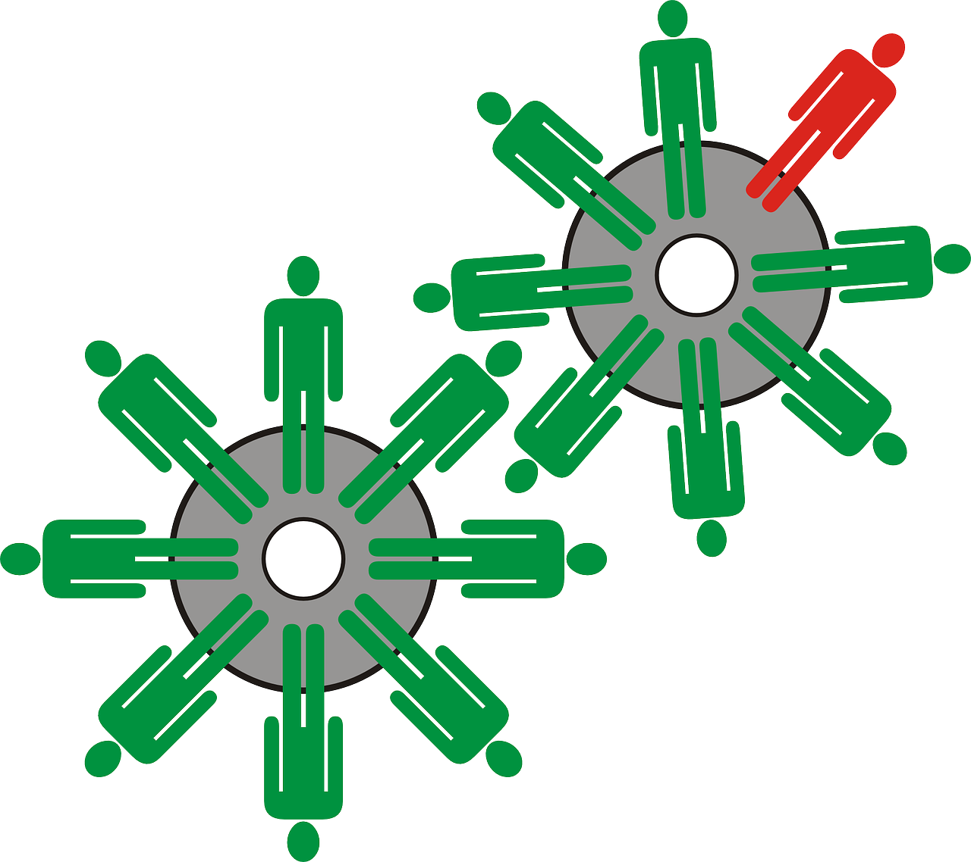
Today’s session
Increase understanding of privilege, intersectionality and structural inequity.
Overview of key terms and definitions.
Learn key ways to use privilege and be an active ally.
Create a safe space and foster an environment that encourages people to openly discuss these topics.

Slide 3
Working Agreement
Listen to each other with respect.
Listen to understand others.
Commit to learning, not debating.
Be mindful of power dynamics.
Respect confidentiality.
Speak from your experiences; speak from “I”.
No expectation to share your experiences.
Taking risks – participating, making mistakes is part of learning.
Supportive and challenging.
Free to leave/return without explanation.

Slide 4
Introductions
Name
Pronouns (optional)
1 word to describe how you are feeling

Slide 5
Discussion in breakout rooms
What feelings came up for you during the exercise?
What might it feel like to move through life as someone who raised their hand a lot?
What might it feel like to move through life as someone who did not raise their hand a lot?
Any other comments.

Slide 6
Privilege: a system of advantage
Seeing people who look like you well represented in positions of power.
Possibility
Authenticity
Safety
Legitimacy
Dignity
Being assured that your entire neighbourhood is accessible to you.
Never having to hide or lie about your sexuality.
The ability to walk into a shop and have the owner assume you are there to buy things and not steal them.
Using public toilets without fear of verbal abuse, physical intimidation or arrest.

Slide 7
Terminology
Privilege: an unearned advantage given by society to some people but not all. It’s often invisible to the person who has it.
Oppression: systemic, pervasive inequality that is present throughout society, that benefits people with more privilege and harms those with fewer privileges.
Intersectionality: the concept that people can be subject to multiple systems of oppression that intersect and interact with each other.
Power: The ability to control circumstances or access to resources and/or privileges.
Adapted from https://frameshiftconsulting.com/

Slide 8
Example
Privilege: The ability to walk into a shop and have the owner assume you are there to buy things and not steal them.
Oppression: The self-reinforcing system of stories, TV, news coverage, police, and legal system stereotyping Black people as criminals, that benefits non-Black people and harms Black people.
Adapted from https://frameshiftconsulting.com/

Slide 9
Terminology
Marginalised person: a member of a group that is the primary target of a system of oppression.
Ally: a member of a social group that enjoys some privilege that is working to end oppression and understand their own privilege.
Note: Being an ally is about action - it is not an identity in itself.
Adapted from https://frameshiftconsulting.com/

Slide 10
Example
Marginalised person: Any Black person who wants to enter a shop.
Ally: A non-Black person who donates to legal system reform organisations, actively objects to racist stories, calls on their MPs to support police reform, and reads news articles about this privilege.
Adapted from https://frameshiftconsulting.com/

Slide 11
BREAK

Slide 12
The Cycle of Oppression
Negative ideas/stereotypes (of a marginalised group)
Structure – laws/ policies/ institutions
Negative outcomes – inequity (for a marginalised group)
Infographic based on resource from www.fearlessfutures.org
Notes:
Oppression: History, policies, practices that lead to inequitable outcomes and disparities
Oppression makes bias normal and reinforces bias in individuals.
“If gay people can’t married, there must be something abnormal about them.”
“If disabled people are less likely to get degrees, it must be because they’re not capable.”
“If I were thinner I’d be happier and people will like me more”
“If black people were more intellectual, there’d be more black scientists and engineers, and fewer athletes”

Slide 13
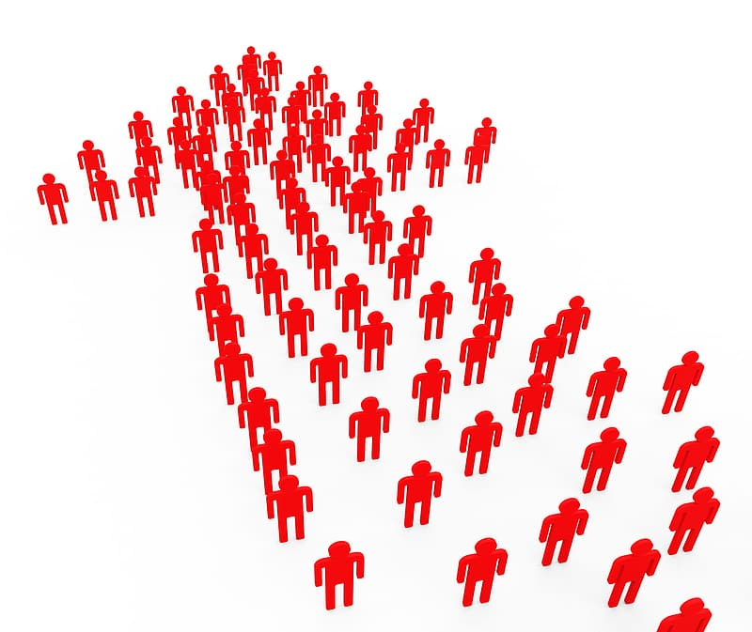
Power
Power: The ability to control circumstances or access to resources and/or privileges.
Privilege grants you power of legitimacy, possibility, authenticity, dignity and safety.
Allies use their privilege to give marginalised people legitimacy, possibility, authenticity, dignity, and safety.
The more privilege and power an ally has, the less risk they have to bear.

Slide 14
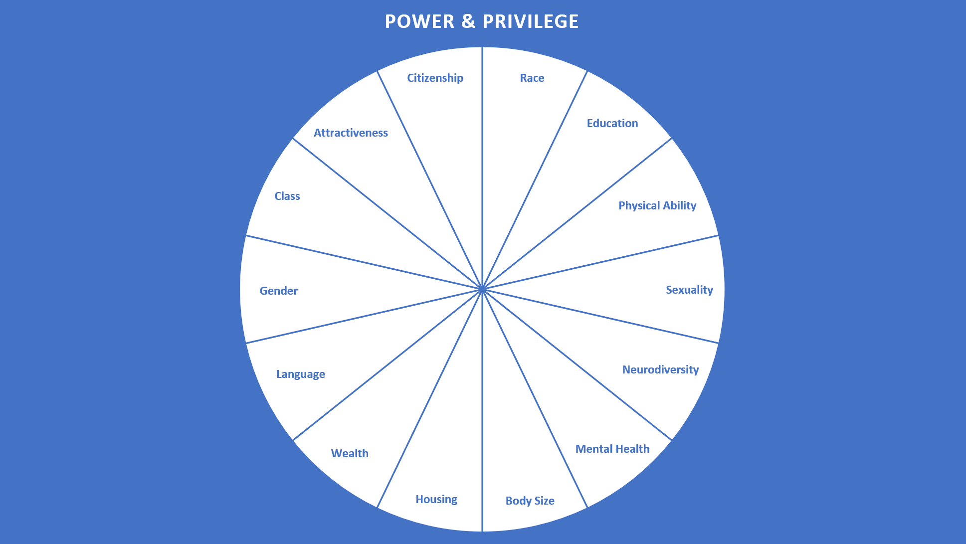
Which identities hold the most social power?
Intersectionality: people can be subject to multiple systems of oppression that intersect and interact with each other.

Slide 15
Inclusion and Equity is…
Disrupting the cycle of oppression by giving marginalised people these things:
Possibility
Authenticity
Safety
Legitimacy
Dignity
Educating yourself about your own privilege, so you will know when you can use your power.

Slide 16
Ally skills
Talk about it
Diversify your feed
Educate yourself
Learning mindset
Listen
Don’t outsource critical thinking
Change policy
Follow your discomfort
Amplify marginalised voices

Slide 17
Activity: Good Allyship Consultancy
Groups of 3-4.
15 minutes.
Read case study: John (on slides 2-3)
In breakout rooms 1 person share screen (PowerPoint file) and be the nominated writer/typist.
You have 10 minutes to discuss and type up allyship advice (on slides 4-6).
Return to the main room.

Slide 18
Activity: Good Allyship Consultancy
John is a 34-year-old, white, cisgender, heterosexual, non-disabled man. He’s married with two young children. John has a managerial position at work and has a good relationship with the senior leadership team. Outside of work, John likes to spend as much time as possible with his family. If he has alone time he likes to catch up on the news, read a book or binge-watch a few episodes of something. While he doesn’t post much, he spends about an hour a day reading and scrolling through social media (Facebook, X fka Twitter and Instagram mainly).
John is starting to understand the concept of privilege but feels uncomfortable thinking about it. He feels guilty for the privilege he has and feels powerless to do anything about it. He often thinks, “is it my place to do something?” and also worries that he’ll end up “mansplaining” or saying something wrong.

Slide 19
Activity: Good Allyship Consultancy
As a Good Allyship Consultant, what would you advise John that he could do? Think about:
How can John understand his privileges better and get more comfortable in these conversations?
What sources of power does John have?
What can John do to educate himself and develop his worldview to be more inclusive? Do you have specific recommendations? (e.g. TV programmes, books, websites etc.)
What conversations can John start, and with who?
What happens if he makes a mistake/says something wrong?

Slide 20
Action planning
Think about different areas of your life e.g. work, family, friends etc.
Where do you have power/safety?
Who can you have conversations with?
Which areas are you uncomfortable talking about?
How can you make it easier to integrate your learning into your everyday life? (Hobbies, books, films, social media etc.)

Slide 21
Links
Allyship resources: https://padlet.com/info8899/qkqahp0eyf4wvujw
Feedback form:
https://forms.gle/7Zanqq4CZRfiKdyC9

Slide 22
Questions?
Contact us at info@jypconsultancy.co.uk

