Slide 1
Part 2: Anti-racism training
Christopher Clannachan (he/him)
Environmental Race Equality Officer
Clare Gallagher (she/her)
Human Rights Officer
Notes:
1-3pm

Slide 2
Aims and objectives
Aim:
Develop understanding of anti-racism in theory and in practice
Objectives:
- Review race in environment sector
- Understand the key concepts of anti-racism
- Build confidence around terminology and challenging racism
- Review good practice EM community engagement

Slide 3
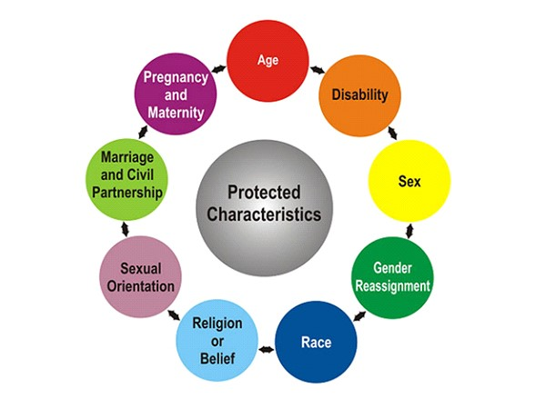
1. EDI (race) in environment sector
Equality Act 2010

Slide 4
Why race?
Environment sector - 2nd least racially diverse after farming
4.81% are EM compared to 12.64% across other professions
EM experience racism in form of stereotyping, discrimination, exclusion and lack of opportunity for progression
84% organisations willing to take action but only 4% have a plan in place
How do we help break this cycle?
Being proactively anti-racist
Notes:
The most recent research conducted by the Wildlife and Countryside Link in England in 2021 and 2022, a coalition of 69 environmental organisations, alongside statistics from the Office for National Statistics has found that the lack of racial diversity is a serious problem.
EDI not a new concept, been around for years but a generalist EDI approach has not improved the situation for EMs:
Has not fixed racism
Has not got to the roots of white supremacy and challenged power structures
Has not provided psychological safety for colleagues
Has not challenged the culture of protecting the majority
Has not improved lack of diversity on boards
Has not challenged discomfort needed to take action
Hence the need to move to a more targeted & proactive approach, otherwise known as an anti-racist approach.

Slide 5
Ethnic Minority Environmental Network (EMEN) Experiences
Notes:
https://www.thinknpc.org/resource-hub/ethnic-minority-communities-and-the-environmental-crises/
At CEMVO we have an Ethnic Minority Environment Network. The network exists to
create connections between ethnic minority groups and individuals, and mainstream organisations addressing climate change and climate justice in Scotland.
EMEN promotes local and national actions that address climate change while being more inclusive of ethnic minority voices
Recently, EMEN partnered with the Race Equality Foundation and New Philanthrophy Capital to produce a piece of research in September 2023 on how EM communities want the government and third sector to respond to climate and nature crisis. They found:
People from ethnic minority communities say they don’t feel listened to by policy makers. They report significant distrust of whether environmental policy recognises the challenges they face.
Charities should support people from ethnic minority communities to have a voice in policy making and hold policy makers accountable for the social impacts of environmental policy.
Charities could also provide information that empowers individual environmental action and builds capacity in local areas to allow grassroots initiatives to thrive.
Despite lots of important work being done by EM in the environment sector, their voices are often excluded from discussions or decisions that affect them. They are often referred to as “hard to reach” communities but the reality is they are not hard to reach and are actually “seldom heard”.

Slide 6
2. Anti-racism: In Theory

Slide 7
To be not racist, does not mean you are anti-racist. To be anti-racist, it’s crucial to understand where racism stemmed from …
Race: history
West
Clean Civilised
Educated
Capitalist
East
Dirty Uncivilised
Illiterate
Socialist
Sociological concept enforced by West based on their own self-constructed superiority.
‘New World’ ideologies: preferred science and philosophy, promoting justifications for slavery and control
Atlantic Slave Trade, Commonwealth, British Empire
V
Notes:
Anti-racism. Now in order to understand anti-racism and what it means to take a pro-active anti-racist approach, it’s important to understand the history and the actual concept of race itself.
So I wanted to start by looking at the motives that actually created racial differences.
So here we have a quote that says “to be not racist does not mean you are anti-racist. To be anti-racist it’s crucial to understand where racism stemmed from”
Racism itself is a social construct, it’s something that we, humans have created, and was most heavily impacted by the era of exploration from the British, French, Dutch and Spanish (the West).
Because of their white skin colour, they self-imposed superiority, viewing themselves as clean, civilized, educated vs anyone who did not have a white skin colour as dirty, uncivilized and illiterate.
We all know the outcome of this which unfortunately lead to slavery and stereotypes that the west was superior over the east (or sometimes referred to as global north, global south).
The effects of this are still felt today and are imbedded into our society through systemic and structural racism.

Slide 8
Racial Hierarchy
White /White Europeans
Mixed Race
Note:
Adaptive/Fluid
Subject to world events
Asian
Black African
Ethnicity Hierarchy is available at : https://www.hierarchystructure.com/category/racial-hierarchy/
Image Credit to Sydney Palmer: https://voxatl.org/racism-colorism-issues/
Notes:
HISTORICALLY race was constructed in order to reinforce the idea that "white" is superior and at the top of the hierarchy, that "Black" is inferior and at the bottom of the hierarchy, and that all other constructed racial categories move up and down between those two anchors depending on what is happening at any given moment in our history.
Another example is where the Chinese population, who were closer to the top of this hierarchy, are now lower because of the xenophobia and blame for COVID-19.
White supremacy refers to the ideology or belief system that this pyramid or hierarchy suggests - the idea that white is superior, better, the ideal - while all other races are inferior, worse, less.
White supremacy is reflected in individual beliefs, in institutional policies and practices, and in our cultural assumptions about who is deserving and who is not.
Nowadays, it is more apt to think of this graph in terms of barriers that are faced in society due to race. For example, someone who is mixed race but has a skin tone lighter to the top of this graph is less likely to experience racism or discrimination than someone who is mixed race but has a skin tone closer to the bottom.

Slide 9
White Privilege
White privilege is often socially rejected because:
The word white creates discomfort among those who are not used to being defined or described by their race. And
the word privilege, especially for poor and rural white people, sounds like a word that doesn’t belong to them—like a word that suggests they have never struggled.
The absence of struggle because of the colour of their skin.
Suggested resource: Peggy McIntosh (1988)
“White Privilege: Unpacking the Invisible Knapsack.”
Notes:
So what we’ve heard is that our experiences in life can be defined by our skin colour, with white people not facing barriers based on being visibly white. We call this white privilege.
To put this into practice in organisational structure, we need to remind ourselves when making decisions, influencing policy, providing services and or hiring people for a job. Thinking outside ourselves, like what would this mean to a black or brown person? Would they access it, would this have a disproportionate impact on them? Does reinforce any of the other barriers EM face?

Slide 10
White Privilege: What do we do with it?

Slide 11
Intersectionality
Multiple identities
“The interconnected nature of social categorisations such as race, class, and gender, regarded as creating overlapping and interdependent systems of discrimination or disadvantage…”
Power structures
Unique forms of oppression
Notes:
Earlier we spoke about white privilege, so whilst we have the notion of privilege in our minds, I want us to zoom out a bit and examine that in relation to intersectionality.
Human beings are not one dimensional and have multiple identities that result in either privilege or disadvantage.
The term intersectionality was coined in the 1990s by black legal scholars like Kimberly Crenshaw because she felt there was no term to describe the unique experiences of Black women.
White women would discriminate against her because she was black
Black men would discriminate against her because she was a woman
Nowadays, intersectionality has broadened and is a way of understanding society by examining intersecting forms of discrimination across all the protected characterises and lived experience. The basic premise is that forms of oppression are overlapping, interdependent systems of discrimination or disadvantage.
However, intersectionality is much more complicated than simply adding up identities and addressing each form of discrimination individually. It’s not just about how many boxes we tick or how many identities we come to acquire, these are core facets of an individual being.
It is the presence of multiple identities alongside power structures that exist in society that then cause unique forms of oppression. You do not experience discrimination, for example simply because you are Black and gay, you experience discrimination because the power structures in society work against you.
The Wheel of Privilege shows how the different parts of your identity can give you power over others in society as well as lead you to being marginalised/excluded. Within certain characteristics, a hierarchy exists and the further away from the centre of privilege the more likely you are to experience discrimination. Similar to the racial hierarchy we looked at earlier.
For example, we can see that a cisgender, straight, white, middle aged male who is not disabled, has a degree and of high socio-economic status is at the centre of privilege and which society is formed around. However, a transgender, elderly, lesbian who is Black, has a disability, lives in poverty with no education is on the outskirts of privilege and is the most likely to experience forms of discrimination.
SELF-REFLECTION EXERCISE: Not going to ask to share this, just for some self-reflection. Place yourself mentally in the middle and map out where you would be and examine your own positionality.
Reason for this – if we can understand our own privileges and/or marginalization, this will aid us in anti-racism work, we will be more empathetic and understanding of white privilege and how we can use that to contribute to breaking down barriers for EM.

Slide 12
Unconscious or Implicit Bias
“An unfair belief about a person or group of people that you are seemingly unaware of that affects your behaviour and decisions”
The onus is on each individual to unpick their implicit biases
Proposed solution:
Building racial literacy to enhance empathy
Answer questions from an EM perspective, i.e. why should I work for the organisation when I have faced racism for majority of my life?
Notes:
While people might like to believe that they are not susceptible to these implicit biases and stereotypes, the reality is that everyone engages in them whether they like it or not. This reality, however, does not mean that you are necessarily prejudiced or inclined to discriminate against other people. It simply means that your brain is working in a way that makes associations and generalizations.
The term unconscious associates a lack of ownership towards our biases, by reframing the narrative to use the word implicit, it brings to the forefront that an acceptance that that we are influenced by our environment and stereotypes that already exist in the society into which we were born, it is generally impossible to separate ourselves from the influence of society.

Slide 13
Microaggressions
Racial microaggressions are the brief and everyday slights, insults, indignities and denigrating messages directed at ethnic minorities, usually from well-intentioned people who are unaware of the hidden messages being communicated. Sometimes people are aware of the hidden messages contained however they communicate this in order to intimidate, ridicule or undermine an ethnic minority person.
Examples:
Giving personality feedback like “smile more” to a Black woman in a performance review
Assuming the competence of people whose first language is not English
“We have lots of Asian employees here, you’ll fit in!”
Notes:
Ethnic minorities are not only made to feel like second-class citizens, but they feel left out and abnormal because of how much it impacts them. This not only makes it difficult for them to experience normality, but they are stereotyped and asked to paint a positive picture of their group, which is too much pressure for any individual. When this becomes a continuous reality, it drains one’s energy, making them frustrated and angry because the discrimination is evident for no fault of theirs.

Slide 14
Microaggressions

Slide 15
BREAK

Slide 16
3. Anti-racism: In Practice

Slide 17
Spheres of Influence – what does this look like in Uist?
Concern
Influence
Control
Of interest and concern but fully outside of sphere of control or ability to influence
Affect outcomes and engage with others but there is no direct control. Things that can be actioned at organizational level
Yourself, your actions, your decisions, your behaviors, your words
Notes:
https://www.kateleto.com/articles/sphere-of-in
Sphere of control –
Things that only we have direct control over. For example, our actions, decisions, behaviours, words etc
What can I do as an individual to contribute to engaging EM?
Sphere of influence –
What can we do as organisations?
What targets can we set? Is it to approach x amount of people or to engage x amount of people?
Also, what advocacy work can we do? Are we doing this in a way that is inclusive, information sharing, and thinking about impact?
Sphere of concern –
For example, within our concern is what % of the population is EM in the local area etc. can’t control that, but it is of a concern to us that this is the confines of which we are working
fluence

Slide 18
Terminology / vocab
Race vs ethnicity?
Control
Race = physical attributes or traits
Ethnicity = shared experiences
What should I use?
BAME, BME, POC EM, ME, VME, BIPOC, Black, Brown, mixed race, mixed heritage,
Notes:
Race can be understood as a categorisation that is based mainly on physical attributes or traits, assigning people to a specific race simply by having similar appearances or skin colour (for example, Black or white). As we have seen, race itself is a social construct which is rooted in white supremacy and efforts to prove superiority and maintain dominance over others.
Ethnicity is broader than race and has usually been used to refer to long shared cultural experiences, religious practices, traditions, ancestry, language, dialect or national origins (for example, African-Caribbean, Indian, Irish). Ethnicity can be seen as a more positive identity than one forged from the shared negative experiences of racism.
BAME/ BME/ EM/ ME etc → Even the race sector itself uses different terms, it varies across organisations, governments, individuals.
So rather than ask – which ONE term is the correct term- that’s not important. What’s more important to understand the meaning behind different terms and stay updated whilst willing to refresh our language so we remain respectful and appropriate.
Again, it comes down to individual preferences. If someone says they would like to be referred to as a person of colour as opposed to an ethnic minority – or vice versa - that’s fine, that is their choice and you should use that language going forward.

Slide 19
Challenging racism & microaggressions
To challenge or not to challenge?
Challenge to avoid escalation
Be part of the solution, not the problem
Consistent commitment
Control
How to challenge
Calling out
Calling in
Written challenge
Ask for support
Refer to senior manager
Notes:
However, it is important that we do challenge to avoid escalation, i.e. those comments being said again, or developing into something worse.
The choice really comes down to you being part of the solution or continuing the harm. Comes down to confidence and prior preparation.
If you choose to be silent, you sanctioned the behavior and you have inadvertently become part of the problem. By not confronting your colleague or someone in a group you’re working with, your inaction informed them that not only are they just in their behavior, but you agree with them. You validated the harm and are, in fact, perpetuating the racist behavior. In being silent, you are centering your own comfort and safety over that of the comfort and safety of colleagues or participants in a group etc.
Consistent commitment - Could happen this afternoon or in 6 months time. Just because you challenged someone’s racism yesterday does not mean you are absolved from challenging it today. It is an ongoing commitment, a lifelong commitment actually. That might seem like a lot of work but it is the responsibility of white people as a group possessing privilege to do this when it arises. That’s what it takes to be actively anti-racist, it requires courage, commitment and tenacity.
How to challenge?
Calling out – slightly more aggressive of the two between calling in and out. This could be stopping someone and saying “no that is racist. Do not say that”. Could be an uncomfortable situation where the other person is likely to be emotional or defensive and likely embarrassed. Could be a defence mechanism to make you look unprofessional as opposed to addressing their wrong behaviour. DOESN’T MATTER whether they didn’t mean it – the impact it has is what’s important, not their intent.
Calling in – difference is in the delivery of your message and probably more productive depending on what was said. “Hey, I’m not sure if you were aware but actually that is wrong because xyz.” Make your message clear that you don’t tolerate, this is wrong but you’re seeking to educate the person. You are helping them to better their understanding.
Written challenge – put it in an email or a message if you cannot in that moment. However, better to address at the time and move on but if it’s not possible to, follow up afterwards. Perhaps direct them to sources on the matter, evidence your point.
Ask for support – ask a colleague or manager to help you relay your message – again delayed but depending on situation perhaps beneficial
Refer to senior leader – sometimes it might be severe that you think this actually requires more formal action beyond your control so you can refer that to your manager or senior leader
Senior leaders – external support with race consultants in specific scenario

Slide 20
Anti-racism in an organisation
Anti-racism
Recruitment
Policies & practices
Data collection & analysis
Training
Organisational culture
Engagement
Influence
Notes:
Recruitment – inclusive recruitment practices that use the appropriate language and encourage ethnic minorities to apply; appropriate job requirements that do not perpetuate systemic barriers; skills based marking schemes; as well as promotion and retention of EM staff
Policies and practices – ensuring that anti-racism is mainstreamed across all policies and practices and that policies do not have a disproportionate impact on EM communities – for example working places without prayer facilities or dress code policies
Data collection and analysis – appropriately disaggregated equalities data collection backed up by meaningful action for EM which is communicated back to them to close the feedback loop
Training – consistent training for staff and volunteers on anti-racism as well as access to resource lists and guides for individual education
Organisational culture – promoting an inclusive and diverse culture that celebrates each others differences and recognises different cultural events throughout the year including black history month, Ramadan etc
Engagement – continued commitment to engage with EM Communities and not just as an add on to existing projects, for example, is there the option to co-design a project or plan with a local EM community group?

Slide 21
Community Engagement
What do you think should be considered when engaging with ethnic minority communities?
What are the challenges?
What is our experience of EM community engagement?

Slide 22
EM Community Engagement – good practice tips
Good practice
Active outreach
Language
Time / avoid religious observance
Explore partnerships
Advertising
Suitable catering
Mutually beneficial
Clear strategy
Feedback
Accessible venue
Influence
Control
Notes:
Clear strategy
When engaging with EM, it is important to have a clear strategy in place, take account of tips when planning thoroughly to remove barriers
Mutually beneficial
Any engagement with EM should be mutually beneficial, ie participants benefit from the engagement and there is something they can get out of it. Otherwise we verge on being tokenistic and simply engaging with people because of the colour of their skin to meet our own targets / indicators
Find common ground.
Active outreach
Part of anti-racism work as we have heard is about being pro-active and that’s no different in community engagement. People often say EM are hard to reach but the reality is they are seldom heard and the former places a burden on an already marginalised group to engagement. It is the responsibility of the organisation to break down barriers and be proactive, not EM. Be aware of power imbalance / white privilege
Explore partnerships
Are there any EM groups or organisations who we can partner with to share expertise and learn from in our engagement? Remember white privilege and power sharing
Language
Using plain, simple English and avoiding jargon. English is not everyone’s first language so be as plain as possible. Furthermore, the climate sector is full of jargon which can put people off from engaging
Also, use of language services or interpreters to break down barriers
Advertising
Good advertisement itself is simply not enough but it is important. Are we just advertising in the usual places or are we being proactive and reaching out to new groups / places/ forums/ etc. Advertising should be welcoming and inclusive. Target local EM groups /religious buildings
Accessible venue
A venue which is both physically, mentally and emotionally accessible. Ie elevators, prayer room etc. But also a building that EM feel comfortable in. For example, avoid buildings that have links to slave trade unless these have been denounced and consider having event in an alcohol free environment when engaging with religious groups. Also, is there a prayer room available etc.
Time / religious observance
Important, any info received from EM about suitable time, use it. Is it at a time that community leaders / business owners can attend. Consider things like avoiding Friday prayers, avoid organising a ‘lunch’ over Ramadan, other cultural holidays. Devise a cultural calendar.
Suitable catering
All dietary requirements are met, including vegetarian and halal options.
Feedback
EM are best placed to tell you what is and what is not working. Ask for feedback, take it on board and learn from it. If you are unsure about language or terminology, seek feedback. Ask questions respectfully.

Slide 23
Influence
Control

Slide 24
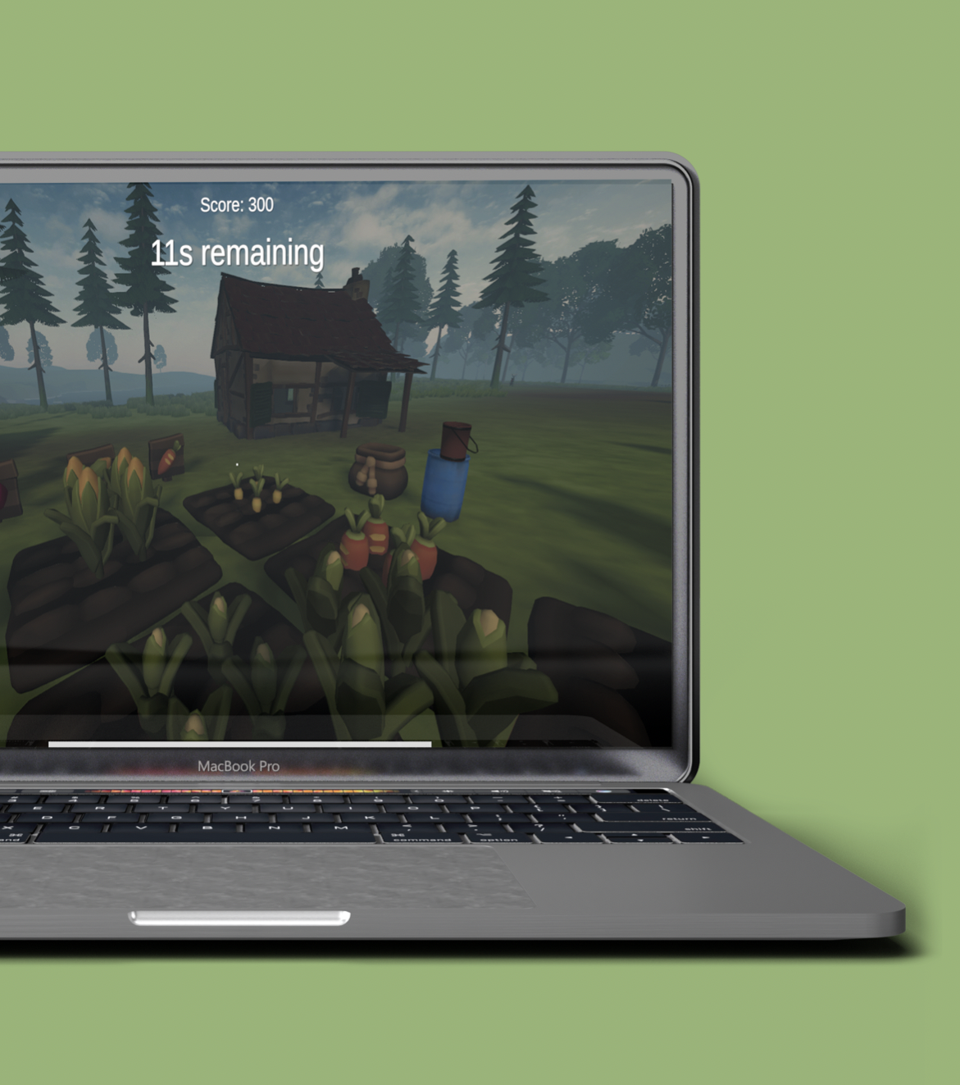
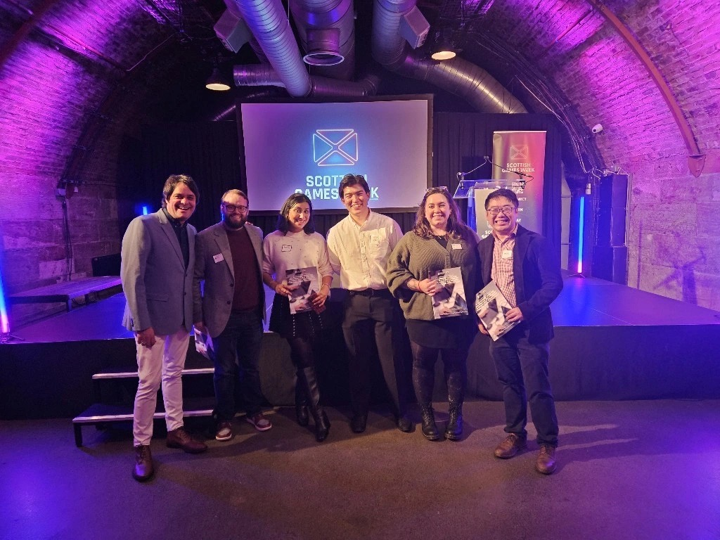
Ethnic Minority Environmental Network SEvEN: Seven Voices One Future
Notes:
An example of EM partnership – citizen power
EMEN Partnership with UoG – EM involved in creating a climate change game
Characters navigate climate challenges and repopulate areas of biodiversity loss etc
Genuine partnership, input and credit – not tokenistic

Slide 25
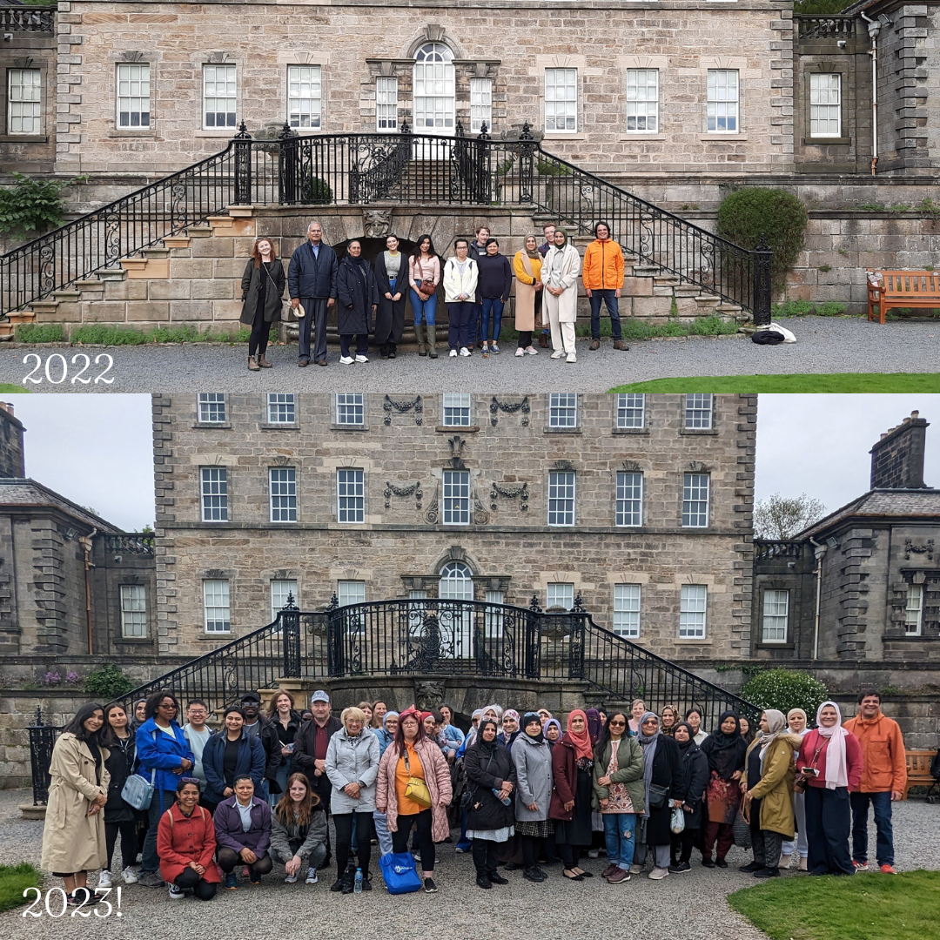
Ethnic Minority Environmental Network (EMEN) – Pollok Country Park: Nature Walk
Notes:
Nature walk and free lunch – consultancy upskill on environmental issues, not just that but feminist issues (witch hunting, etc).
Good practice:
Two way street / mutually beneficial
Active outreach
Advertisement
Suitable catering
Feedback – tripled in size
Previously owned by John Maxwell, was a Scottish landowner, politician and philanthropist. Founded National Trust.

Slide 26
Organisational/ project stance
What is my organisation’s stance on anti-racism?
How do we regularly communicate this to the public?
Do we use diverse imagery?
What agreed language and terminology are we using?
What are we currently doing to break down barriers for ethnic miniorities?
Can we be doing more?

Slide 27
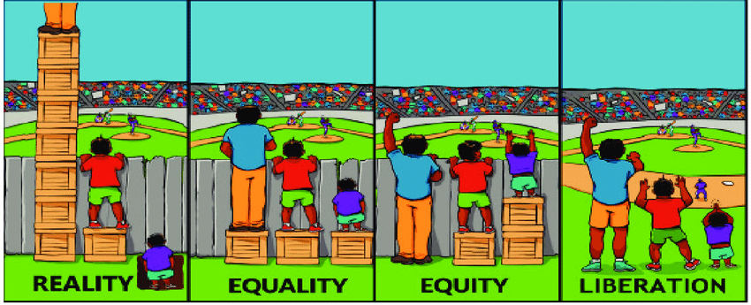
Anti-racism in a nutshell:
An anti-racist approach:
To not be racist, does not mean you are anti-racist.
EDI, equality vs equity
Equality: everyone treated the same with equal opportunities
Equity: giving people what they need to achieve their fullest potential. Acknowledging the playing field is not level
Shereen Daniels:
“Equality is the destination. Equity is how we get there”.

Slide 28
What can we/organisations do? Top 10 tips.
Recognise
Data
Engage
Culture
Embed
Training
Networks
Educate
Champion
Listen
Notes:
Recognise
Recognise that the playing field is not level for EM, historically excluded, racism in society, we all need to be actively anti-racist
Recognise different identities exist, that humans are not one dimensional, their identities overlap and society either grants them privilege or disadvantages due to the power structures that exist.
No two peoples experiences will be the same even with the same identities – important to be person-centred in our work as opposed to generalising
Data
Data is a funny one, or should I say quantitative data is a funny one because it essentially asks people to put themselves into boxes and categories which again, as we know, people are not one dimensional
However, data is so important. It really forms the basis of any of our actions in an organisation. If we are reaching the south Asian community in our outreach, what demographic is that? Is it mostly older south Asian people, younger? Men? Women?
How we disaggregate the data is important.
When gathering data, important to also gather qualitative data to capture intersectional experiences of work force / participants etc
Engage
Speak to ethnic minorities, engage with them, listen to what their needs are and if they are being met.
Listen
Off the back of that listen. Remember no one persons experiences are the same so its important to listen to them, meaningfully and take what they have to say on board because again, their experience will be unique
Culture
Foster a culture that recognises EDI, anti-racism and intersectionality at its heart
No matter your identity you are welcome, appreciated and respected. Allow people to bring their full self to work and nuture a culture in the organisation that promotes this.
Embed
Anti-racism in our EDI initiatives, our human rights work, our community engagement. Don’t just state that you practice EDI and anti-racism but actually embed and show how as an orgnaisation you understand and respect intersectionality.
Training
Ask your organisation to include formal training on anti-racism and intersectionality
If unsure, outsource, ask an expert in the field / other org to come in and facilitate this
Continual learning
Networks – for intersectional experiences to
Race network / women’s network – what one should a mixed race woman attend?
Welcome all identities and even set up an intersectionality network that’s open to anyone from any background to discuss issues they are experiencing around their identity.
Educate ourselves / colleagues
On anti-racism. Continuous learning, books, articles, journals, videos. Kimberly Crenshaw is a good place to start, during BLM very vocal about the experiences of black women and the police
Of a partner or colleagues in another organisation are doing good work around anit-racism, ask them to educate you on this, learn from each other. We don’t need to work in silos in this area.
Champion
Again very similar to my culture point, always champion anti-racism at all levels. Senior management buy in, top down, bottom up, cross-cutting, champion the diversity of everyone in an organisation, not just those identities which you feel are more ‘deserving’.

Slide 29
Aims and objectives
Aim:
Develop understanding of anti-racism in theory and in practice
Objectives:
- Review race in environment sector
- Understand the key concepts of anti-racism
- Build confidence around terminology and challenging racism
- Review good practice EM community engagement

Slide 30
Thank you
Questions

Slide 31
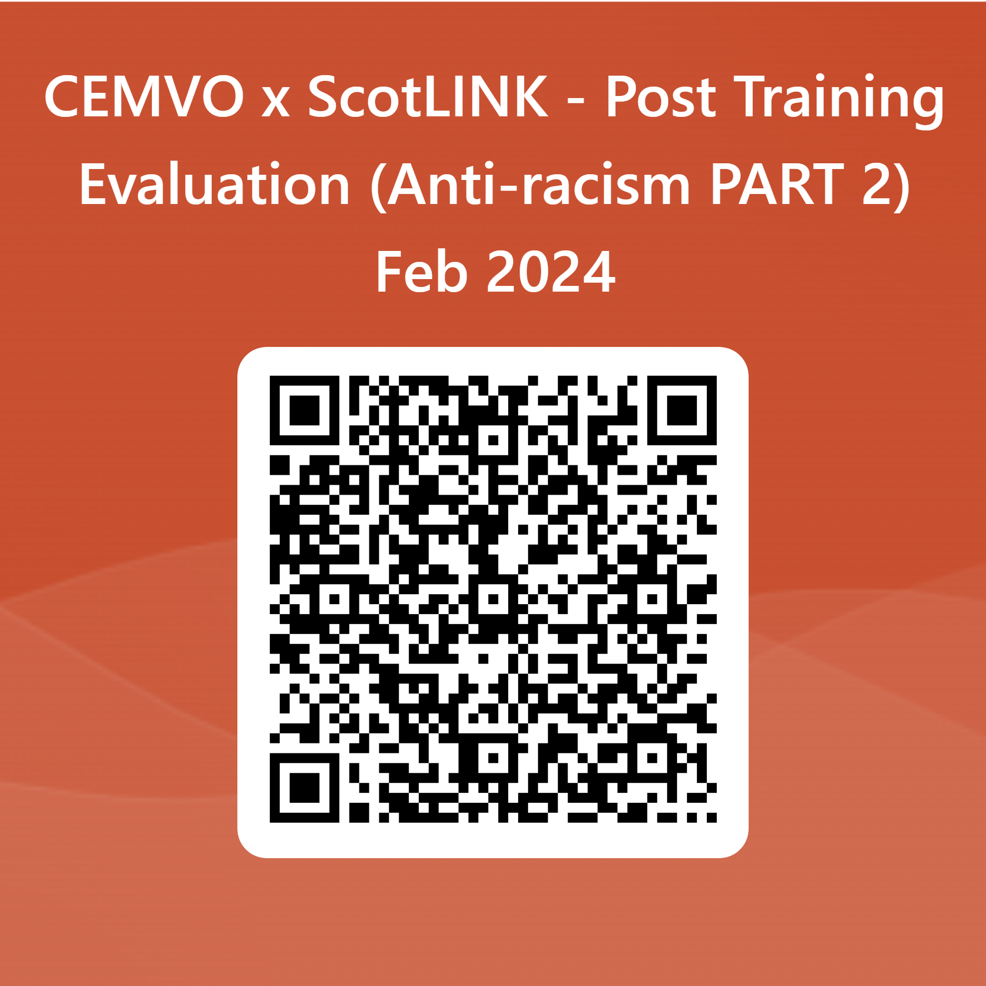
Evaluation Form
christopher.clannachan@cemvoscotland.org.uk
claregallagher@cemvoscotland.org.uk
Notes:
https://forms.office.com/Pages/ResponsePage.aspx?id=8qyVw4uDhkivT13ze3OBw79jid0OwJhBkH0XwMH7tQtURU1TN0FYSVI4WFpRUE9KSTlITzUxN0VZTC4u

