Slide 1
Part 1: Data Collection & Analysis Training
Christopher Clannachan (he/him)
Environmental Race Equality Officer
Clare Gallagher (she/her)
Human Rights Officer

Slide 2
Aims and objectives
Aim:
Review equalities data collection & analysis procedures to reflect good practice
Objectives:
1) Why do we ask for it?
2) When do we ask for it?
3) How do we ask for it?
A) Challenges
B) Good approaches
C) Communication campaigns
4) What do we do with it?
Case study

Slide 3
Ice Breaker
Name
Job Role / organisation
Describe self with first letter of your name

Slide 4
Notes:
https://cemvoscotland.org.uk/wp-content/uploads/Diversity-Data-Collection-Analysis-Toolkit.pdf

Slide 5
1) Why do we collect data?
What do we know?
Evidence base
Meaningful EDI action
Assess impact
Notes:
What do we know
Very plainly – it answers the question of what do we know about the people in our organisation
It provides a detailed snapshot, whether that be in recruitment, who is applying for jobs, who are we reaching, or of our workforce or volunteers
Evidence base
Data is our evidence base, it tells us what we know and also what we don’t know. We might think we know our workforce or volunteer base by just looking at them, but it is a mistake to assume and actually, we might be failing to meet an employees needs by not collecting data, for example they are non-visibly disabled.
Diversity data is also really important across any equality diversity and inclusion actions as it acts as a benchmark.
Meaningful EDI action
From this benchmark you can report on progress and further inform EDI initiatives or strategies.
It will allow you to measure whether EDI initiatives have been successful or whether more targeted actions are needed to meet your short-, medium- and long-term EDI goals.
For example, we want to increase our ethnic minority job applicants by 10%, if we don’t have a baseline level of data in recruitment and we don’t collect sufficient data in the recruitment cycle, how will we know if we have met this?
This data will also form your evidence base if any positive action measures are required.
Assess impact
Are our policies and procedures equitable and fair and do not disproportionately affect a group from a protected characteristic? For example, a meeting time during a Friday afternoon that disrupts Friday prayers for a Muslim employee

Slide 6
2) When do we collect data?
Recruitment
Existing workforce
Volunteers
External
Current procedure?
Notes:
When do or when should we collect diversity data?
Recruitment –
Equal ops form when applying
Should be anonymised to remove bias so you can’t identify but should be able to match back up. For example a number system.
Existing workforce –
Either asked for annual or every 6 months or ‘staff can update their employee passport’
Circumstances may change, i.e. disability, caring responsibilities etc
Should be continually monitored for career progression / diversity perspective / equal access to development opportunities
Identifying any internal blockages, for example only white people are being promoted – ask why?
Volunteers –
Same for volunteers
External –
Not necessarily diversity data but data of all our partners, stakeholders, groups we work with. Interesting to see the diversity or not amongst groups. Who are our usual suspects.
Diagram on the right shows what types of questions can be answered using data throughout an employee’s lifecycle. This will not only tell you things about individuals btu of your organisation as a whole. If you identify a blockage you can take focused action from that. For example, you may attract a variety of ethnic minority applicants for a job vacancy but find that none make it past the selection stage. Here you can conduct a root cause analysis of this, such as whether a skills gap exists or whether further unconscious bias training is required for hiring staff.

Slide 7
3) How do we collect it?
Equal ops
What questions?
What tool do we use?
Storage?
Notes:
Equal ops form –
Most common way is an equal opportunities form
Standardised across all – so same for recruitment as it staff
Saves you work but allows meaningful comparisons
Example in our data toolkit
What questions
Only ask the questions you will need and analyse and take action from. For example, no point asking someone’s socio-economic background if you don’t plan on doing anything with that data. Otherwise it will sit on a shelf and the individual completing wont see any changes from giving it, lead to apathy
Avoid microaggressions in the questions and avoid using other
What tool do we use–
No right or wrong way to collect the data, keep it consistent and easy for you
Paper form – manual input and storage
Online tool like Microsoft forms – draws graphs and does some of the analysing for you. For example, 55% of the workforce identify as a woman
Storage–
Paper – internal organisational files – should be in line with internal organisation GDPR files, only accessed by stated persons
HR system – some let employee update directly, ensure works for your needs, can edit questions etc, often generates reports
Covered by GDPR - Collecting and storing diversity data is covered by the Data Protection Act 2018 (the legislation implementing GDPR into UK law), which allows the collection and processing of diversity data with the aim of monitoring equal treatment and the protection of equality of opportunities. It also gives people rights, such as access to the information, the right to amend information that is incorrect, and remedies if things go wrong.
GDPR not an excuse not to collect

Slide 8
3a) Challenges when collecting data
Mistrust
Apathy
Non-mandatory
What can we do to combat this?
Notes:
Mistrust –
High non-disclosure rates in essence boils down to a lack of trust of individuals in an organisation. Thus, the onus is on an organisation to build trust and create a safe environment where applicants and employees feel comfortable enough to share their sensitive information.
Apathy –
Marginalised groups might feel apathetic for continually being asked to share sensitive information about their identity or experiences and it leading to no change
Weve heard of ‘consultation fatigue’ but data fatigue/apathy can also be a thing where individuals simply don’t want to share because they feel it wont make a difference
For example – an EM repeatedly returns data forms with their ethnicity but is still continually facing microaggressions at work / a persons religion is not respected via uniform, prayer times etc
Non-mandatory –
No legal obligation to give data over, onus on the organisation to build trust and empower staff to feel comfortable to share this info
Also no legal obligation on orgs to collect however highly recommended for the reasons we have stated already
Legal obligation for public bodies

Slide 9
3b) Good approaches
Human Rights-based approach / person-centred
Regular staff surveys that include questions around work satisfaction, career progression, level of support provided in the workplace to tackle racism, etc
Exit interviews to determine reasons why staff left – e.g. lack of progression / support, discrimination/microaggressions? Etc
Feedback from equality staff network
Data collection statements
EDI statement / commitment
Senior leadership commitment

Slide 10
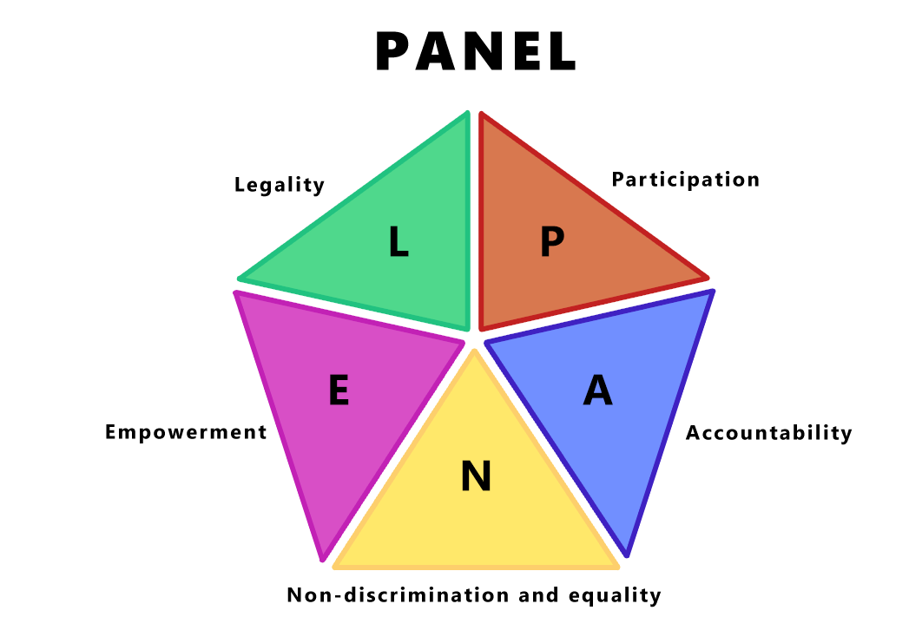
3b) Human Rights Based Approach
Notes:
At CEMVO Scotland, we support our national human rights institution and the United Nations endorsed, PANEL principles.
P-Participation, A-Accountability, N-Non-discrimination and equality, E-Empowerment, L-legality
Participation is based on the principle of nothing for us without us.
Participation must be free, accessible and meaningful
Accountability- having law as our safety net but also having route to redress/remedy available in the first instance.
Who is responsible for collecting, storing and disaggregating data?
Is there a complaints / grievance procedure?
N- All forms of discrimination must be prohibited, prevented and eliminated. It requires prioritization of those most vulnerable or who face the biggest barriers in realising their rights.
Ensure that the collection/storing and disaggregation of data does not unfairly impact protected characteristic or marginalised groups
E- people should be able to name and claim their rights, be empowered and encouraged to participate in development of policy and practice which affect them.
Empowering people can make them feel valued, involving them in the process, supporting them to participate, being transparent in collection process helps improve trust.
L- legal protection of rights- all must be protected, respected and fulfilled
If we are collecting data what laws are we exercising? Equality Act, Human Rights Act, GDPR. Key human rights that can be potentially impacted by data collection are:
Article 7 right to private and family life
Article 9 right to freedom of thought, conscience and religion
Article 10 right to freedom of expression
Article 11 freedom of assembly and association

Slide 11
3b) Benefits - Human Rights Based Approach
Upholding rights of every individual
Human Rights language to assure staff and empower them to know their rights
Apathy
Apathy
Improve institutional culture and relationships
Mistrust
​
Person centred provision and delivery of service
Mistrust
Notes:
It is also worth remembering that there are several benefits of adopting a HRBA that can help combat some of the challenges that are faced:
Use rights language to assure staff and empowers them to know about their rights
If these principles are used they should uphold the rights of every individual, be person centred and demonstrate that they aim to ensure good decision making, improvement in institutional culture and relationships, legal compliance and best practice
Remember human rights are the floor not the ceiling of our aspirations, these are basic rights and freedoms.

Slide 12
3c) Communications Campaign
Video
Email
Blog
Consistent marketing
Social media
In person
Usually from senior leaders / CEO
Build trust
Increase disclosure rates
Consider timing
Varity of methods
Notes:
Usually from senior leaders / CEO – senior leadership buy in is important, and gives the process more ownership, accountability. Managers should also be prepared to answer questions around diversity data collection.
Build trust – a chance to relay the importance of data collection and make it more personable to workforce
Increase disclosure rates – if trust is built
Consider timing - you should also think about when the actual data collection will take place. For example, is this during the on-boarding process, an annual event or do you have a staff development day coming up where it is convenient to capture data? Calendar events like Black History Month or LGBTQ+ Pride may also be opportunities to update staff diversity data.
Varity of methods – video, email, blog, consistent marketing, social media, in person

Slide 13
4) What do we do with the data?
Reporting
Analysis
Action
Inform EDI strategy
Set targets
Review policies / procedures
Staff training & development
Seek external support
Open dialogue with staff
Notes:
The first thing that we can do is use for our reporting
Upwards – to senior leaders and managers or board of trustees, chance to endorse any follow-up actions from the data collection exercise → for example, make reasonable adjustments
Horizontal / downwards – report back to staff with results and what actions have been taken → build trust, accountability and transparency
Second thing is analysis stage
Identify before the collection has taken place who is going to do the analysis stage – accountability
Use data to compare to
Previous workforce diversity data;
Your short-, medium- and long-term EDI goals to measure progress;
National demographic statistics from the census;
Regional demographic statistics from the census; and
Other organisations working in the sector
Lastly, the action stage
Inform EDI strategy - monitor progress, review whether any actions have been successful and focus efforts
Set targets – we are currently at x and we want to be at y (not enough, must have the action behind them)
Review policies & procedures – things about your workforce / staff you did not know, for example if you find that a certain percentage of staff are reporting that they have dyslexia, you may wish to update working practices and invest in a simplified tech solution to aid them.
Staff training & development – should we do some anti-racism training? Targeted at HR managers?
Seek external consultancy support – programmes like REEP / R4HR who can work on internal support / build capacity
Open dialogue with staff – For example, if staff report that working times do not allow a reasonable amount of flexibility that hinders them from taking part in religious prayer time, you may wish to consult staff on flexible working arrangements.

Slide 14
Data: client case study
Client gathers quantitative recruitment data through an equal ops form as legally required but not qualitative data about the recruitment process. This gathered data was not used further, there was no data statement and disclosure rates were poor. The equal ops form used did not reflect good practice. There was no up to date data for the existing workforce either quantitative or qualitative. Regarding external partners and stakeholders, no data was gathered.

Slide 15
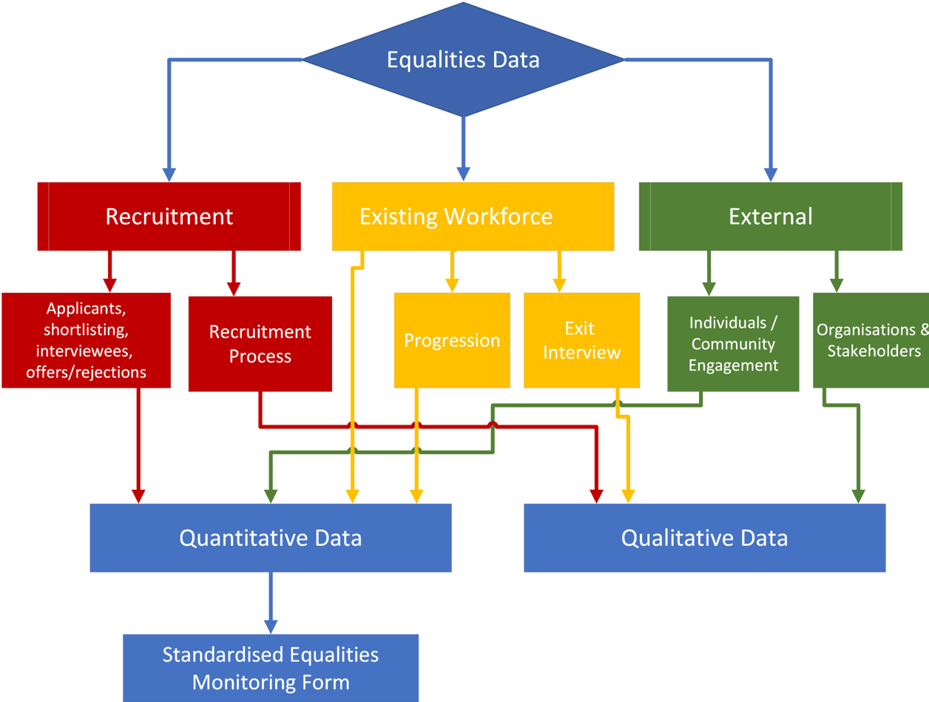
Data: client case study
REEP support:
Reviewed equal ops form
Deep dive training session on good data collection practices
Human-rights based approach to data collection guidance doc provided
Data report and suggested practice, including flowchart diagram
Advised on different approaches to data campaign before collection
Part 2 deep dive session on data analysis
Used to inform equality strategy
Notes:
Christopher

Slide 16
Roadmap - Summary
1
2
3
4
Why?
When?
How?
What?
Why is it important to collect equalities data?
When do we collect equalities data?
How do we ask for it?
What challenges exist?
What are good approaches?
What do we do with the data we collected?

Slide 17
Thank you
Questions

Slide 18
Evaluation Form
christopher.clannachan@cemvoscotland.org.uk
claregallagher@cemvoscotland.org.uk
Notes:
https://forms.office.com/Pages/ResponsePage.aspx?id=8qyVw4uDhkivT13ze3OBw79jid0OwJhBkH0XwMH7tQtUNk1OR1pTQTNOUDlQNVFTSUkwNFdDUk03RS4u

