Slide 1
One Ocean Journey
Catherine Gemmell
Scotland Conservation Officer

Slide 2
There can be no ocean justice without social justice, so diversity, equality and inclusion must be central to the way we work.

Slide 3
The Marine Conservation Society was established to look after the ocean - recognising the inextricable connection between a healthy ocean and human health and wellbeing – now and in future generations.

Slide 4
One Ocean Journey
Catherine Gemmell
Scotland Conservation Officer

Slide 5
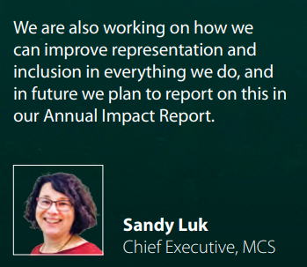
2019/2020
Commitment to report on EDI made in Annual Impact Report

Slide 6
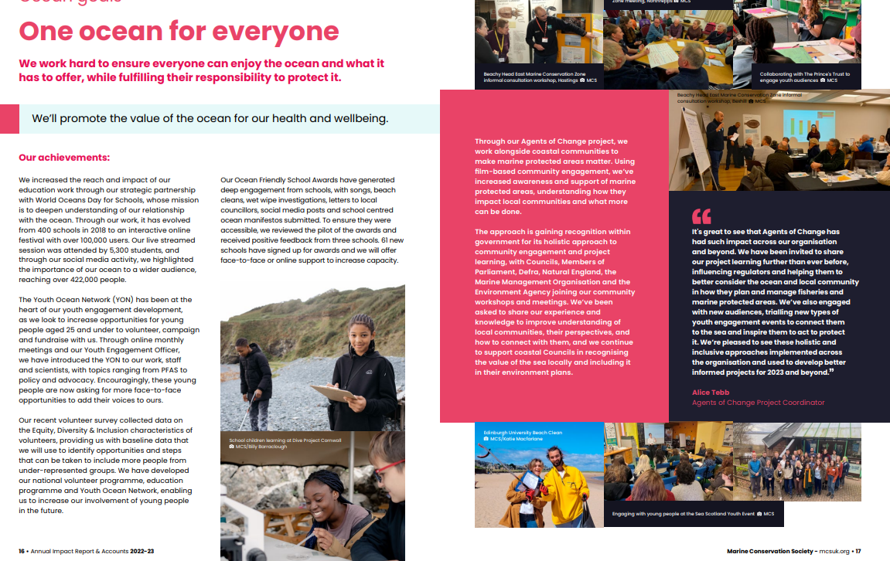
Notes:
https://s3.eu-west-1.amazonaws.com/media.mcsuk.org/documents/MCS_Annual_Impact_Report_2022-23_Web_Dzota8c.pdf

Slide 7
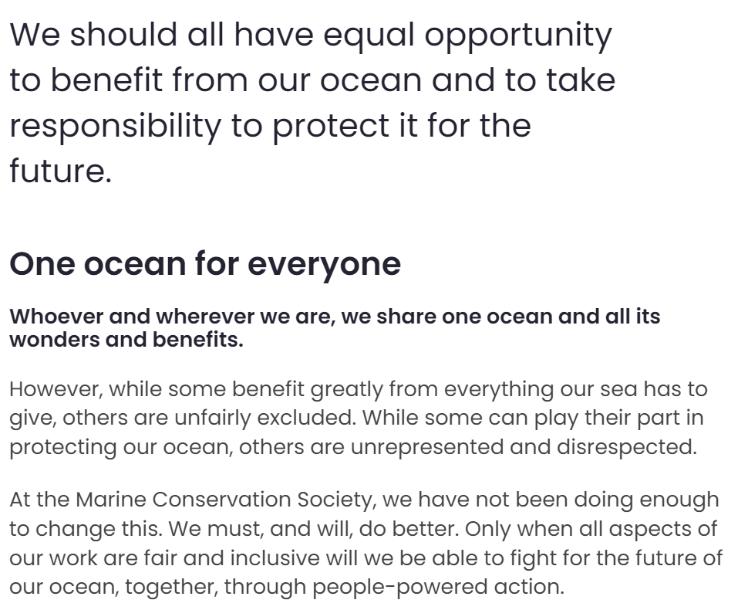
2020/2021
Board Champion for EDI nominated
Cross-organisational working group launched
EDI statement published
Strategy refresh included new fourth ocean goal called One Ocean For Everyone

Slide 8
2021/2022
EDI staff training session
Blind recruitment
Equality Impact Assessments on policies up for renewal
Launch of Youth Ocean Network

Slide 9
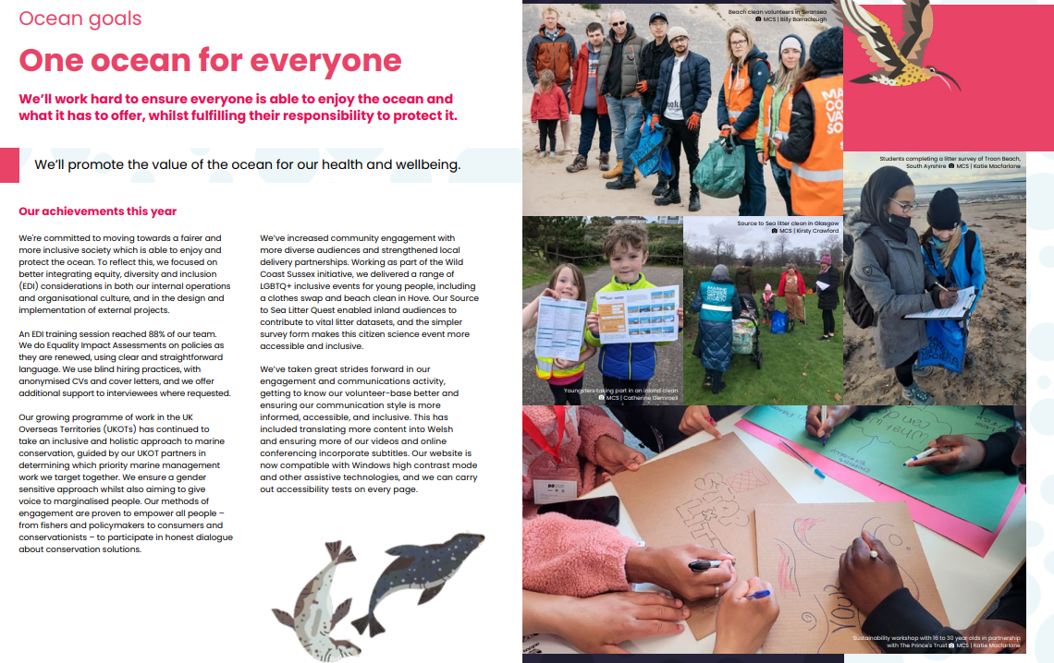
Notes:
https://s3.eu-west-1.amazonaws.com/media.mcsuk.org/documents/MCS_Annual_Impact_Report_2021-22_WEB_v2.pdf

Slide 10
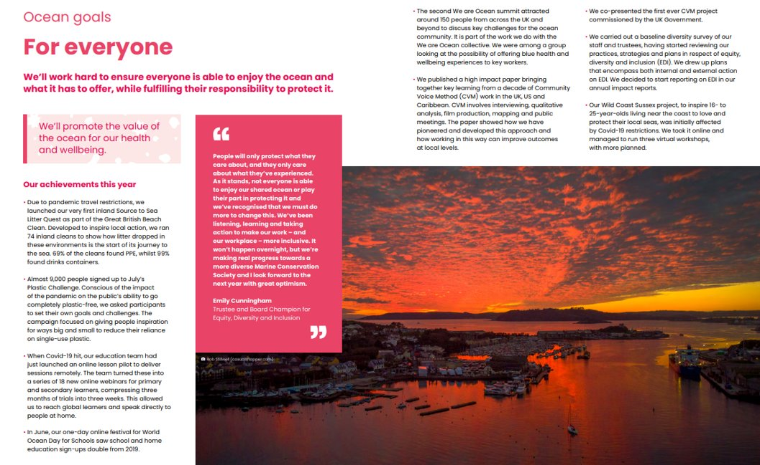
Notes:
https://s3.eu-west-1.amazonaws.com/media.mcsuk.org/documents/MCS_Annual_Impact_Report_2020-21_Web_1.pdf

Slide 11
Through our work conserving ocean habitats and engaging coastal communities and wider society we can drive positive change for people and ocean, which is why we are challenging ourselves to ensure that our organisation and our actions are as inclusive as possible.

Slide 12
2022/2023
Volunteer survey included EDI questions to create baseline
Response to RACE Report – adapting how we collect data
Sitting on or contributing to LINK network EDI groups and events
Notes:
https://www.mcsuk.org/news/one-ocean-for-everyone-race-report-2022/

Slide 13
2023/24 plans
EDI plan with KPIs established and integrated into operational plans
Develop an inclusive behaviours framework
Ensure content is inclusive and accessible
Regular reporting on EDI goals

Slide 14
Some learnings
We can't do everything at once
Learn and listen to staff and volunteers to bring everyone with you on your journey
Importance of keeping energy up and sharing of responsibilities and ensure staff have a chance to recharge
Clear roles, responsibilities and expectations
It can’t be a tick box exercise or all funding driven
Good balance of top down and bottom up approach across staff
Consider specific role or expert in EDI to help develop, facilitate and keep work on track

Slide 15
2024/25 plans
Our working group has ensured that EDI is now firmly integrated across our charity. We are now looking to take this to the next level and work on the strategic development of our EDI planning. Our Stakeholder Experience Committee, that reports to the Board, will be working across the organisation to lead on our strategy, plans, monitoring and reporting.

Slide 16
EDI in practise examples
Ministry of Justice
Youth Ocean Network
Policy and Advocacy – speaking up

Slide 17
Ministry of Justice & Beachwatch
Partnership developed in 2021. Aim to train staff to run beach clean surveys with service users to engage them in marine conservation issues and to feel part of the solution.
5 regions across England and Wales were trained up to run litter surveys throughout the year.
Feedback suggests an increased interest in litter issues, from service users, due to understanding the importance of data and how they can make a difference. Leads to lasting skills development, ocean literacy and behaviour change.
Next stage is training staff on Source to Sea Litter Quest for inland locations.

Slide 18
Thank you
Links:
https://www.mcsuk.org/useful-information/equity-inclusion-and-diversity/
https://www.mcsuk.org/what-you-can-do/fun-learning/young-people/youth-ocean-network/
Catherine.gemmell@mcsuk.org

Slide 19
Equalities, Diversity and Inclusion at Froglife
Sheila Gundry, Operations Manager
Christina Nijjar, Project Manager Coalface to Wildspace

Slide 20
Where we started
Most of Froglife’s work focuses on engaging disadvantaged groups, particularly:
Disadvantaged young people
People living with mental health issues
People living with dementia
EDI is up front in our Mission Statement and Strategic Plan
Amphibians and reptiles are hidden and often forgotten about which is an interesting connection with EDI.
In summer 2021 we did a comprehensive review of EDI good practice
Learning 1: standards change and it’s important to review regularly
Learning 2: we need to make sure that we
are ready to welcome people from all
backgrounds
Notes:
Froglife has a long term commitment to working with under-represented groups. As a result we attracted staff who had an interest in this area and had a positive attitude towards diversity.
We have run projects focusing specifically on disadvantaged young people for over 15 years; BAME groups for over 10 years, people with mental health issues for over 10 years and people living with dementia for over 5 years.
Non-binary example.

Slide 21
What we did
• EDI Training for all staff
• EDI data collection and analysis for staff
• Standardising data collection across projects.
What we found
Froglife staff are representative in terms of socio-economic background, LGBTQ+ and senior female staff; OK in terms of disability; poor on representation in terms of race and ethnic background.
Froglife staff and volunteers have a positive view of EDI and a personal commitment to Froglife's EDI policy
Simple systems were effective eg EDI is included in induction for all staff, and supervision forms include a specific opportunity for staff to feedback on EDI.
Learning 3: Tracking progress better has a
multitude of benefits

Slide 22
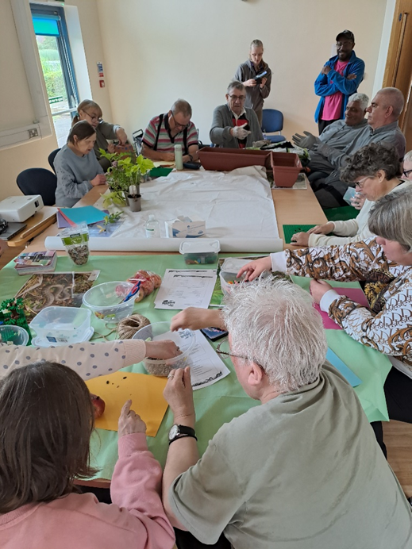
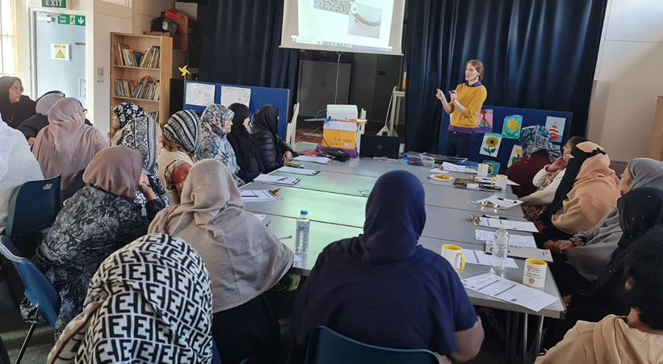
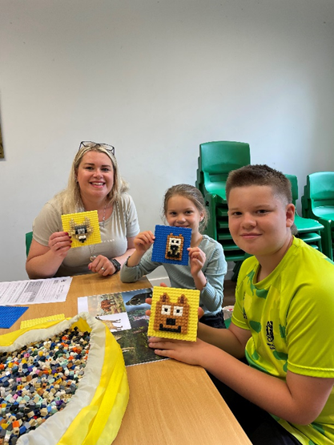
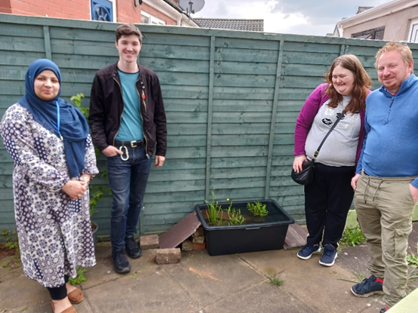
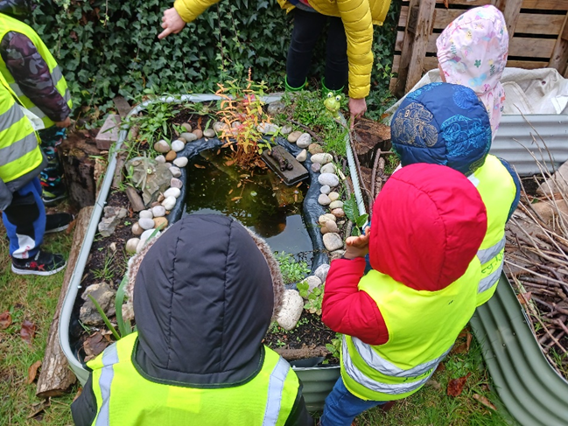
Developing our work engaging with disadvantaged communities

Slide 23
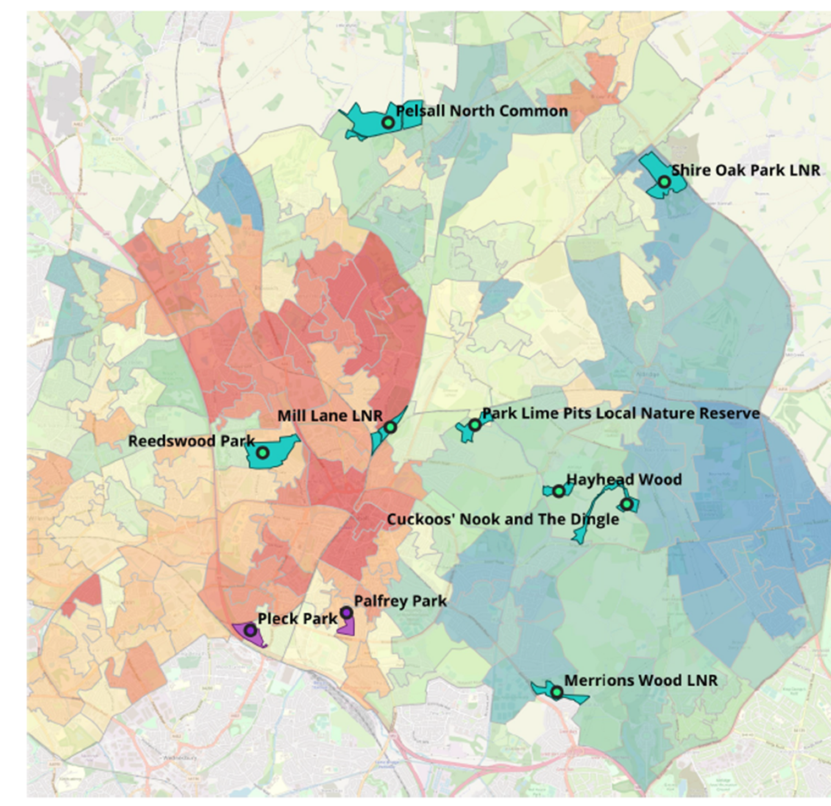
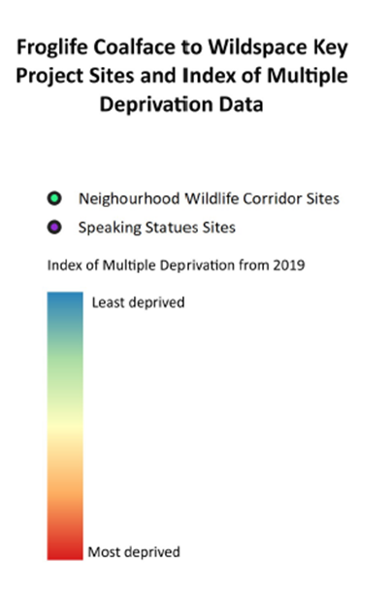
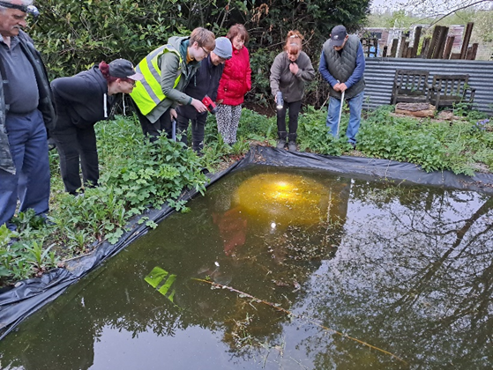

Slide 24
Next steps
CEMVO provided specific advice on anti-racism and we improved:
EDI Data Collection - streamlining and some forms shorter!
Recruitment, with a focus on anti-racism
Staff training on EDI & anti-racism
Learning 4: Access to Work scheme supports disability, including mental health
Learning 5: There’s a big range of opinions and terms, sometimes conflicting, but it doesn’t need to be off-putting. We need to be more willing to get it wrong and open to criticism
Notes:
Improved the wording on our job applications to make Froglife more attractive to a wider range of people, particularly ethnic minorities.
7. Further expanded where we advertise our job opportunities, to reach a wider range of people, particularly ethnic minorities.

Slide 25
Next steps
Reviewed images on our website, since not all staff have been following our procedure of having a range of ethnic backgrounds in our publicity.
Agreed to stop calling our office closure the ‘Christmas break’ and use the term ‘end of year’ break, to make our workplace more welcoming to all religions
Analysed our data to see if we had improved
Learning 6: care with how new ways of working are brought in and language used eg Winter break
Learning 7: It takes time – we still get very few job applications
from ethnic minorities
Learning 8: Importance of paid Traineeships to support staff
into the conservation sector
- and good terms and conditions
Notes:
few applicants so creating them ourselves

Slide 26
Final message
From Kate Bradbury, Froglife patron. Her thoughts for Pride month:
"The mental and physical benefits that come with being outdoors and engaging with nature are unparalleled, and so EVERYONE should have equal access.
But access is also important for the natural world itself: now, more than ever before, the world needs EVERYONE to be invested in nature – it’s the only way we have any hope of saving it.
Diversity and biodiversity go hand in hand – let’s break down those barriers."
?
froglife
Sheila.Gundry@froglife.org
Christina.nijjar@froglife.org

Slide 27
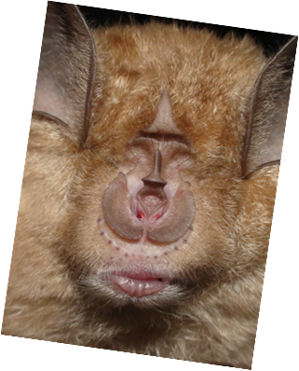
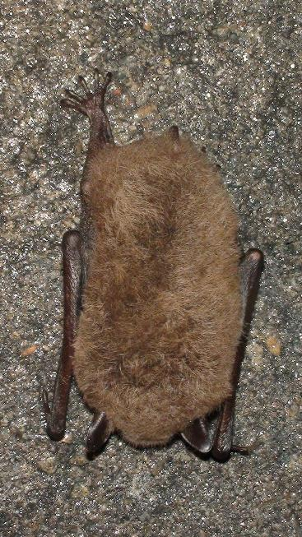
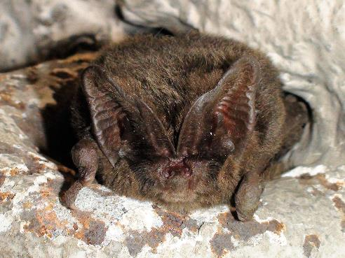
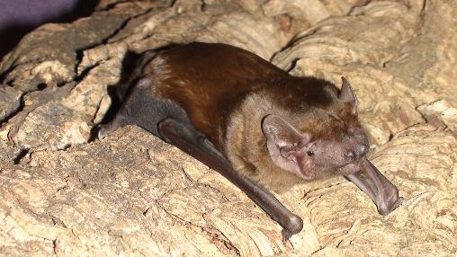
EDI Lessons Learnt… and still learning
Claudia Gebhardt
Bat Conservation Trust
Photos: Daniel Hargreaves
Notes:
Equity
Diversity
Inclusion
We will go through some of our lessons learnt so far with some examples of the work we are doing

Slide 28
Bat Conservation Trust
The leading non-governmental organisation in the UK solely devoted to the conservation of bats and the landscapes on which they rely.
Our vision is of a world rich in wildlife where bats and people thrive together.

Slide 29
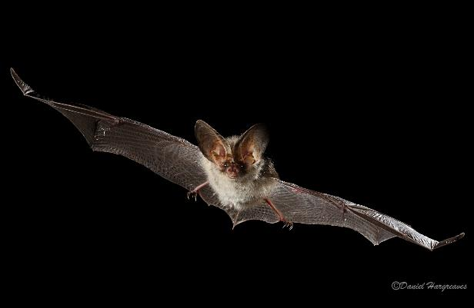
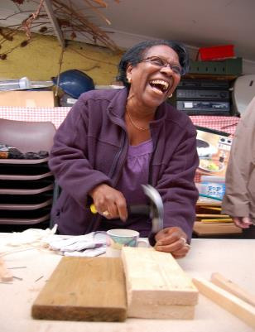
Long-term interest in diversity and inclusion
Count Bat Project (2008 – 2012)
Engagement project focused on deaf and hard of hearing people, visually impaired people, children and young people and minority ethnic groups
Notes:
This presentation only includes a snapshot of what BCT is doing.

Slide 30
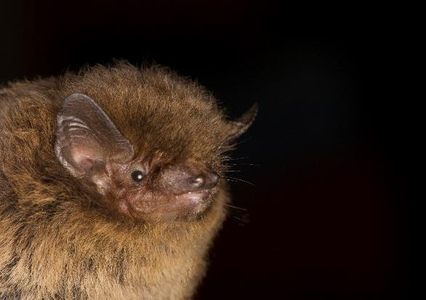
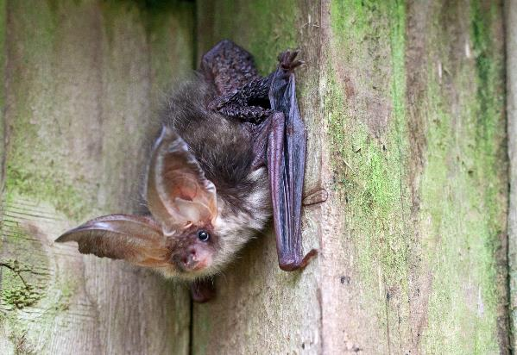
Lesson 1 – EDI is not a “side of the desk” challenge
Capacity held back our progress
EDI now specified within 2 staff members role descriptions
Photo: Daniel Hargreaves
Notes:
WCL =Wildlife and Countryside Link

Slide 31
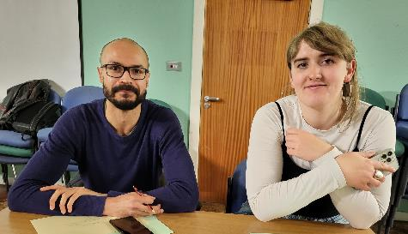
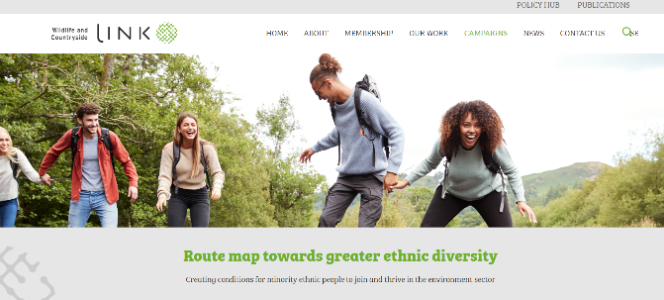
Lesson 1 – EDI is not a “side of the desk” challenge
Formed an EDI working group with all departments and levels of the organisation represented including Trustees
WCL Route map – some tasks taking longer than expected – marathon not a sprint
Notes:
WCL =Wildlife and Countryside Link
Which tasks are taking longer?

Slide 32
Lesson 2 – Public declaration and accountability
Signed up to WCL Route Map, Race Report, Diverse Sustainability Initiative commitments
Strategy review – Inclusion added as one of our values in the new BCT strategy
Fully embedded into our Memorandum and Articles of Association - voted at last year’s AGM
Published our EDI Statement of Values
Notes:
Wildlife and Countryside Link Route Map
The Diverse Sustainability Initiative is a collaborative programme of work that launched in March 2021 with the vision to transform diversity within the sustainability profession and wider environment sector.

Slide 33
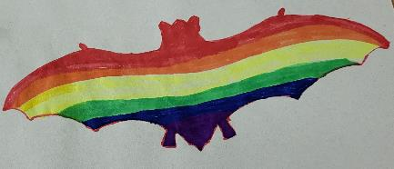
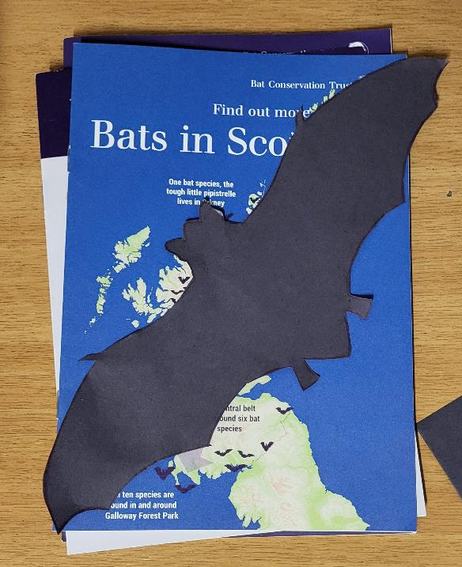
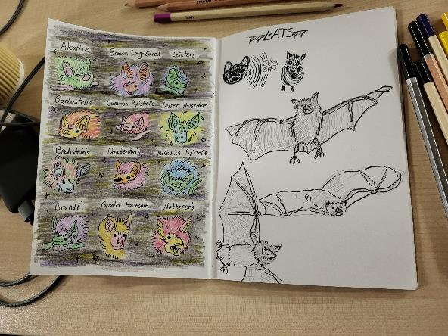
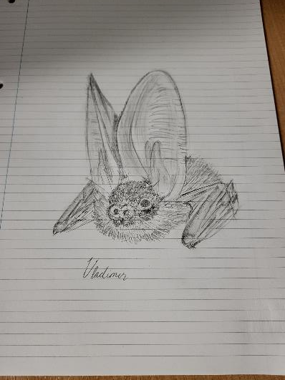
Lesson 3 – Inclusive conservation comes in many different forms
LGBTQ+ community
NightWatch PAM
Bat talk and craft session
Bat walks
Notes:
In partnership with LGBT Health and Wellbeing

Slide 34
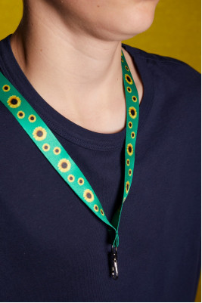
Lesson 4 – small changes can make a big difference at events
Introduced quiet/chatty tables or quiet spaces
Offer specific tips for neurodivergent delegates, e.g. inviting them to bring sound-reducing headphones, sunflower lanyards, if they find them helpful
Notes:
Sunflower – hidden disabilities
“It was good to see provision for neurodivergence” Conference delegate 2023

Slide 35
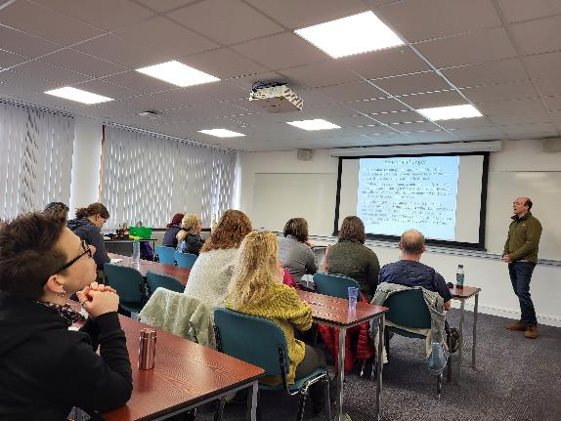
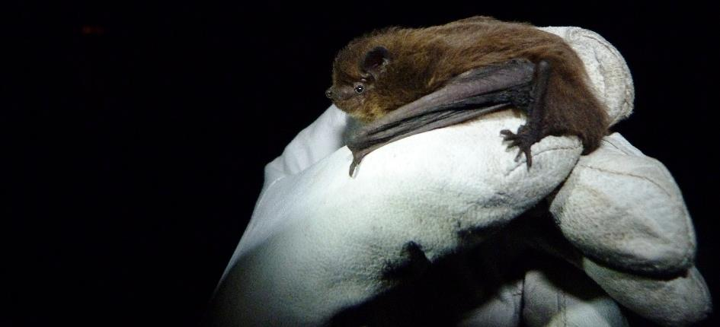
Lesson 4 – small changes can make a big difference at events
Provide fidget toys and doodle pads for people to borrow at events
Option to include pronouns on your name badge
Highlight gender neutral toilets on delegate hub
Photo: Daniel Hargreaves

Slide 36
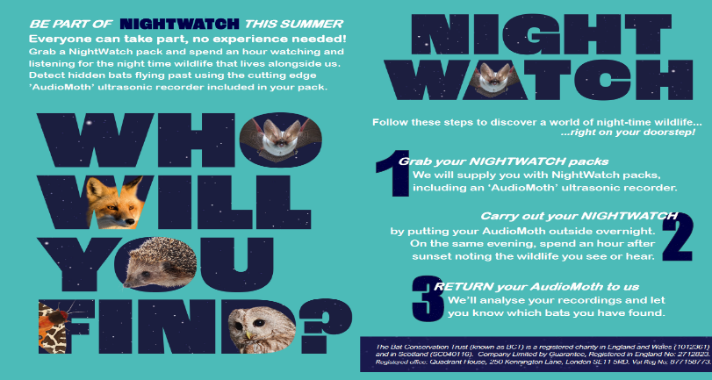
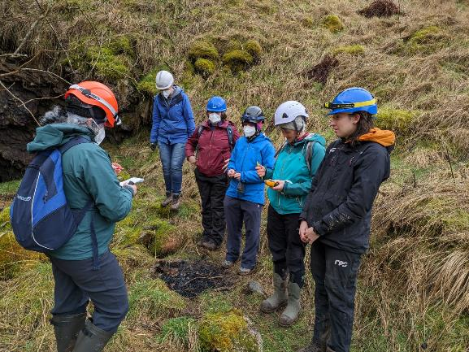
Lesson 5 – we are learning as we go
New to Nature intern – improvements to recruitment processes
“Hidden barriers and breaking taboos” talk at CIEEM Conference – new taboos and barriers shared each time we ask
Notes:
New to Nature Intern March 2023, part of NightWatch project: 8-month paid internship
NightWatch: ‘everyone can access the benefits of connecting with nature, particularly those from ethnic minority communities, and those living in urban areas’
CIEEM Breaking Taboos: February 2022, incl. women in field-work

Slide 37
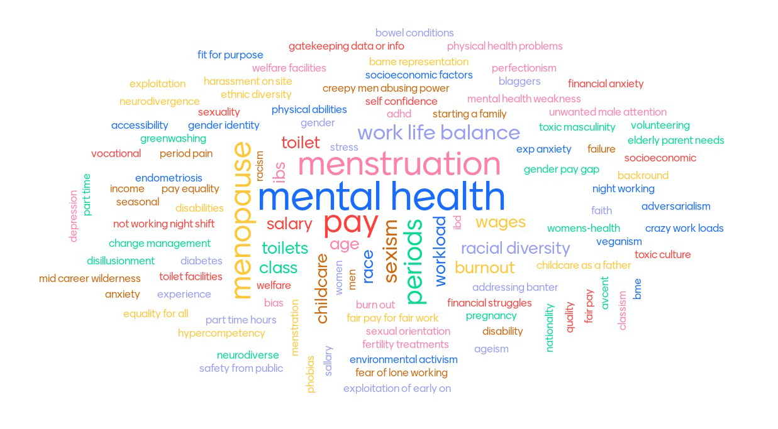

Slide 38
Lesson 6 – some people have different perspectives on EDI
Recent negative press attention about our EDI activities led to emails, phone calls and some membership cancellations
BCT put out a statement clarifying misunderstandings/misrepresentation and why we think this work is important
Notes:
Example in relation to our evidence to an all-party group at Parliament for the enquiry into Racism and the Environmental Emergency and was submitted by Wildlife and Countryside Link and signed by us and several other environmental NGOs (during ‘race in policy week’)
.

Slide 39
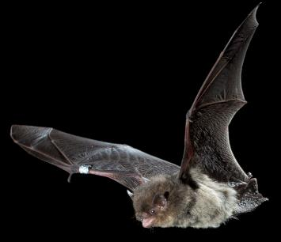
Ongoing activities
Anti-oppression training for BCT staff
Species on the Edge project in Scotland – Youth Panel
NightWatch Project – engaging urban communities with night wildlife
Connecting People and Landscapes project – traineeships
Improvements to our recruitment processes
Research and collaborations to increase the diversity of bat monitoring volunteers
Photos: Daniel Hargreaves
Notes:
Contact us for more information.
This is only a snapshot

Slide 40
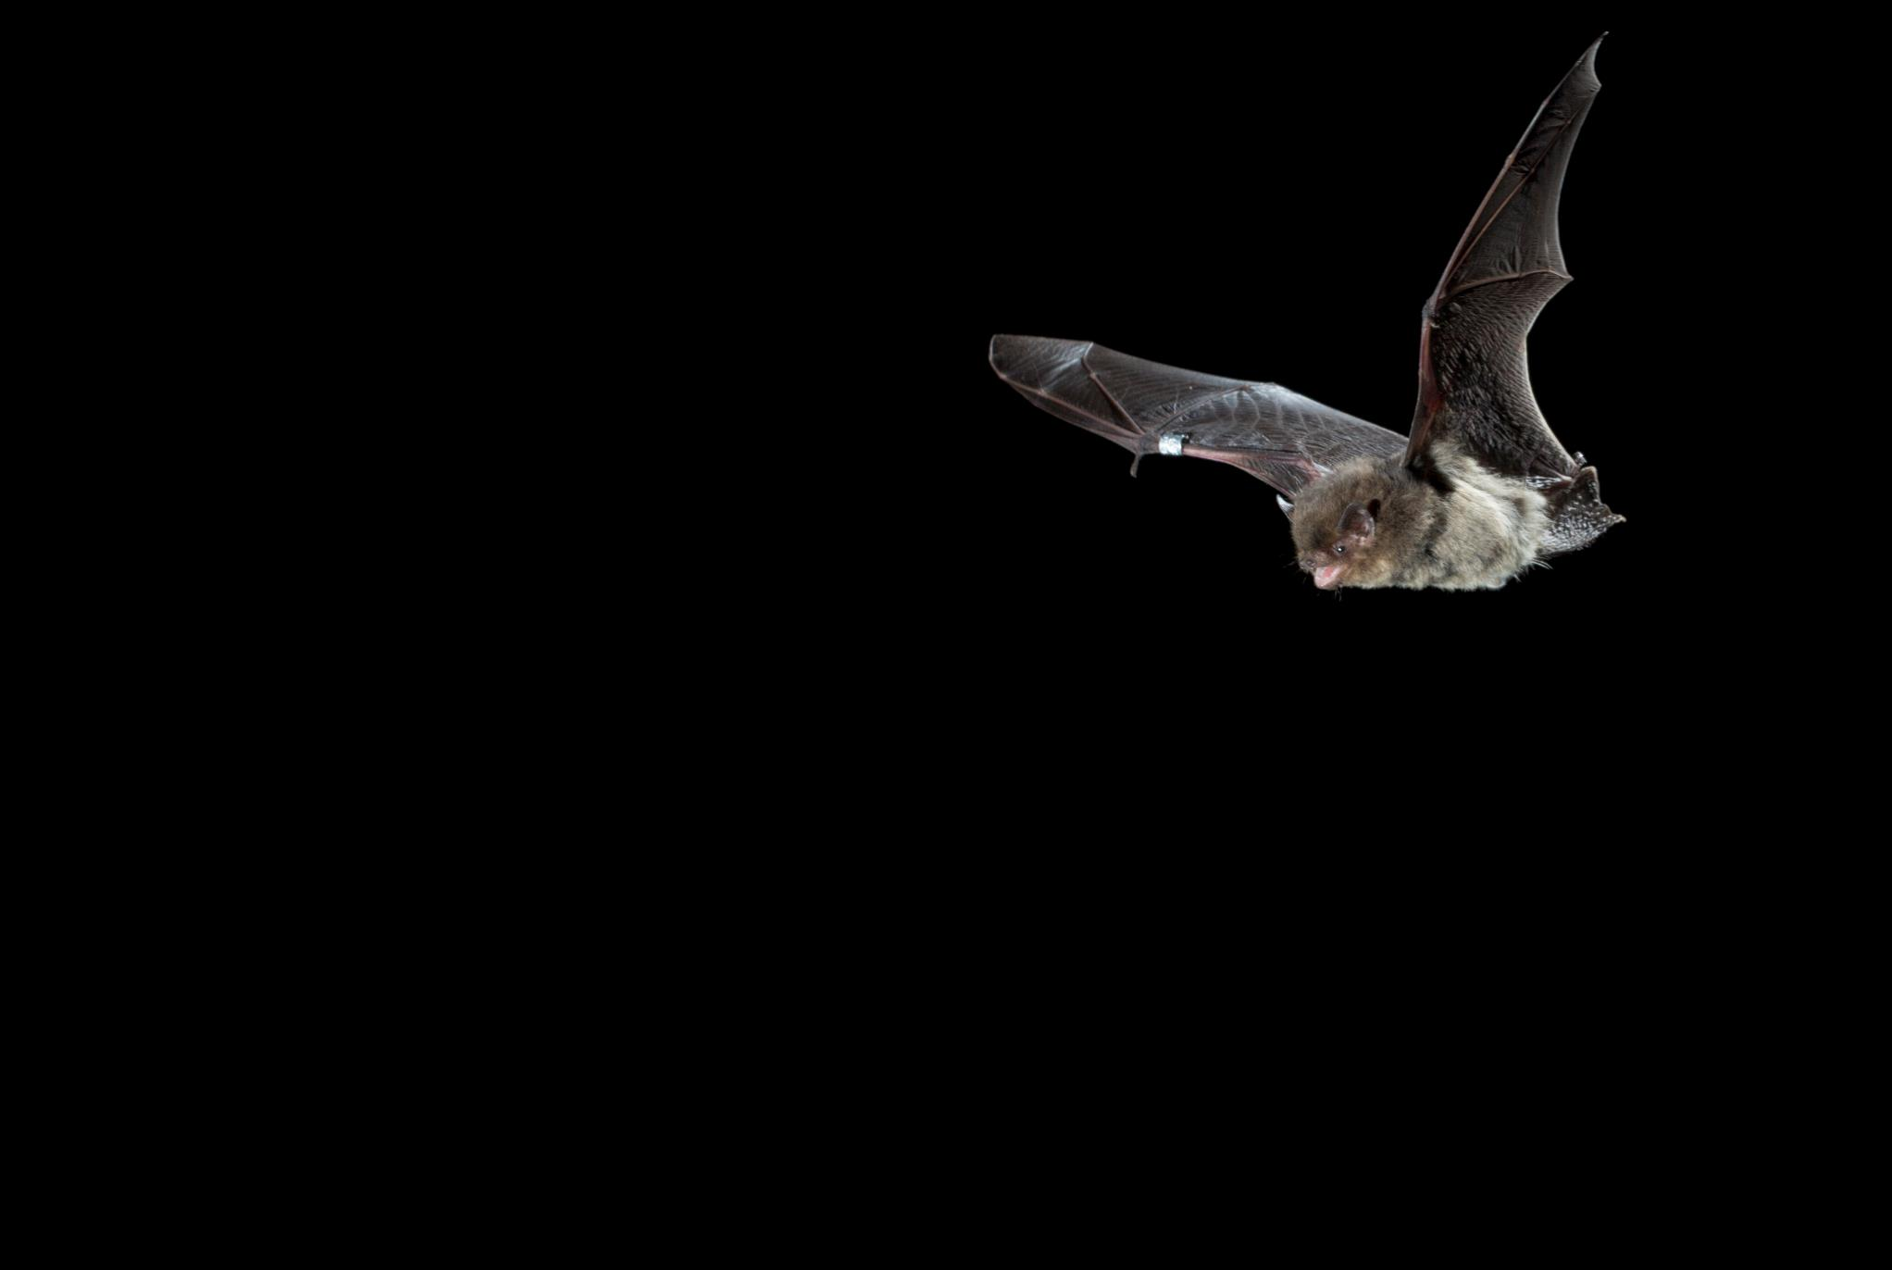
Thank you!
Photo: Daniel Hargreaves
Notes:
Contact us for more information.
To make it more engaging could be one per slide with an image and rapidly click through them?

