Slide 1
LINK advocacy training 2024
Session 2:
Dealing with the media

Slide 2
Why SHOULD environmental NGOs engage with the media?

Slide 3
FRAMING: Having environmental voices in the media can change how issues are viewed (by public and policymakers)
POLITICAL PRESSURE: Media stories can be a tool to force government action
MOTIVATE OUR SUPPORTERS
AWARENESS RAISING: Much harder! Needs sustained effort over time to have meaningful impact
Why SHOULD environmental NGOs engage with the media?

Slide 4
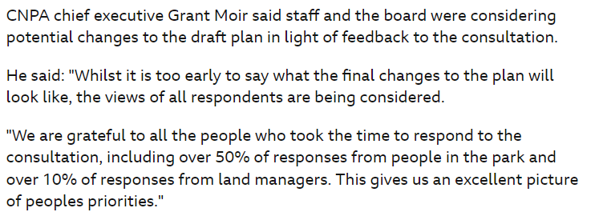
BBC News article on land management in Cairngorms framed entirely by opposition.
Without environmentalist voices, environmental arguments are absent.
What impact does this have on decision makers?

Slide 5
WHY are you taking this story to the media? What are your objectives? (Just ‘getting coverage’ is not necessarily a good motivation!)
HOW is your story newsworthy?
WHO are you trying to reach?
Are YOU a trustworthy voice to speak to this audience? Think about who the best spokesperson is. It is possible that it isn’t your organisation!
Things to consider before engaging with media

Slide 6
You can have an interesting story, with the perfect framing… but most people won’t remember it if they only hear it once!
The key to changing minds and motivating supporters is for them to hear your message repeatedly over time
You can do this by using consistent language and framing while finding new hooks to interest people
This principle applies to all forms of communication: news media, supporters list, digital marketing…
The fundamental issue…

Slide 7
Understanding your audience Public opinion and news consumption

Slide 8
Know your audience – it is probably not “the general public”
Use the right medium
Speak to your audiences' interests, not your own
Principles of effective media communication

Slide 9
Sources used for news by people in Scotland:
TV (69%) [down 6%]
Social media (54%) [up 4%]
Radio (38%) [down 7%]
Print newspapers (25%) [unchanged]
Source: Ofcom, 2023 (vs. 2022)
How do people consume news?

Slide 10
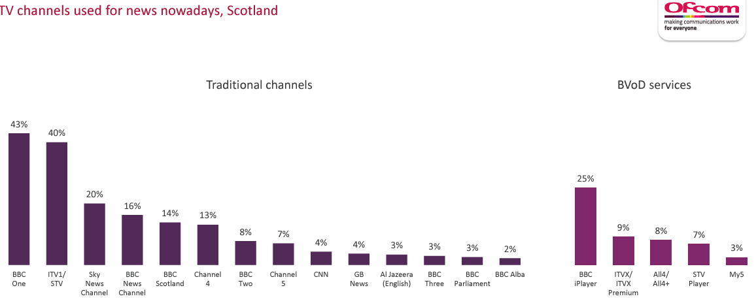
Source: Ofcom, 2023

Slide 11
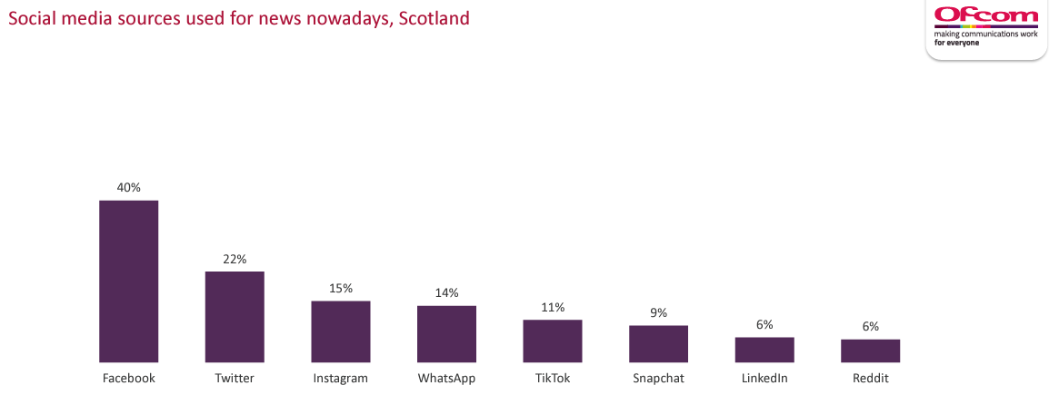
Source: Ofcom, 2023

Slide 12
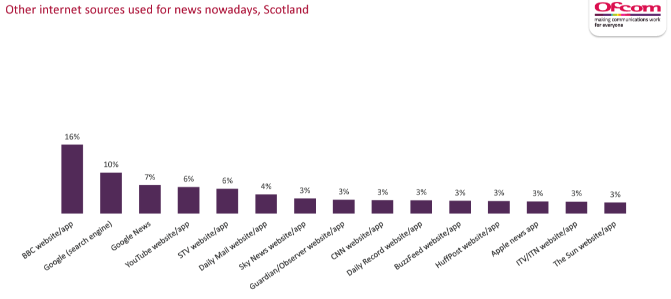
Source: Ofcom, 2023

Slide 13
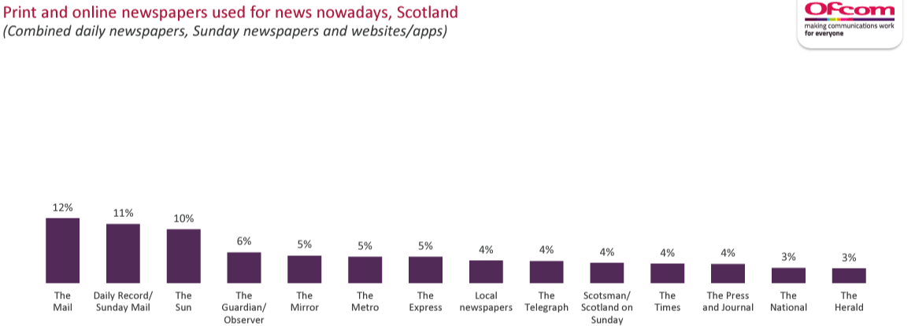
Source: Ofcom, 2023

Slide 14
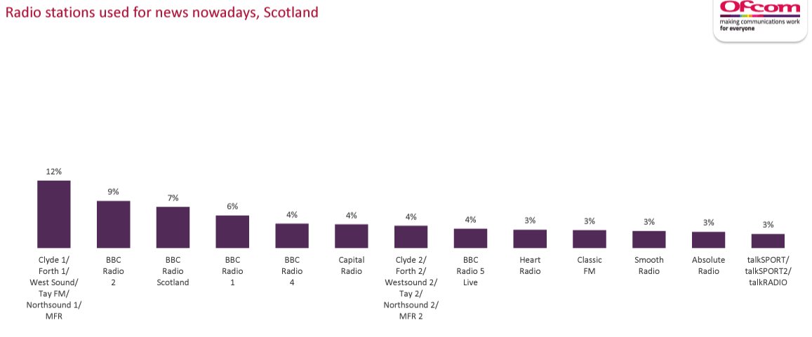
Source: Ofcom, 2023

Slide 15
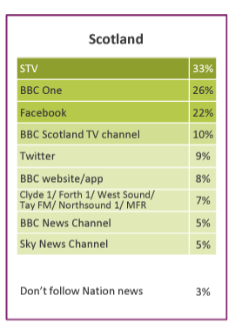
Source: Ofcom, 2023

Slide 16
Creating a strong message

Slide 17
Speak to shared values. Most people care about the environment. Most people worry about climate change. Acknowledge this!
Key things to consider

Slide 18
Speak to shared values. Most people care about the environment. Most people worry about climate change. Acknowledge this!
Identify the problem – and the impact. Make this is relevant to people’s lives as you can. How does the problem impact people like you today?
Key things to consider

Slide 19
Speak to shared values. Most people care about the environment. Most people worry about climate change. Acknowledge this!
Identify the problem – and the impact. Make this is relevant to people’s lives as you can. How does the problem impact people like you today?
Provide (and normalise!) the solution. Bad environmental news can be demotivating. Highlight where solutions are happening and make this seem normal.
Key things to consider

Slide 20
Speak to shared values. Most people care about the environment. Most people worry about climate change. Acknowledge this!
Identify the problem – and the impact. Make this is relevant to people’s lives as you can. How does the problem impact people like you today?
Provide (and normalise!) the solution. Bad environmental news can be demotivating. Highlight where solutions are happening and make this seem normal.
Find the ‘phrase that pays’.
Key things to consider

Slide 21
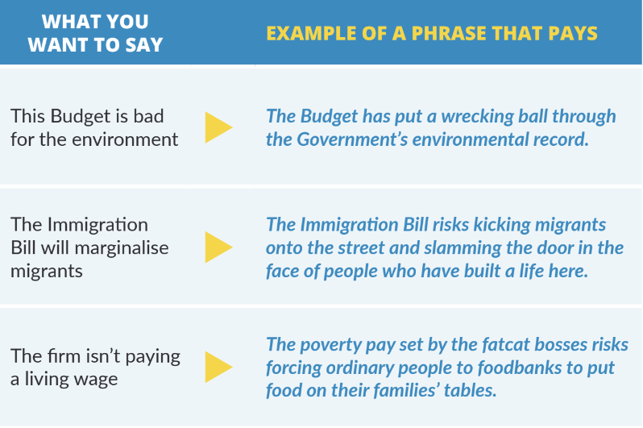
Source: New Economy Organisers Network

Slide 22
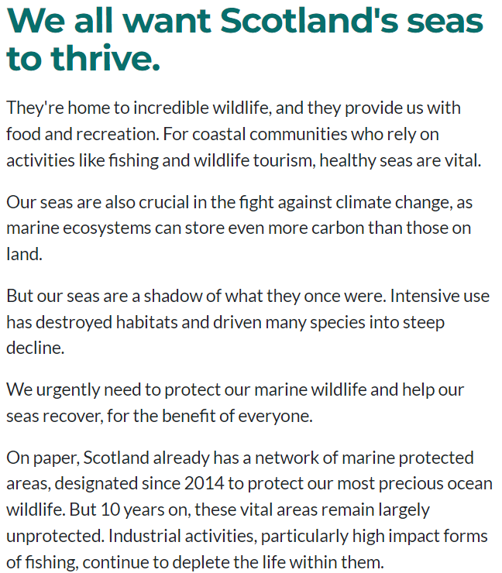
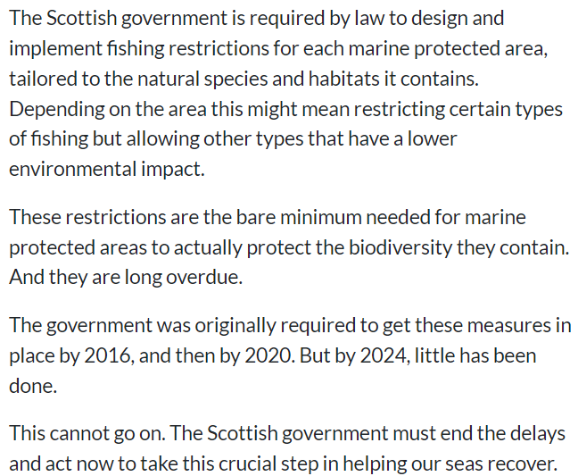

Slide 23
Shared values
Providing solution
Identifying the
problem
Highlighting delay makes answers seem ‘normal’ – we aren’t asking for something new, just what should already be in place!

Slide 24
Statistics can be powerful but they can also overwhelm. Ideally you should only use one statistic as it’s unlikely people will remember any more.
Fractions are better than percentages.
People don’t really understand very large numbers (especially related to money). Try and find a way to make numbers relatable.
Round up or down to make a statistic snappier.
Using statistics

Slide 25
Writing a press release

Slide 26
Ask yourself…
Is this new? Is it noteworthy?
Is there a wider relevance?
Is there a fresh or unique perspective?
“Awareness days” are not that interesting to journalists.
But… there are lots of ways to make a story seem interesting.
What gives a story a “hook”?

Slide 27
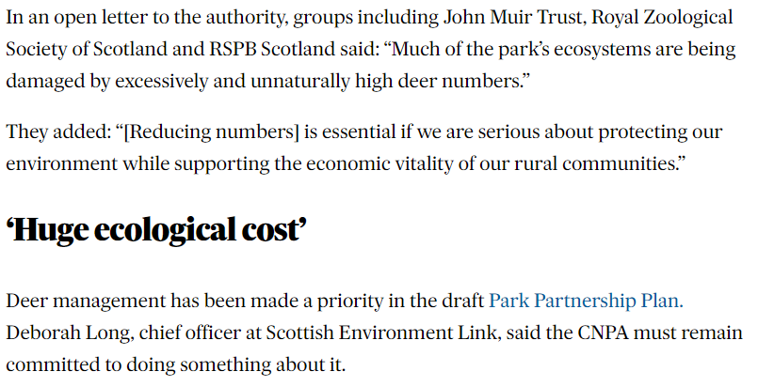
Press & Journal article highlighting LINK perspective on Cairngorms National Park Plan.
Open letter format creates sense of an “intervention”
Multiple signatories makes it more interesting
Timed just before Board meeting

Slide 28
All of these could be newsworthy
Consultation responses
Reports
Briefings
Open letters
Letters to government
New research (FOIs, PQs)
Events
Case studies
Making your story newsworthy

Slide 29
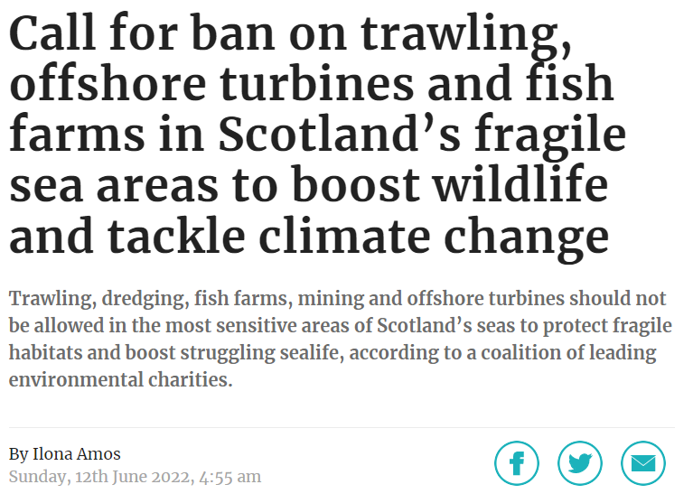

Slide 30
Keep language simple and accessible and aimed at a non-expert audience.
Assume the reader has minimal prior knowledge (without being patronising).
How to write a press release

Slide 31
Keep language simple and accessible and aimed at a non-expert audience.
Assume the reader has minimal prior knowledge (without being patronising).
Have one clear newsline (an “ask” or new piece of information).
How to write a press release

Slide 32
Keep language simple and accessible and aimed at a non-expert audience.
Assume the reader has minimal prior knowledge (without being patronising).
Have one clear newsline (an “ask” or new piece of information).
Make it easy for the journalist. Don’t make them fill in the gaps – provide the evidence and background they need.
How to write a press release

Slide 33
Keep language simple and accessible and aimed at a non-expert audience.
Assume the reader has minimal prior knowledge (without being patronising).
Have one clear newsline (an “ask” or new piece of information).
Make it easy for the journalist. Don’t make them fill in the gaps – provide the evidence and background they need.
Make it look like a news story - not a “statement”.
How to write a press release

Slide 34
Keep language simple and accessible and aimed at a non-expert audience.
Assume the reader has minimal prior knowledge (without being patronising).
Have one clear newsline (an “ask” or new piece of information).
Make it easy for the journalist. Don’t make them fill in the gaps – provide the evidence and background they need.
Make it look like a news story - not a “statement”.
Golden rule – be concise and precise.
How to write a press release

Slide 35
Headline – with clear newsline
Introductory sentence – encapsulating the main points of the story.
Further explanatory detail.
Quote from named spokesperson: “X”
ENDS
Notes: With references to sources and further background detail inappropriate for main text
Contact details
How to Structure a press release

Slide 36
Headline and opening sentence have clear newsline
Short, snappy sentences – 1 or 2 per para
Quote is concise – position stated simply without being burdened by detail

Slide 37
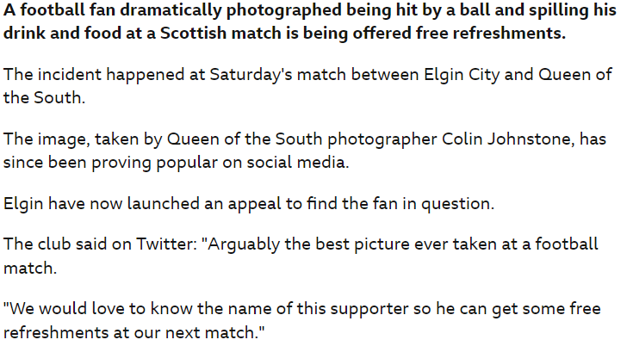
Compare structure and language to a typical BBC News article…

Slide 38
Usually, your best chance of getting good coverage is to offer a story to a specific journalist as an exclusive.
Plan in advance and give journalists notice. They are more likely to find space if you can contact them (at least) several days in advance.
For a Sunday newspaper, aim to contact the journalist by Tuesday or Wednesday at the latest.
Factor in that the first person you approach might say no.
Responding to events after the fact rarely works.
Timing is everything…

Slide 39
Consider who your intended audience is. Broadcast is great for reaching the general public. Politicians read newspapers. Officials notice what is picked up by media monitoring.
Approach a journalist who has covered similar stories before.
One story is fine – repeated stories builds pressure. Try to build a relationship with a journalist who can create momentum on an issue.
Who to approach?

Slide 40
Other print stories

Slide 41
These are usually 600-800 words, where a named spokesperson sets out an argument at length.
If you have something interesting to say, it is usually quite easy to place an op-ed somewhere – but it might not be somewhere with a big readership!
Op-eds work best when accessible and relatable.
Can be a useful tool – but don’t rely on op-eds to change the narrative on an issue.
Comment pieces / ‘op eds’

Slide 42
Features are ‘softer’ and less news-orientated than reporting.
This can be a good way to highlight your organisation’s work or an issue that isn’t likely to be high on the news agenda. But remember to link to advocacy asks!
Remember - you still have to make it seem interesting. What is the human interest? Charismatic species can help.
For a feature, you (or a colleague) may be interviewed or host a site visit. You would not usually prepare a press release, but background info can help.
Pitch stories to dedicated features staff.
Features can also be a good way to get broadcast interest!
Features

Slide 43
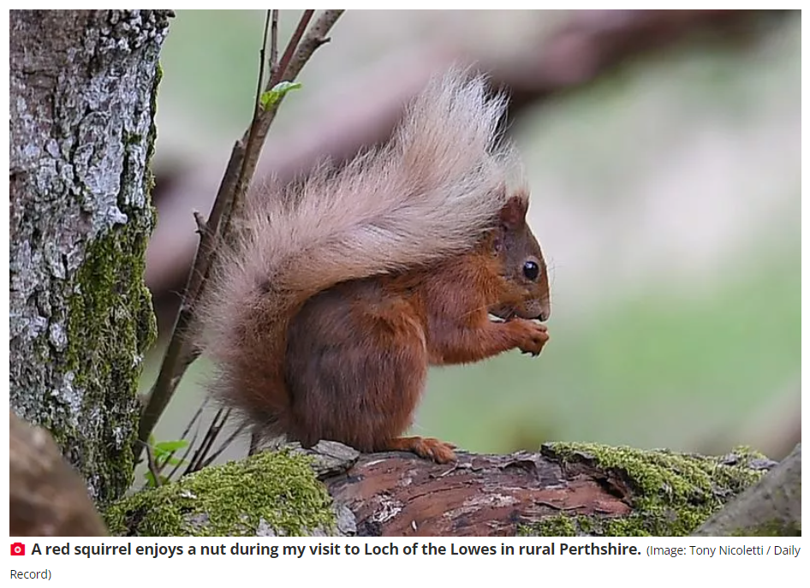

Slide 44
Pitching for broadcast

Slide 45
You will need a strong pitch to get on news bulletins – but it can be worth the effort!
TV will expect you to have strong visuals – think a site visit with people involved, or a very strong wildlife visual.
Even for news stories, getting coverage can take weeks of prep – so consider timing of approach.
Think about alternatives to news. Lots of LINK member work will be of interest to specialist TV shows, or even breakfast/daytime TV.
TV

Slide 46
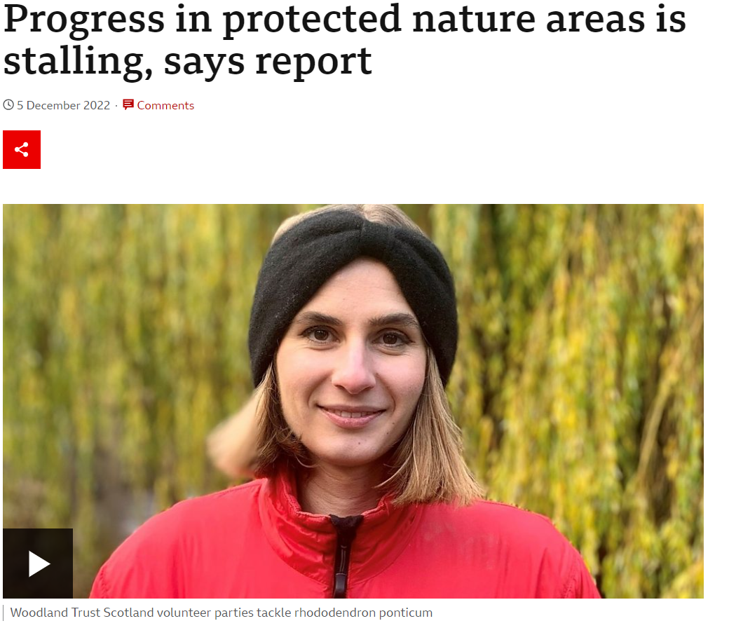

Slide 47
BBC radio (morning/drivetime) need a lot of stories. They like to be pitched!
Radio will take both news/politics and softer features. If a story is contentious, they might ‘both sides’ you after you pitch.
Radio interviews can take place in studios, but are now commonly done from home.
Be prepared for an early rise!
radio

