Slide 1

LINK ADVOCACY TRAINING 2024
Session 3:
Engaging with parliamentary committees

Slide 2
Parliamentary committees: the basics
MSPs who are not in government sit on committees
Each committee focuses on specific policy areas
Committee balance and Convener roles reflect number of party MSPs in parliament

Slide 3
Parliamentary committees: the basics
Committees have a range of functions, including:
Scrutinising Bills and secondary legislation
Holding inquiries
Examining the work of the Scottish Government, including budgets

Slide 4
Parliamentary committees: the basics
Key committees related to LINK work:
Rural Affairs and Islands
Net Zero, Energy and Transport
Local Government, Housing and Planning

Slide 5
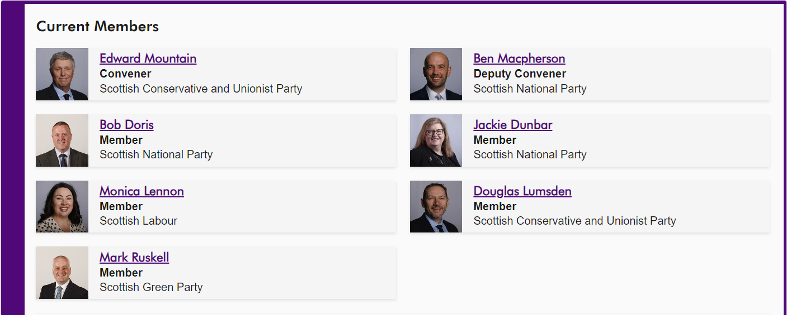

Slide 6
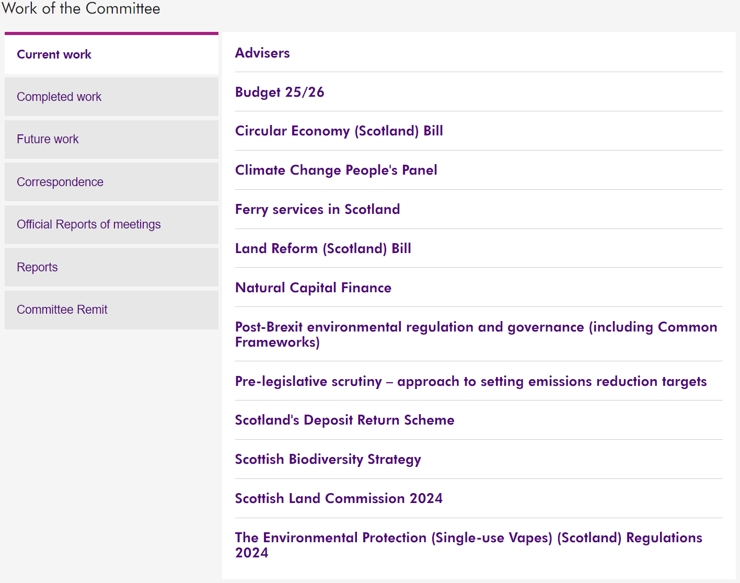

Slide 7
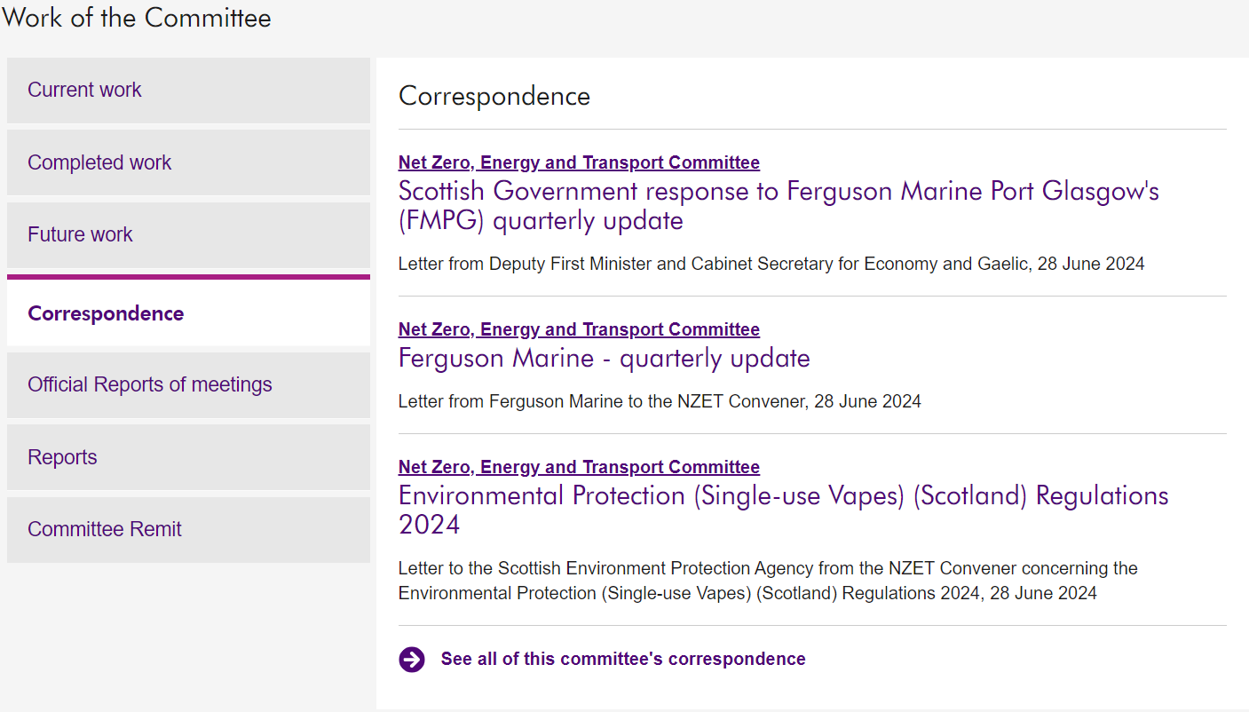

Slide 8
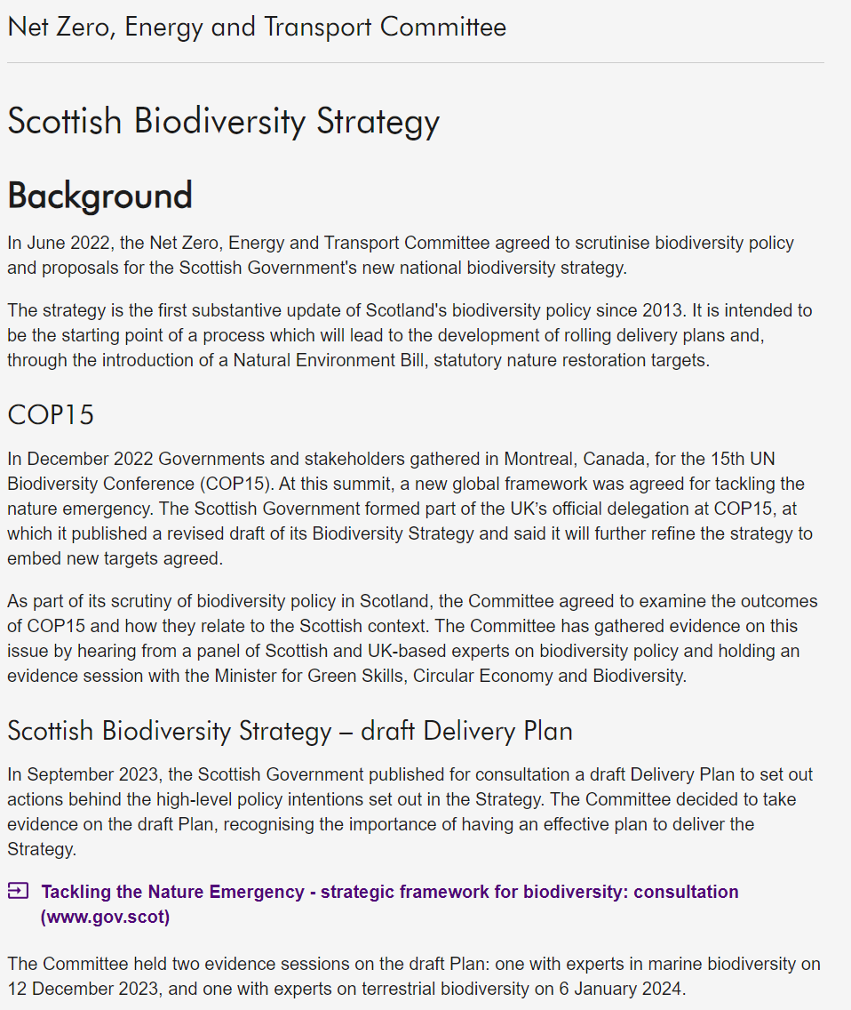
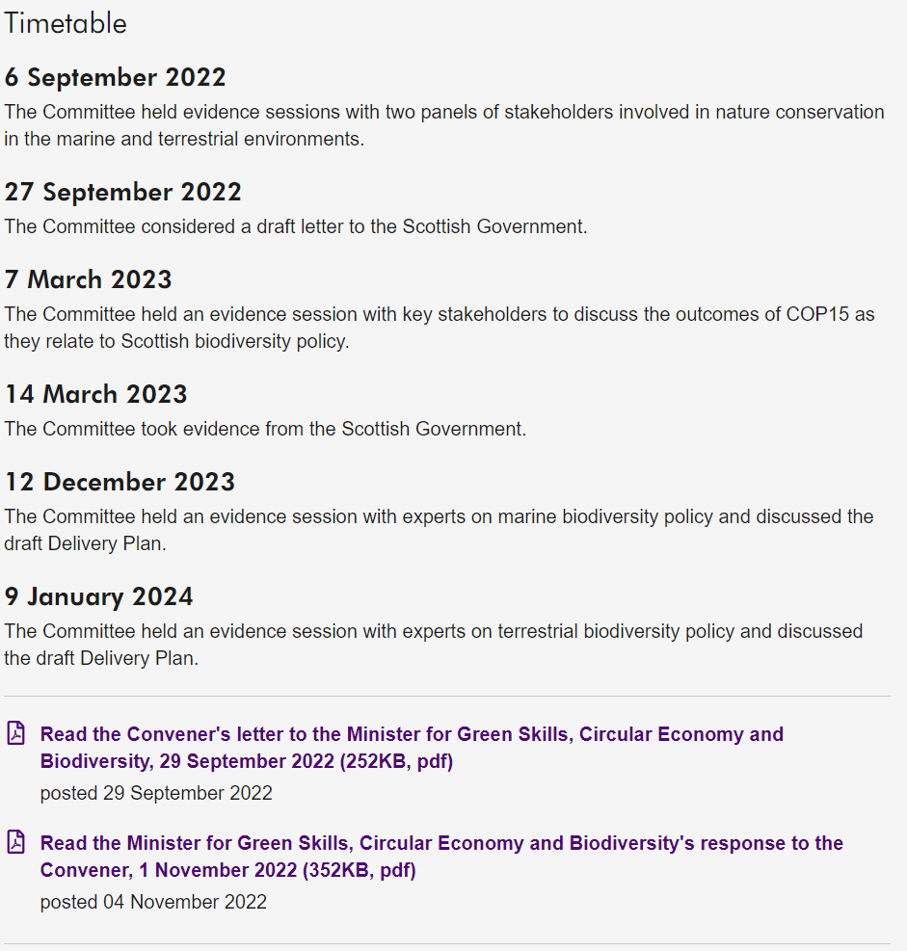

Slide 9
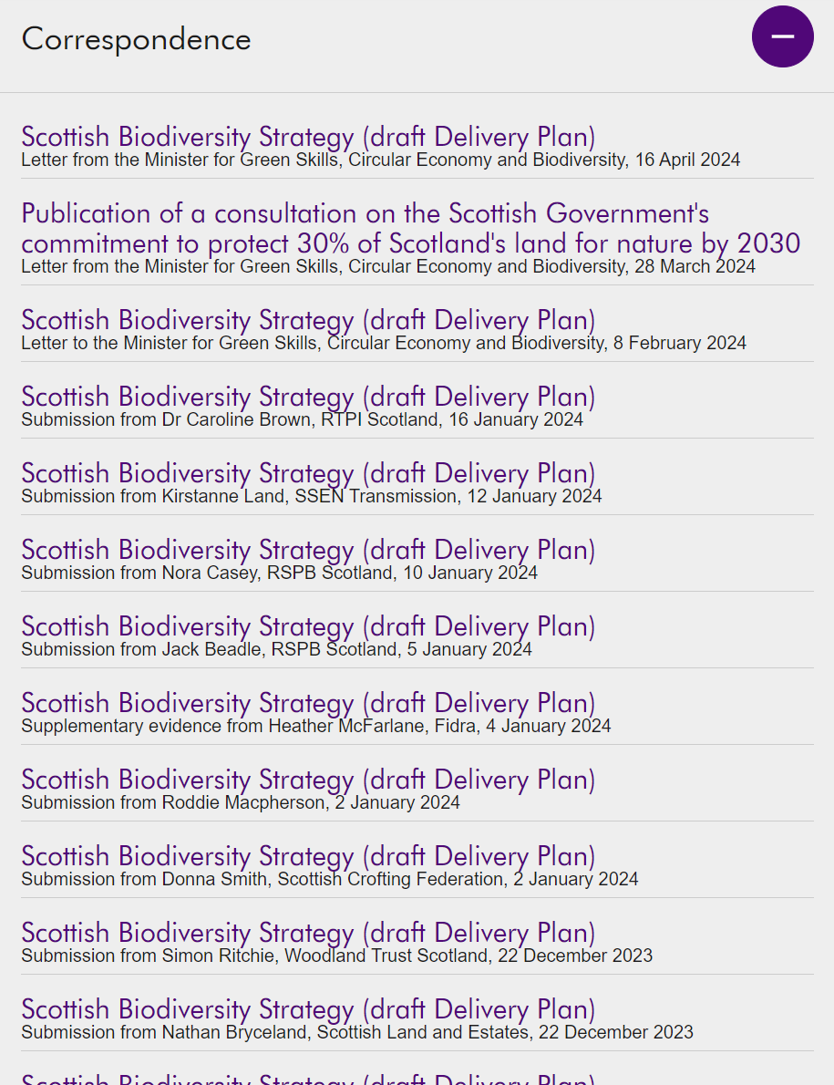

Slide 10
Committee role in legislation
Committees can perform pre-legislative scrutiny ahead of a Bill
This will involve a Call for Views where you can submit written evidence
After submitting written evidence, you may be invited to appear at Committee

Slide 11
Committee role in legislation
At Stage 2 of a Bill the lead Committee will vote on proposed amendments
The Bill as amended will then be considered by the whole parliament at Stage 3
This makes engagement with Committee members hugely important when trying to influence legislation

Slide 12
Committee role in legislation
Committees also consider subordinate legislation (‘secondary legislation’ or ‘regulations’)
Committees can choose to consider how existing legislation is working as part of their work

