Slide 1
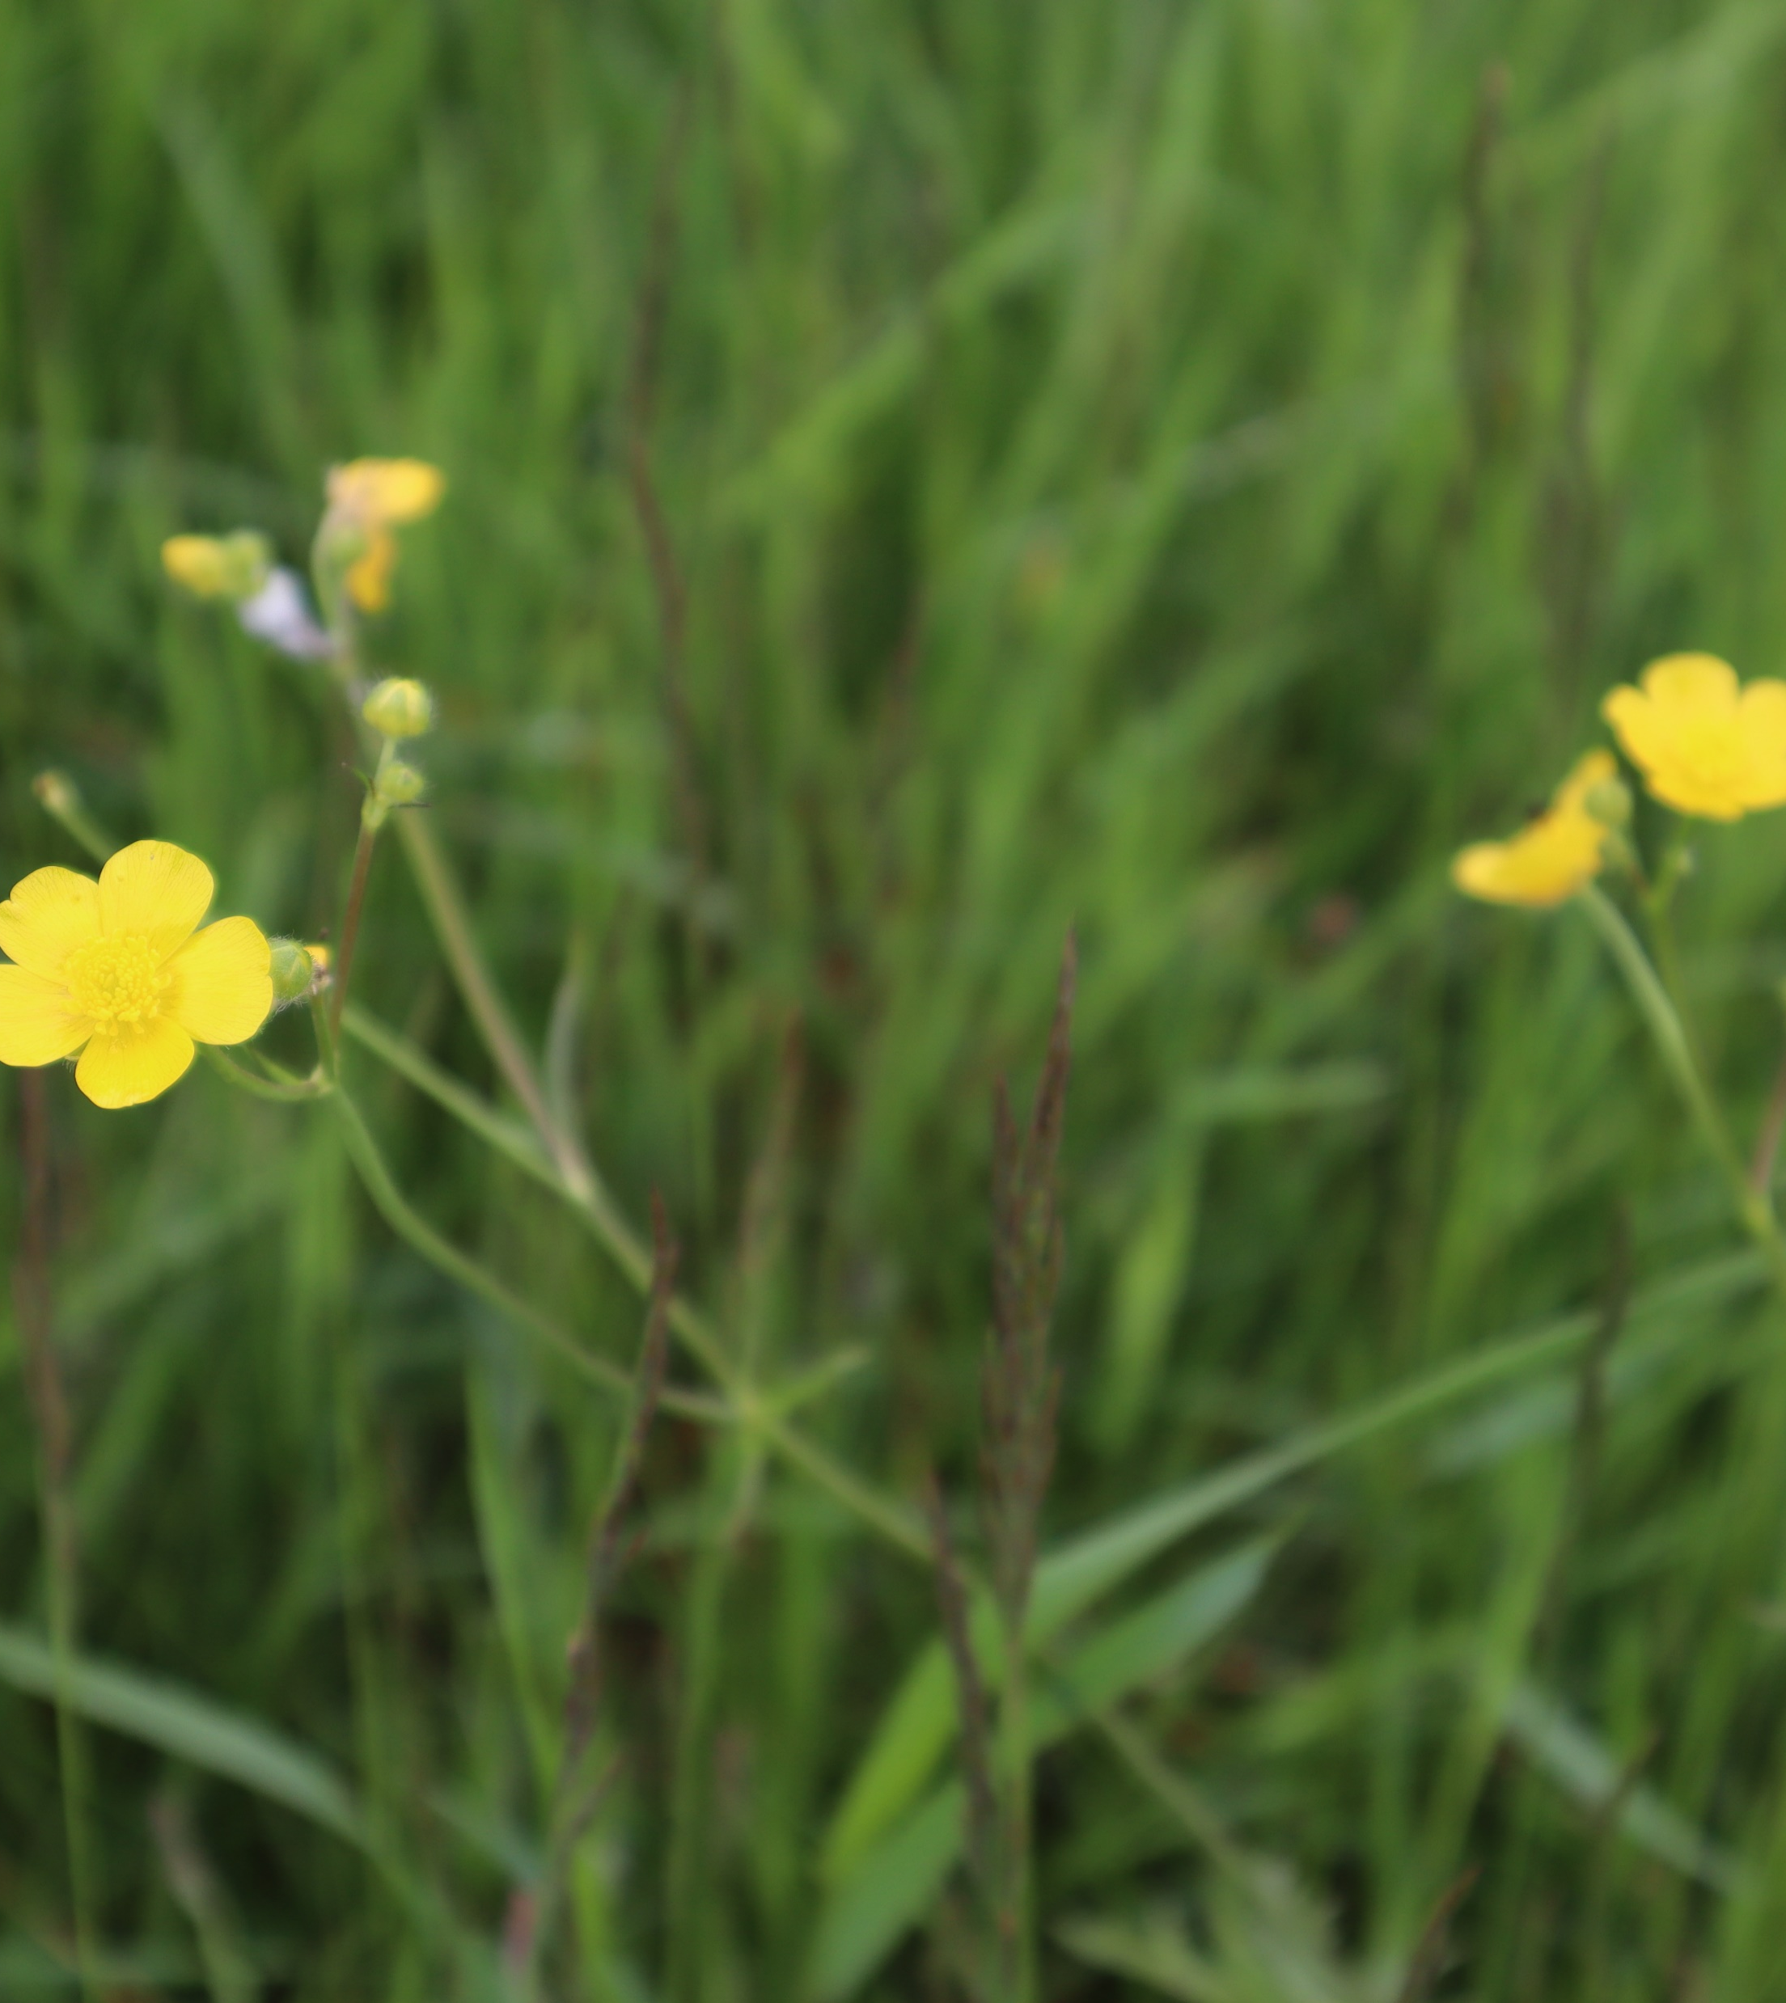
LINK ADVOCACY TRAINING 2024
Session 4:
Understanding public opinion and messaging

Slide 2
What today is all about
Public opinion – how to measure and understand
Where is public opinion today?
Lessons from psychology
Top tips for messaging

Slide 3
Part 1: Public opinion
How do we measure and understand public opinion?
We aren’t always good at understanding what, or how, other people think!

Slide 4
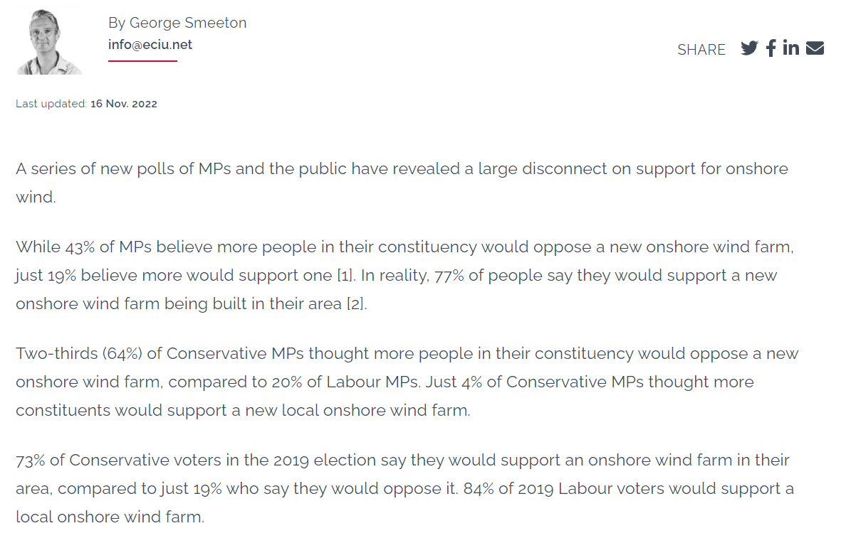

Slide 5
Opinion polling
Shows you representative, population level views on issues
Can make comparisons across demographics, or even across different countries
Reasonably affordable to commission

Slide 6
Opinion polling
But…
A poll tells you how many agree with a statement – not why!
Widely-held vs. deeply-held views
Framing can be everything
Who commissioned and why?

Slide 7
Opinion polling
Most people don’t have firm, fixed views on most issues
How the public respond to an issue depends on context, framing… and how familiar they are with a topic

Slide 8
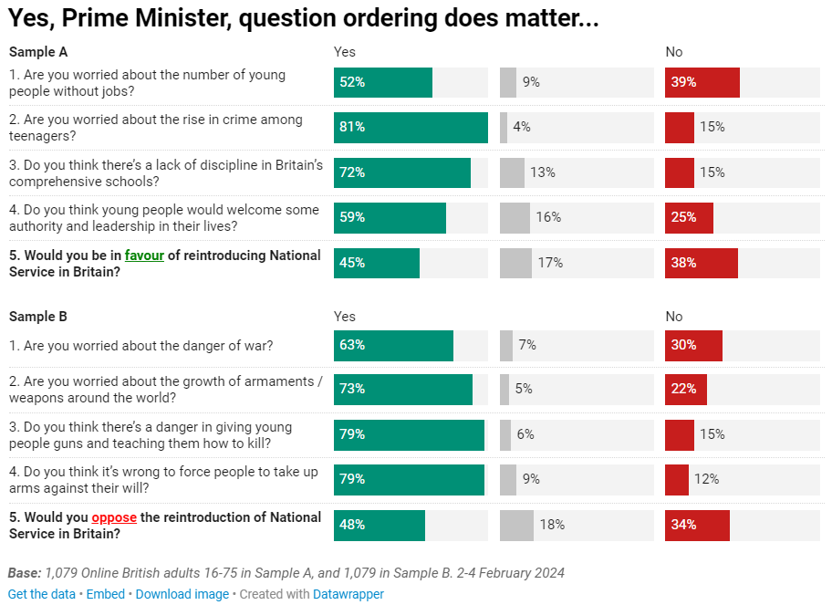

Slide 9
Opinion polling
How to make polling useful
Look for trends (over time, and across different pollsters)
Think critically – what is polling telling you, and what isn’t it telling you
Interpret polls alongside other forms of evidence

Slide 10
Does the real world match the polls?
Ways to test ideas, language, issue salience:
Focus groups
Background noise – media, social media, campaigns, community groups
Informally – friends and family, in the local community
All have limitations!

Slide 11
Does the real world match the polls?
Quantitative vs. qualitative
Use polling to understand trends, gut reactions to issues, political instinct
Interpret these – why do people think that way? What’s going on ‘under the bonnet’ of the polling numbers?

Slide 12
Focus groups
Small number of participants – not representative
Can discuss issues at greater depth – and test why people hold beliefs
Depth of knowledge and depth of feeling might not match headline polling figures

Slide 13
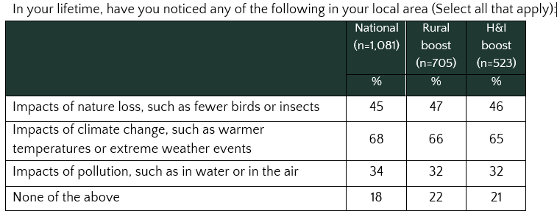

Slide 14
“We haven’t had such a cold winter, but it’s been a long, long winter. It’s been very windy… we’ve had a lot of trees down here, and a lot of rain.”
“[climate change] seems to be more extreme. Harris has always been heavy rain, but it seems to be more erratic now.”

Slide 15
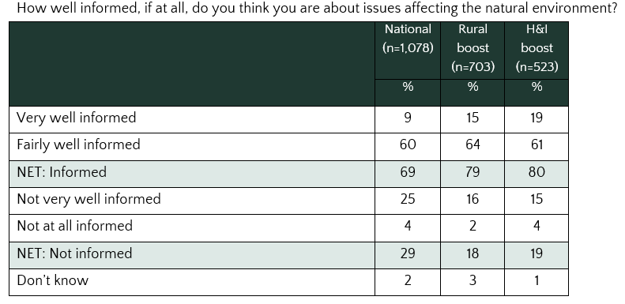

Slide 16
When asked about the phrase ‘nature and biodiversity crisis’:
“I can go along with that.”
“I will say it’s not been widely publicised if that’s the case. I’m sure it is the case in lots of local areas but they’re not really saying how there’s a crisis, what’s causing the crisis, and where it’s happening specifically… We all know there’s climate change…”
“I’ve not seen anything about it, it’s not commonly talked about… I’m only 18… even I’ve noticed there’s a lot less butterflies and bees around since I was a child.”

Slide 17
When presented with State of Nature statistics:
“I didn’t realise it was as bad as this.”
“They don’t surprise me those figures, you just need to drive from Inverness to John o’Groats to see a lot of that.”
“The question for me is have we left it too late to try and reverse that.”
“You don’t hear a lot about Scottish species that are threatened with extinction… You don’t really hear about what’s happening in your local area. We can’t individually do anything about it or try and affect change if we don’t know anything about it.”

Slide 18
What does polling show us?
The public are very concerned about the environment and strongly support climate/nature action
This doesn’t always mean it is a political priority for voters
There are lots of barriers to change and ways of rationalising inaction

Slide 19
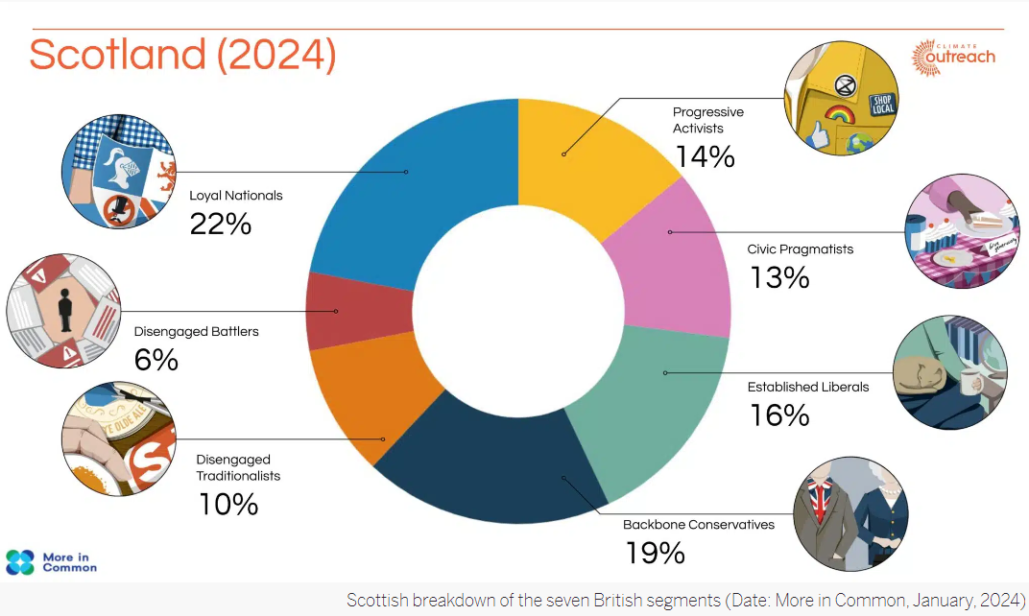

Slide 20
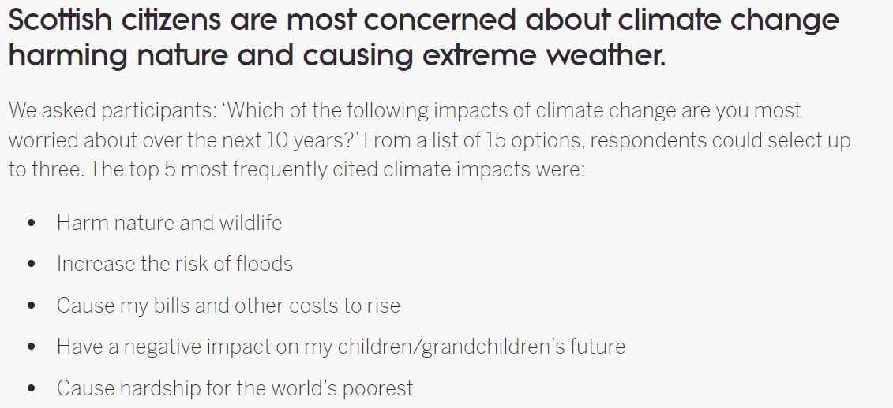

Slide 21
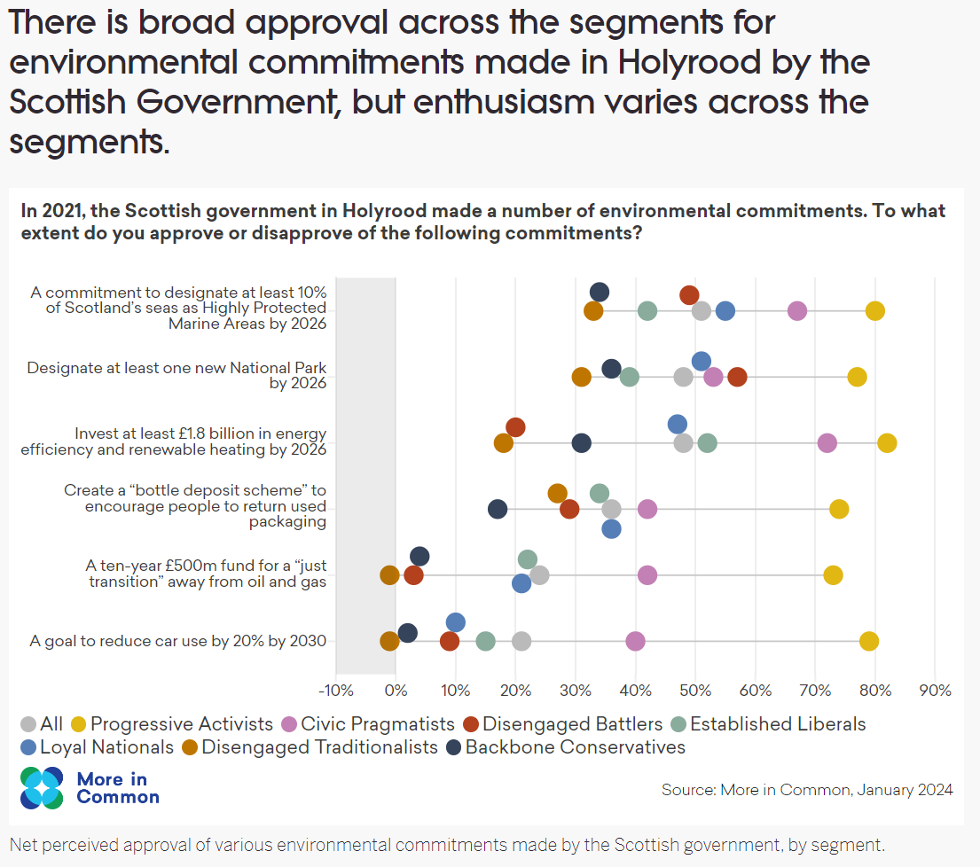

Slide 22
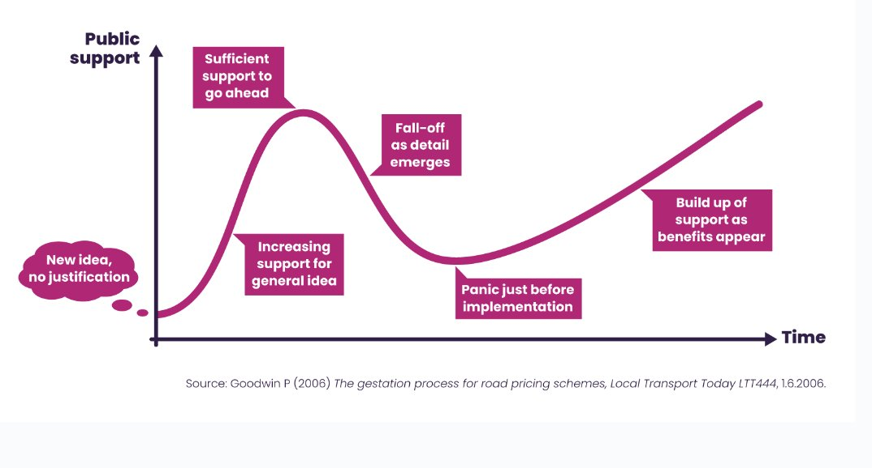

Slide 23
Part 2: Conservation psychology
Conservation psychology involves research on:
Motivating environmentally friendly behaviour
Encouraging people to care about the natural world and their role in it

Slide 24
The ‘Value-Action’ Gap
Researchers used to assume that increasing environmental knowledge would increase pro-environmental behaviour. This was wrong.

Slide 25
The ‘Value-Action’ Gap
Possible explanations for this gap include:
Direct vs. indirect experience – passive learning less likely to encourage change
Normative influences (society, culture, family)
Attitude-behaviour measurement (‘do you care about the environment?’ is broader than ‘do you recycle?’)

Slide 26
Learning from psychology
Top lessons from conservation psychology research:
Use personal or economic frames to discuss issues – highlighting impact on specific individuals, or wider financial self-interest
Reduce psychological distance to issues – emphasise impacts on ‘people like you’, impacts occurring nearby, and impacts occurring now or in the near future
Utilise social norms by highlighting widespread support for the environment and where other people are undertaking pro-environmental behaviour

Slide 27
Framing
‘Framing’ refers to the way we present an argument
This includes the choice of language, the wider context, and the implicit assumptions in an argument
Framing isn’t a one-off “trick” to persuade someone, but a long-term strategy to change attitudes

Slide 28
Framing
Opponents of environmental action will also try to frame issues in ways that benefit them – for example, by talking about jobs, economic impacts, or personal liberty
It is hard to win an argument framed by your opponent!

Slide 29
Framing
“Framing goes deeper than just presenting information in a particular way… ‘all of our knowledge makes use of frames, and every word is defined through the frames it neurally activates.’ These neural pathways are built up over time, conditioning how individuals interpret information. As a result, ENGOs wishing to shift public perception of environmental problems must commit to long-term communication strategies that, over time, can alter how the brain contextualizes these issues… research has largely determined that the oft-used ‘gloom and doom’ frame depicting environmental ruin is ineffective.”
Anspach, N. and Dragujic, G. (2019) ‘Effective advocacy: the psychological mechanisms of environmental issue framing’, Environmental Politics, 28(4), pp. 615 – 638

Slide 30
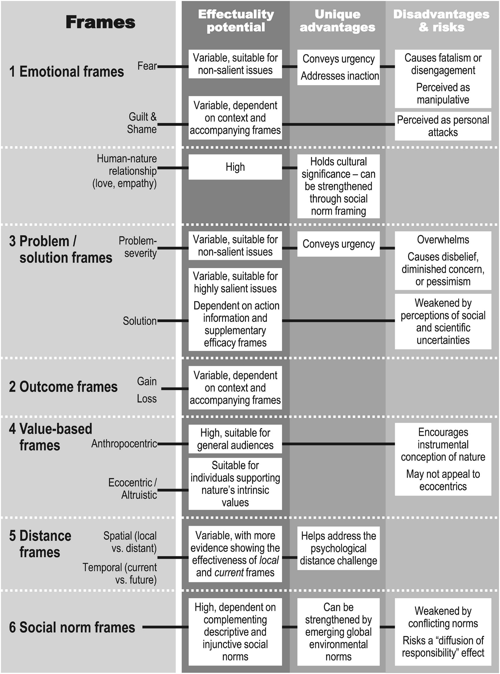

Slide 31
Framing
Research has found that economic or personal frames are most likely to increase support for an environmental campaign.
Personal frames use identifiable individuals to make an issue relatable and reduce psychological distance.

Slide 32
Framing
One study found that emotional responses to climate change have strong associations with support for various policy options.
  Guilt > support for personally costly measures
  Anger > support for regulation
  Hope > support for proactive policy
  Sadness > support for climate justice
  Fear > support for self-protection

Slide 33
Psychological distance
Psychological distance can be temporal (a long time away), spatial (happening somewhere else), or cultural (happening to other people).
When we feel psychologically distant from an issue, we view it abstractly.

Slide 34
Psychological distance
We can close this gap by emphasising environmental impacts on ‘people like you’, in culturally familiar areas, in the present or near future.
Who is our spokesperson? What stories are we telling?
Relatable climate change stories in Scotland are very different from other parts of the world.

Slide 35
Social norms
People often underestimate the consensus around environmental issues – they think other people don’t care.
People are less likely to change their behaviour if it conflicts with social/cultural expectations.

Slide 36
Social norms
Examples in practice:
Highlighting the scientific consensus around climate change is effective
Social media videos with high views are more likely to persuade that ‘most people’ are interested
Believing that other people are contacting government officials will encourage people to do the same

Slide 37
Social norms
Emphasise that good behaviour is widespread and is socially approved!
There can be a ‘boomerang effect’ from highlighting bad behaviour
‘Dynamic norms’ can be used to show an upward trend in behaviour “e.g. in recent years more people are reducing meat in their diet”

Slide 38
Part 3: Messaging
Who is your audience? Who is your messenger?
What medium are you using?
Objectives of a ‘strong message’:
  Motivate supporters
  Win over ‘the persuadables’
  Alienate your opponents

Slide 39
Messaging principles
(NEON)
Open with shared values
Name villains and spell out the impact (example of sewage)
Emphasise unity and collective action to solve problems
Offer solutions, connect people uniting to achieving our vision
Say what you are for not what you are against
Keep it real – would a ten year old understand?

Slide 40
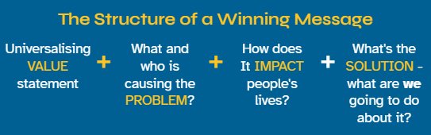
Messaging principles
(NEON)

Slide 41
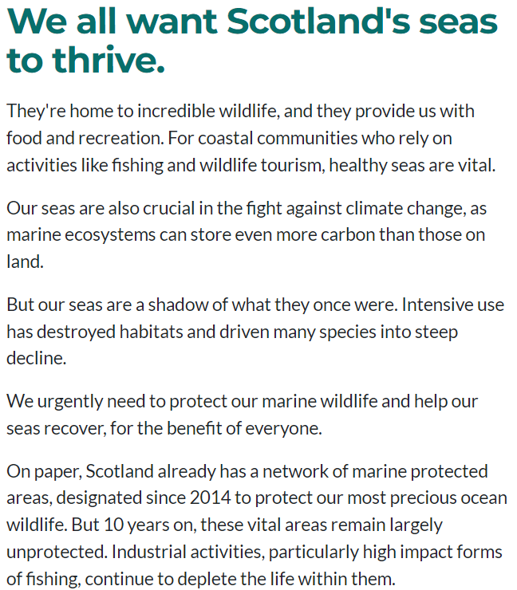
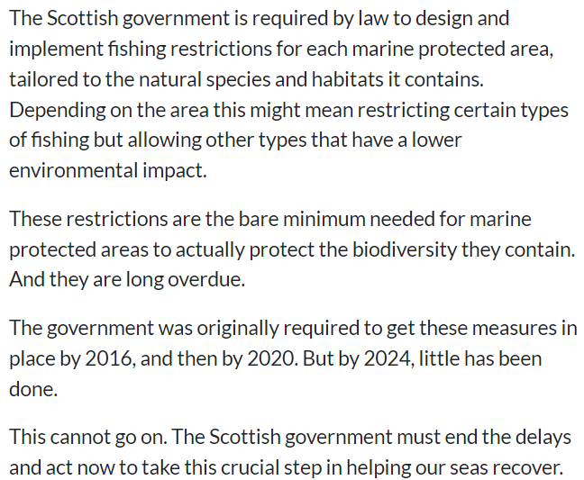
Shared values
Providing solution
Identifying the
problem
Highlighting delay makes answers seem ‘normal’ – we aren’t asking for something new, just what should already be in place!

Slide 42
Bringing it all together
People love nature – be confident we can appeal to pro-environmental sentiment (shared values)
Make your arguments relevant to your audience – people like you, communities like yours, today/in the near future
Appeal to positive social norms

Slide 43
Bringing it all together
Identify problems and offer solutions
Use trusted and trustworthy messengers
Respect nuance and sensitivities underneath broad support for nature

Slide 44
And remember…
It’s a long-term game!
Don’t panic about short-term pushback…
Do try to set the agenda and own the issue

