Slide 1
From Awareness to Action: Tools for effective bystander intervention
Jo Yuen (they/them)
Founder, Anti-Oppression Trainer, JYP Consultancy

Slide 2
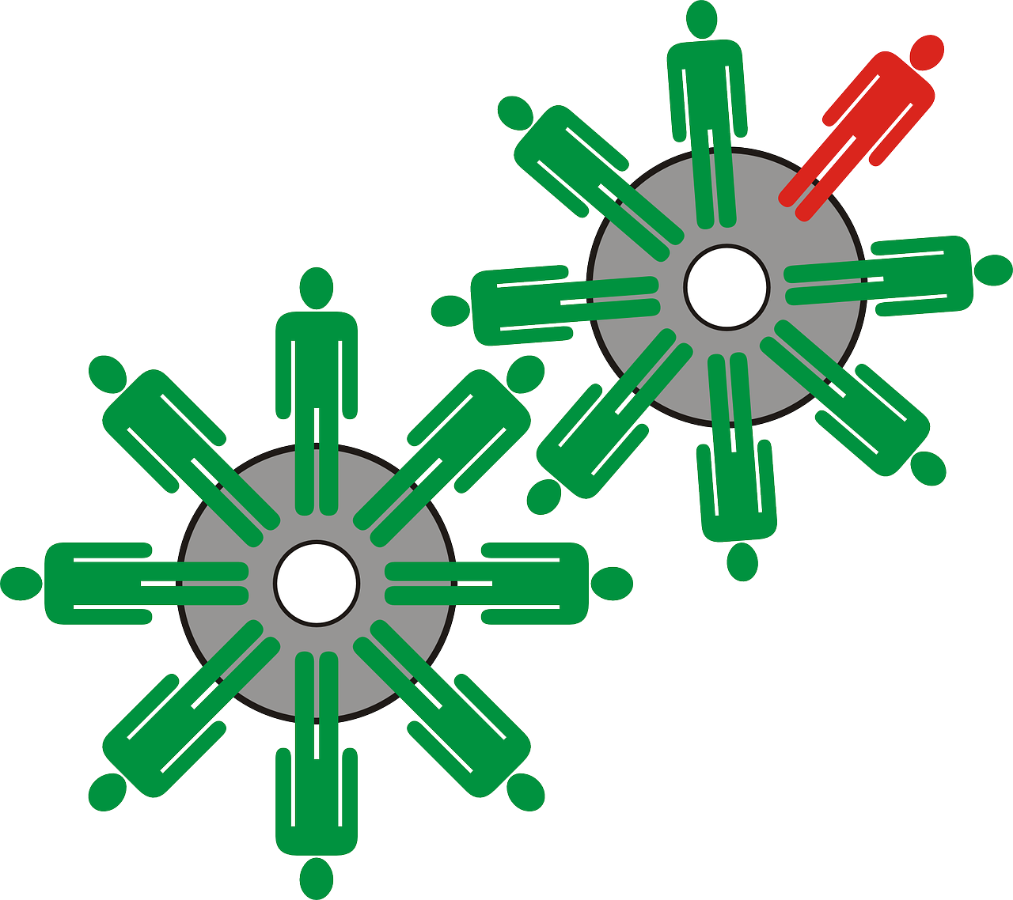
Today’s session
Understand microaggressions, their impacts, and the role of power dynamics.
Learn options for bystander intervention and how they work.
Build confidence in responding by evaluating scenarios and interventions.

Slide 3
Working Agreement
Listen to each other with respect.
Listen to understand others.
Commit to learning, not debating.
Be mindful of power dynamics.
Respect confidentiality.
Speak from your experiences; speak from “I”.
No expectation to share your experiences.
Taking risks – participating, making mistakes is part of learning.
Supportive and challenging.
Free to leave/return without explanation.

Slide 4
Introductions
Name
Pronouns (optional)
1 word to describe how you are feeling

Slide 5
What are microaggressions?
A statement, action, or incident regarded as an instance of indirect, subtle, or unintentional discrimination against members of a marginalised group such as a racial or ethnic minority.
Verbal, behavioural, or environmental slights.
Often automatic and unintentional.
Typically occur due to underlying biases and prejudices outside of awareness.
Occur in brief instances on a daily basis.
Communicate hostile, derogatory, or negative viewpoints.
Can exclude, negate, or nullify an individuals’ thoughts or feelings.

Slide 6
How microaggressions are like mosquito bites
Video link

Slide 7
Activity: exploring impact of microaggressions
Groups of 3-4 (20 mins)
Discuss the example microaggressions on the cards.
Put yourself in the marginalised person’s shoes – if you were to hear/see/experience this everyday, what is the message that you receive?
Discuss the impact of the underlying messages of each microaggression.
Focus on understanding from the marginalised person’s point of view, not the intention of the micro-aggressor.

Slide 8
When it happens to you
Did I interpret that correctly?
Did she say what I think she said?
What did he mean by that?
Should I say something?
Saying something may make it worse.
They’ll probably think I’m overreacting.
Speaking up is going to hurt more than it helps.

Slide 9
BREAK

Slide 10
The 5 Ds of Bystander Intervention
Quick, practical strategies to step in when you see harm happening.
Different situations call for different strategies.
No one-size-fits-all.
Your safety and the impacted person’s safety come first.
🌀
Distract
🛎️
Delegate
📷
Document
⏳
Delay
✋
Direct

Slide 11
Distract
Interrupt the situation without directly confronting the person causing harm.
Good for: De-escalating tension and protecting safety.
Examples:
Drop something nearby.
Ask for directions.
Start an unrelated conversation.
🌀
Distract

Slide 12
Delegate
Get help from someone else – staff, security, a leader, another bystander.
Good for: When you don’t feel safe stepping in directly.
Examples:
Find someone with authority.
Ask another bystander to assist.
🛎️
Delegate

Slide 13
Document
Record what’s happening (with permission) to support the person being harmed later.
Good for: Creating a record, if safe and respectful.
Examples:
Take notes.
Record video (only if safe).
Share documentation with the harmed person – not on social media without consent.
📷
Document

Slide 14
Delay
Check in after the incident if it’s not safe to intervene during.
Good for: Showing care and supporting healing even after harm.
Examples:
“Are you okay?”
“I saw what happened – that wasn’t right.”
“Can I help you report it or find support?”
⏳
Delay

Slide 15
Direct
Speak up in the moment to address the harm.
Good for: When you feel safe and able to be clear and firm.
Examples:
“That’s not appropriate.”
“Please stop – that’s not okay.”
“Let’s move on from that comment.”
✋
Direct

Slide 16
Starter scripts for Direct interventions
“Hey, I know that was meant kindly, but comments like that can sometimes feel a little off.” (Then redirect: “Let’s focus on [their contribution/event details] instead.”)
“Just so you know, I really appreciate your ideas/your being here.” (Centres the person instead of the harm.)
Sometimes comments like that can unintentionally make people feel othered. Let’s keep it welcoming for everyone.” (Naming the impact without blaming.)
“Let’s keep it focussed on [skills/ideas/why we’re here]!” (Gentle nudge without big confrontation.)
✋
Direct

Slide 17
Choosing the right strategy
How do you choose?
Context:
Is it escalating? Public or private? Are you safe?
Power dynamics:
Who has more power (e.g. authority, social status)? Will a direct approach make it worse?
Safety:
Protect yourself and the person harmed.
Impact:
Focus on supporting the person harmed, not punishing the person causing harm.

Slide 18
No “Perfect” Intervention
🌀
Distract
🛎️
Delegate
📷
Document
⏳
Delay
✋
Direct
Any supportive action is better than silence.
You don’t have to fix everything – even small actions can show care, shift group dynamics, and reduce harm.

Slide 19
Quick discussion
Why do you think people hesitate to intervene?
Which D feels most natural to you – and why?
Is there a D that feels more difficult/uncomfortable for you? Why do you think that is?

Slide 20
Activity: Scenario analysis & response planning
Groups of 3-4 (15 mins)
Read your assigned scenario, discuss and plan:
Identify the harm:
What’s happening? Who is impacted?
Discuss interventions:
Choose 2-3 possible responses (using the 5 Ds)
Analyse options:
What are the pros and cons of each response?
Think about risks, power dynamics and potential impact.
Nominate someone to share their screen in the breakout room and type up notes.
Write up your notes on the shared Google doc – be ready to share with the wider group!

Slide 21
Key takeaways
Microaggressions cause harm – even when unintentional.
You have tools: 5 Ds = 5 ways to step up.
Courage + care > perfection.
Small interventions = real change.
What’s one thing you’re taking away from today’s session?

Slide 22
Links
Allyship resources
Feedback form

Slide 23
Questions?
Contact us at info@jypconsultancy.co.uk

