Slide 1
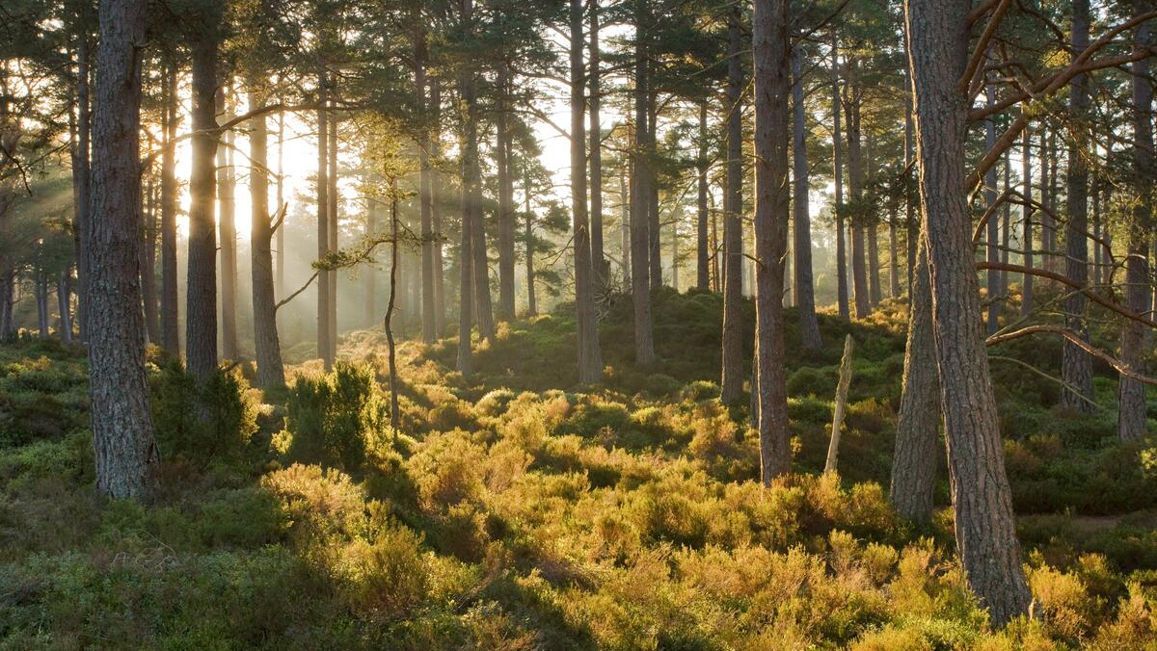
Diversity, Equity & Inclusion
in communications
© ScotlandBigPicture.com/ WWF-UK

Slide 2
What we’ll cover today
WWF Scotland’s approach to DE&I in our communications
Our DE&I charter – how we developed it and why
Social media – hints, tips and how tos
© naturepl.com / Alex Mustard / WWF

Slide 3
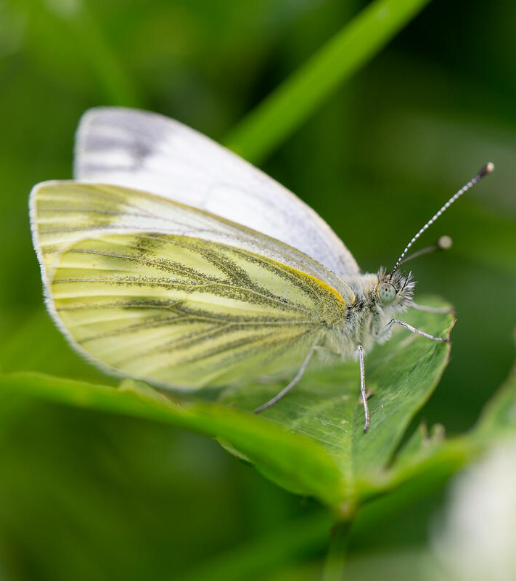
About us
WWF Scotland is a small team working on climate and nature policy and restoration projects
We’re part of WWF-UK and together we have been on a journey to improve our DE&I for a few years
We’re not experts on accessible and inclusive comms – but it’s important to us and we make a point to learn and do our best
© David Bebber / WWF-UK
Image Credit XXX

Slide 4
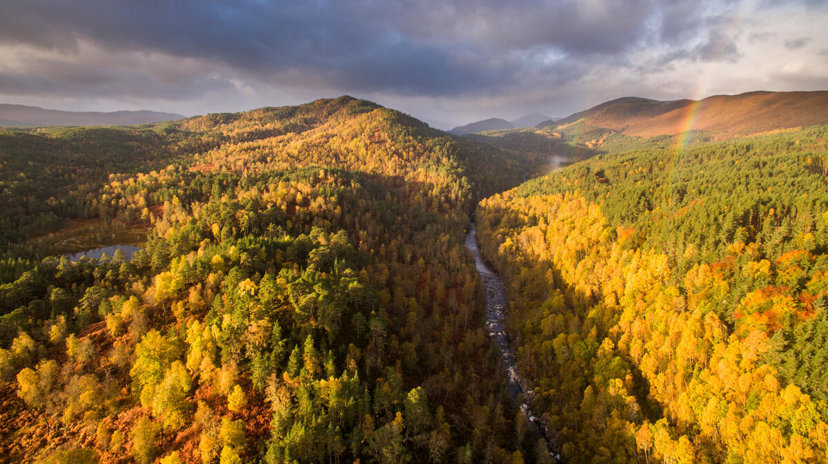
Why do accessible & inclusive communications matter?
© ScotlandBigPicture.com/ WWF-UK

Slide 5
Not just the right thing to do, the smart thing too!
Firstly, why are you communicating? Why are you posting that social media post, blog or newsletter?
We don’t just want to transmit info, we want it to be understood. But not just understood. We want it to resonate with our audience so they do something with it – know something, feel something, do something.
To do this you need to remove barriers – whether that’s the language you’re using, the images, or the way you’re sharing your message. You need to make sure you’re not unintentionally excluding any groups of people.
The good news is, if you’re getting inclusion and accessibility right in your comms – you’re probably getting the rest of it right too. Win win!
Image Credit XXX

Slide 6
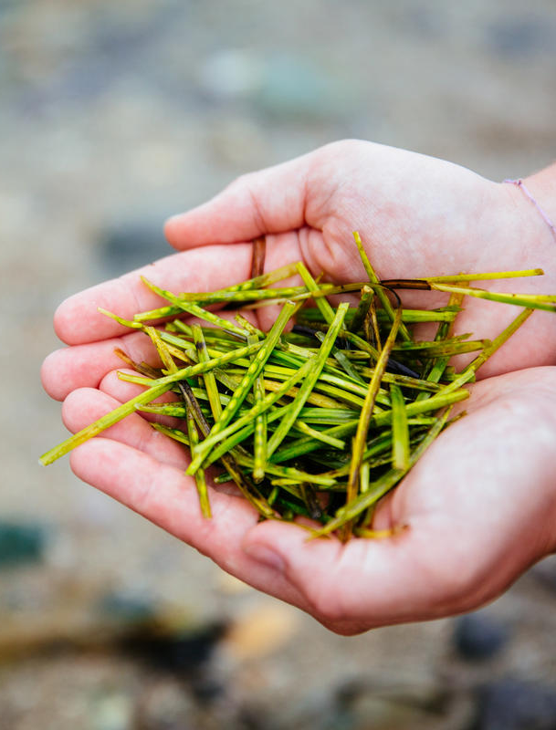
Where we were
We knew as a team we were committed to DEI and making our comms as inclusive and accessible as possible.
We were all talking about DEI, learning about it, and trying to embed it in our work.
But we needed something that gave us focus and a shared understanding of what that meant for us.
Something practical that gave us direction.
© Greg Armfield

Slide 7
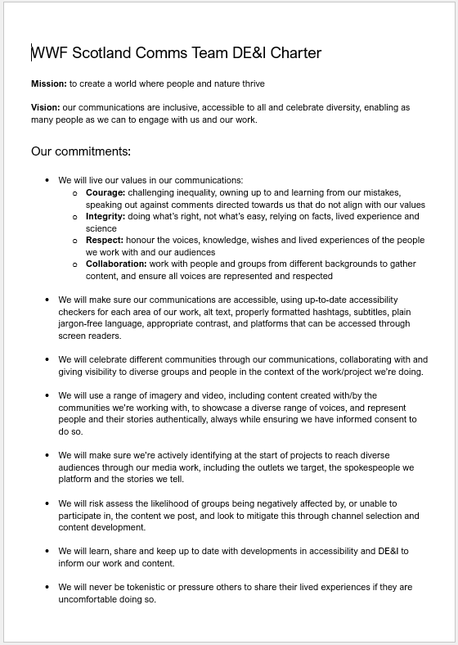
Comms DE&I charter
We created a “charter” – a shared set of principles and actions based around “we will always” and “we will never” statements that fit on one page.
We worked on it as a team so everyone understood and could use it in their work
We centred it around our organisational mission, values and DEI strategy so it spoke directly to our work
We created an action plan to go with it so we were accountable.
Image Credit XXX

Slide 8
Mission: to create a world where people and nature thrive
Vision: our communications are inclusive, accessible to all and celebrate diversity, enabling as many people as we can to engage with us and our work.
Image Credit XXX

Slide 9
Our commitments:
We will live our values in our communications:
Courage: challenging inequality, owning up to and learning from our mistakes, speaking out against comments directed towards us that do not align with our values
Integrity: doing what’s right, not what’s easy, relying on facts, lived experience and science
Respect: honour the voices, knowledge, wishes and lived experiences of the people we work with and our audiences
Collaboration: work with people and groups from different backgrounds to gather content, and ensure all voices are represented and respected
Image Credit XXX

Slide 10
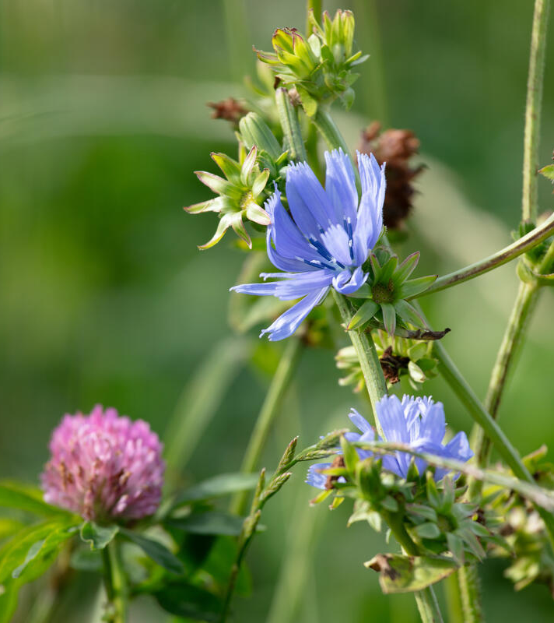
What helped us
Setting out why it matters to us
Talking through what accessibility and inclusion in our comms meant to us
Mapping that to our audience and how do they engage with us
Figuring out what we can do now, and what we would have to develop or learn – and how/who would do that
© David Bebber / WWF-UK
Image Credit XXX

Slide 11
Why?
“Social media accessibility means that everyone can join in the conversation and the weird and wonderful things that take place online. It's a love note that says, ‘we want you here too’.” RNIB

Slide 12
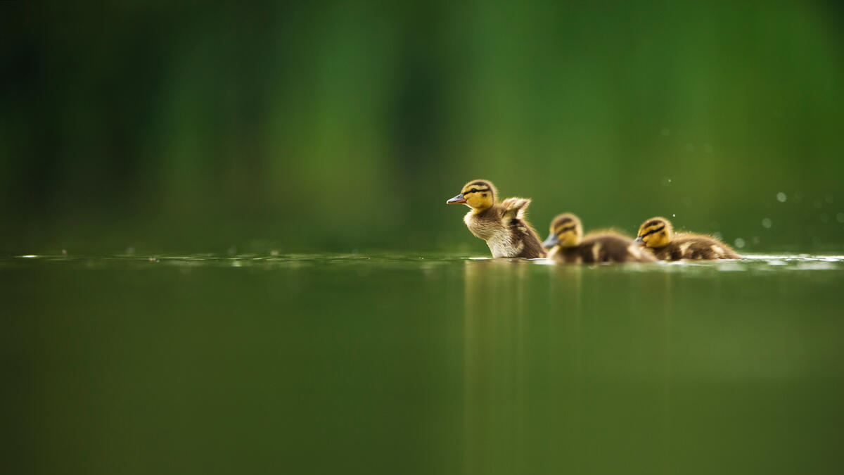
Progress over perfection
© Andrew Parkinson

Slide 13
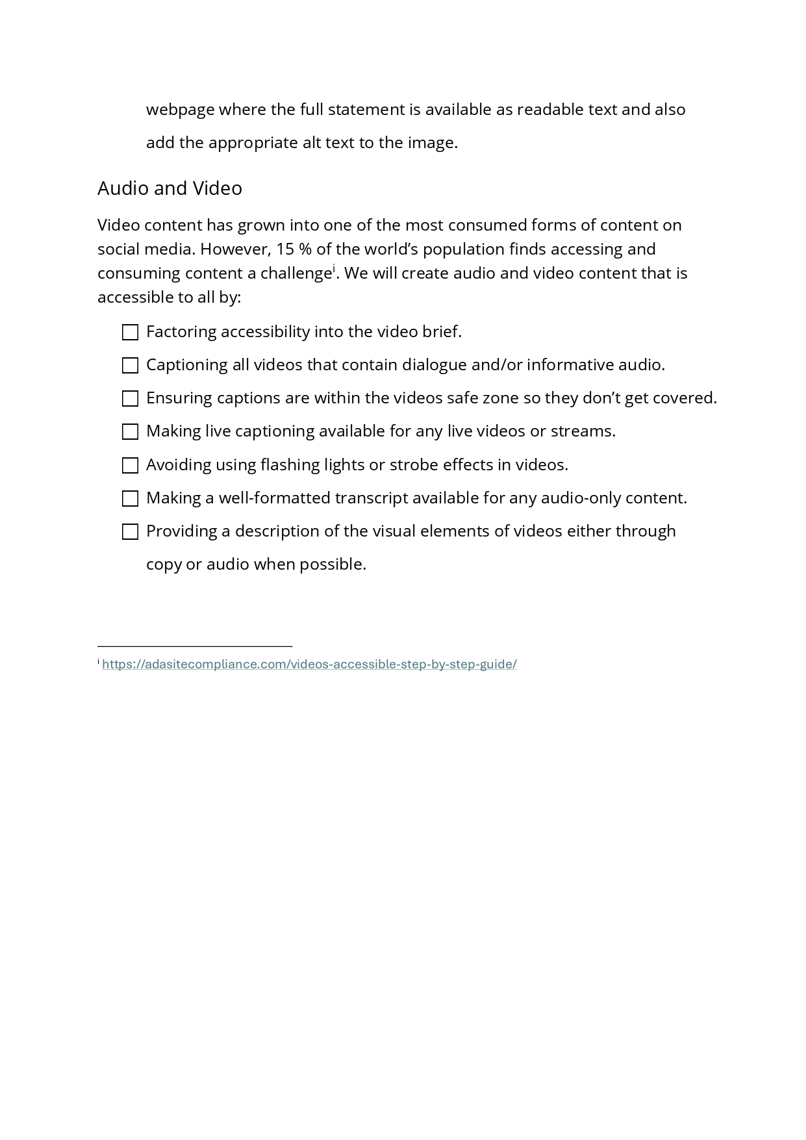
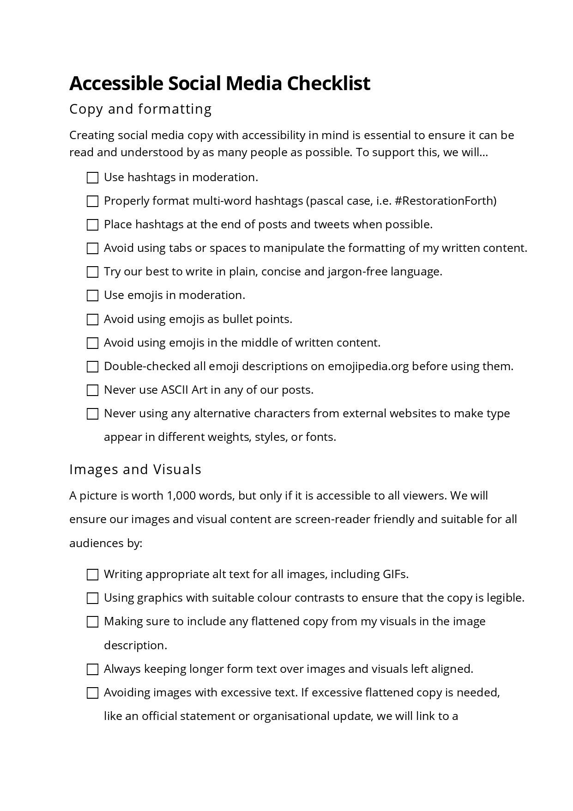
Our social media checklist
For checklist guidance:
RNIB
accessible-social.com

Slide 14
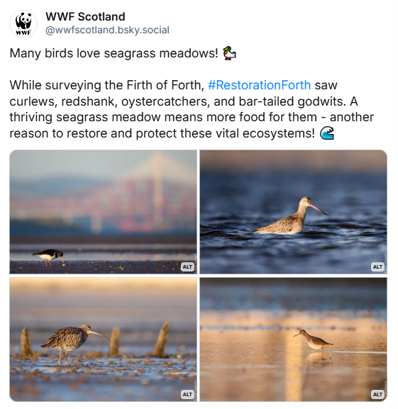
Use properly formatted hashtags, using pascal case or camel case. For example, #RestorationForth
Copy and formatting
Write in plain, concise, jargon-free language. Check difficult to read sentences on hemingwayapp.com
Use emojis in moderation, not as bullet points and check their descriptions before use on emojipedia.org.

Slide 15
Images and visuals
Write appropriate and descriptive alt text for images and GIFs
Check colour contrasts pass for good readability by using a site like colourcontrast.cc
Avoiding longer form text over images and visuals and keeping text left aligned

Slide 16
Alt text for James Webb Telescope image
"A starfield is speckled across the image. They range from small, faint points of light to larger, closer, brighter and more fully resolved stars with eight-point diffraction spikes. The upper-right portion of the image has wispy, translucent, cloud-like streaks rising from the nebula."
NASA, ESA, CSA, and STScI

Slide 17
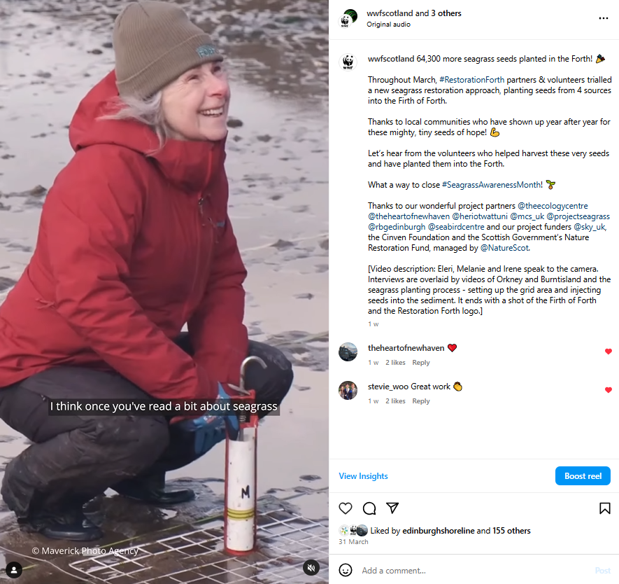
Audio and video
Include written video description alongside video to highlight visual elements
Factor accessibility into the video brief
Add captions to videos (within safe zones) that have dialogue / informative audio

Slide 18
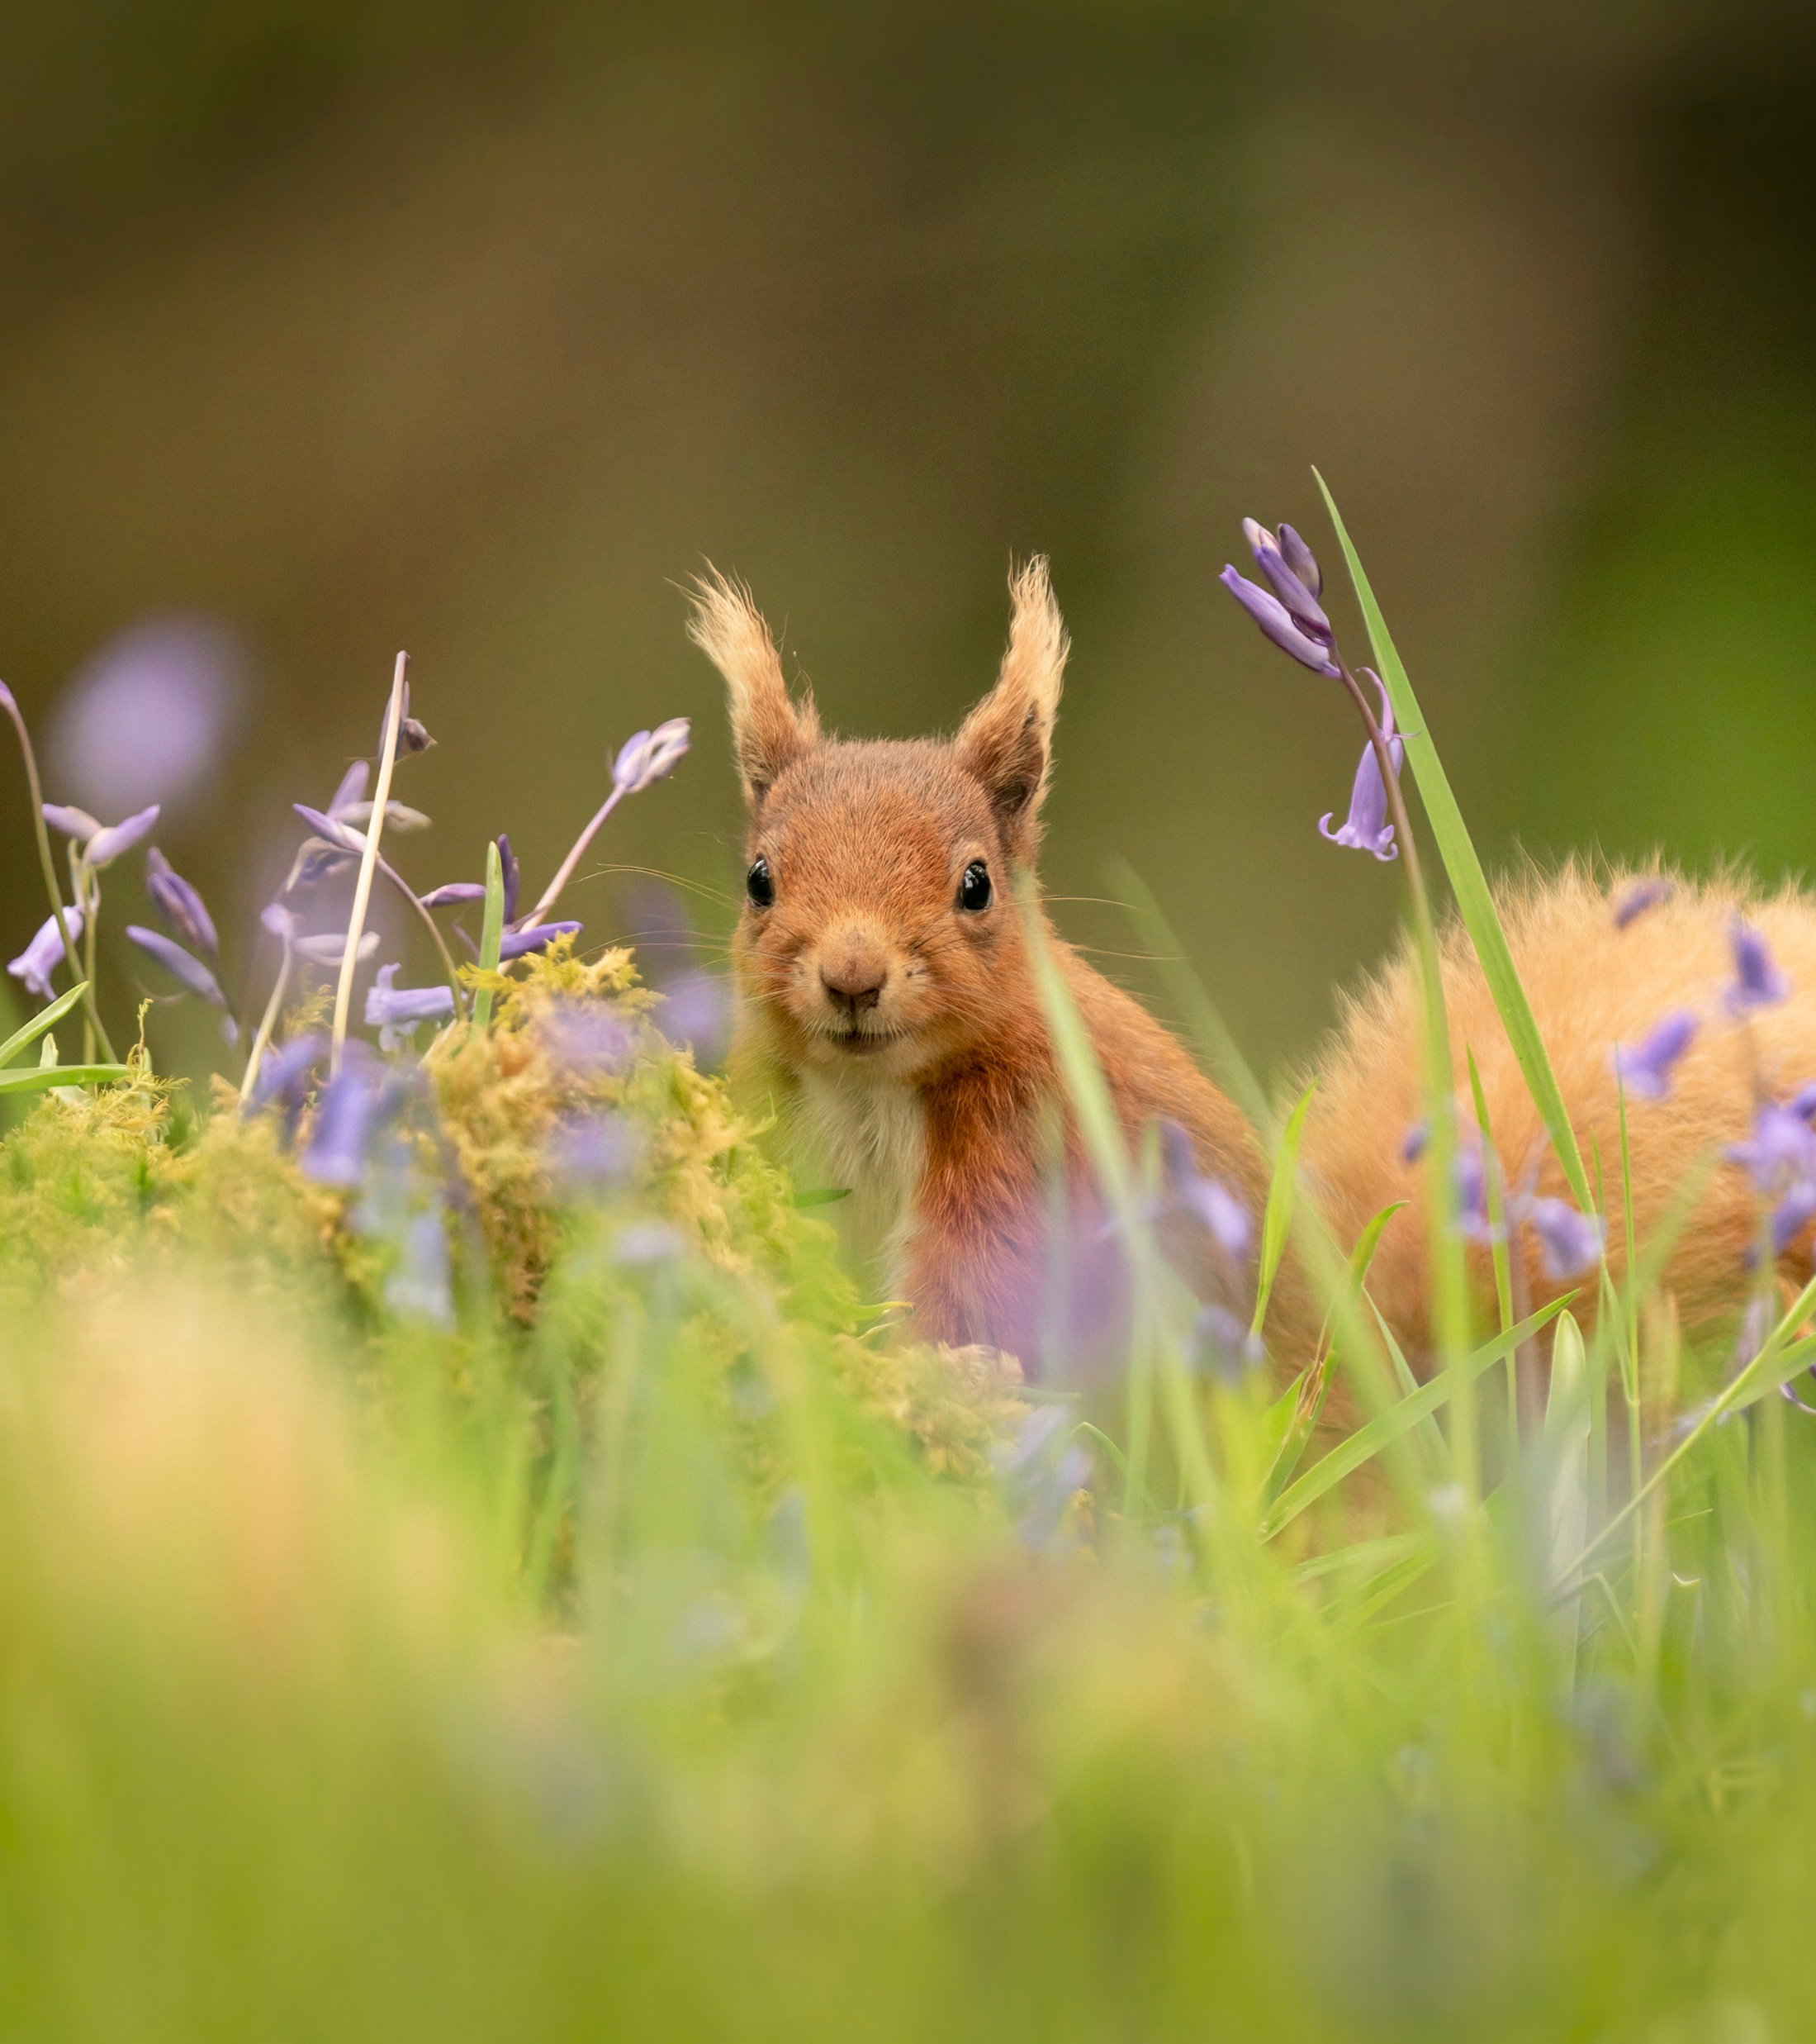
Task
Create a social media post about something you’ve learnt during LINK’s DE&I fortnight.
This could be a reflection, a tip for others or putting something you’ve learnt into practice.
Feel free to share your idea in the chat if you wish.
© Karin Greevy / Shutterstock.com / WWF-UK

Slide 19
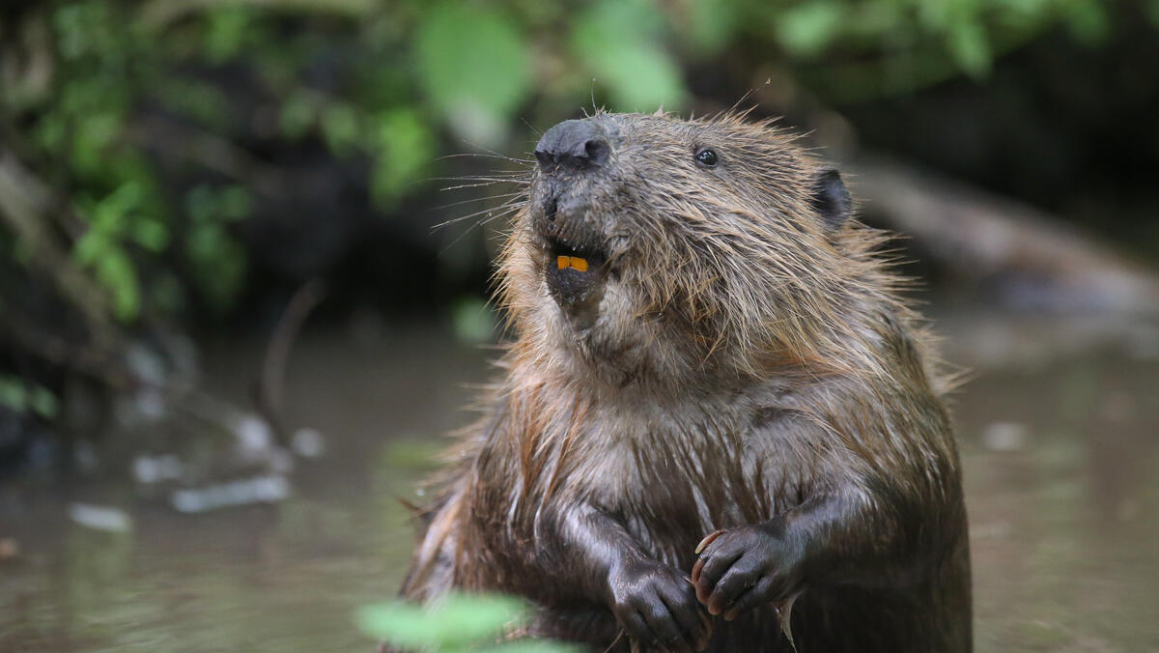
Questions?
© Jonathan Lewis

Slide 20
Helpful links
Leonard Cheshire accessible, inclusive communications and team training
RNIB’s tips to make for accessible social media
Guidance on Microsoft's accessibility checker

