Slide 1
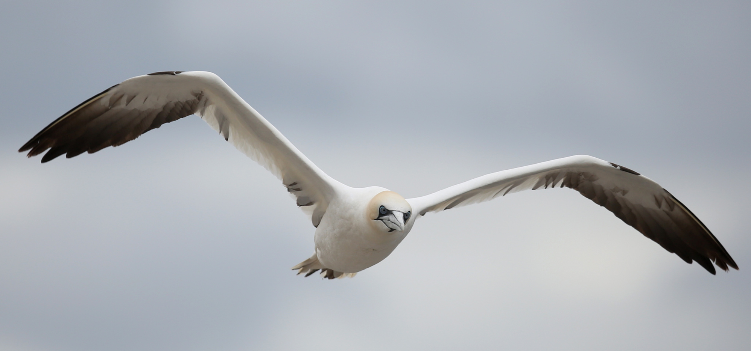
New to Nature at the Scottish Seabird Centre
Emily Burton, Senior Conservation Officer
Image: Northern Gannet
© Paul Hackett

Slide 2
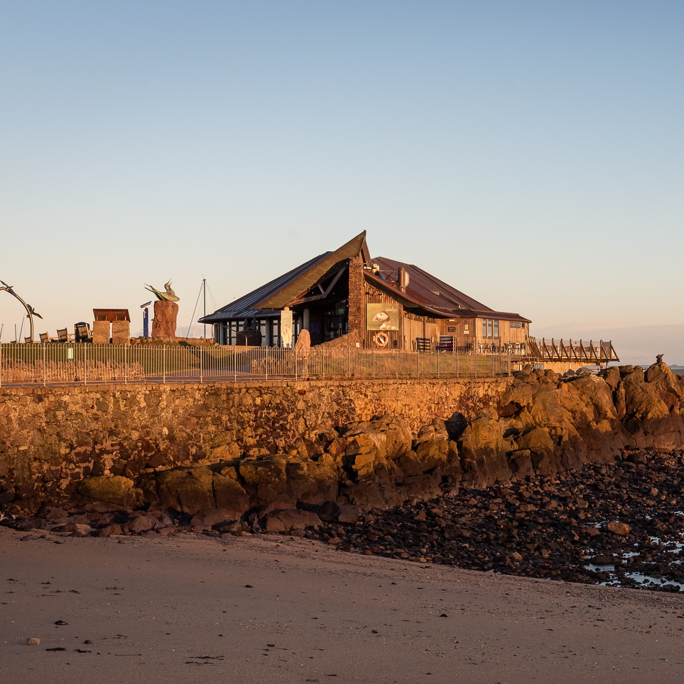
.
The Scottish Seabird Centre
Marine conservation & education charity
Image: Scottish Seabird centre building at sunrise.
Vision: Scotland’s marine environment is healthy, wildlife-rich, valued and enjoyed by all.
Purpose: Inspiring, educating and motivating people to care for Scotland’s marine environment.
© Jamie McDermaid
Notes:
Who are we? Where are we?

Slide 3
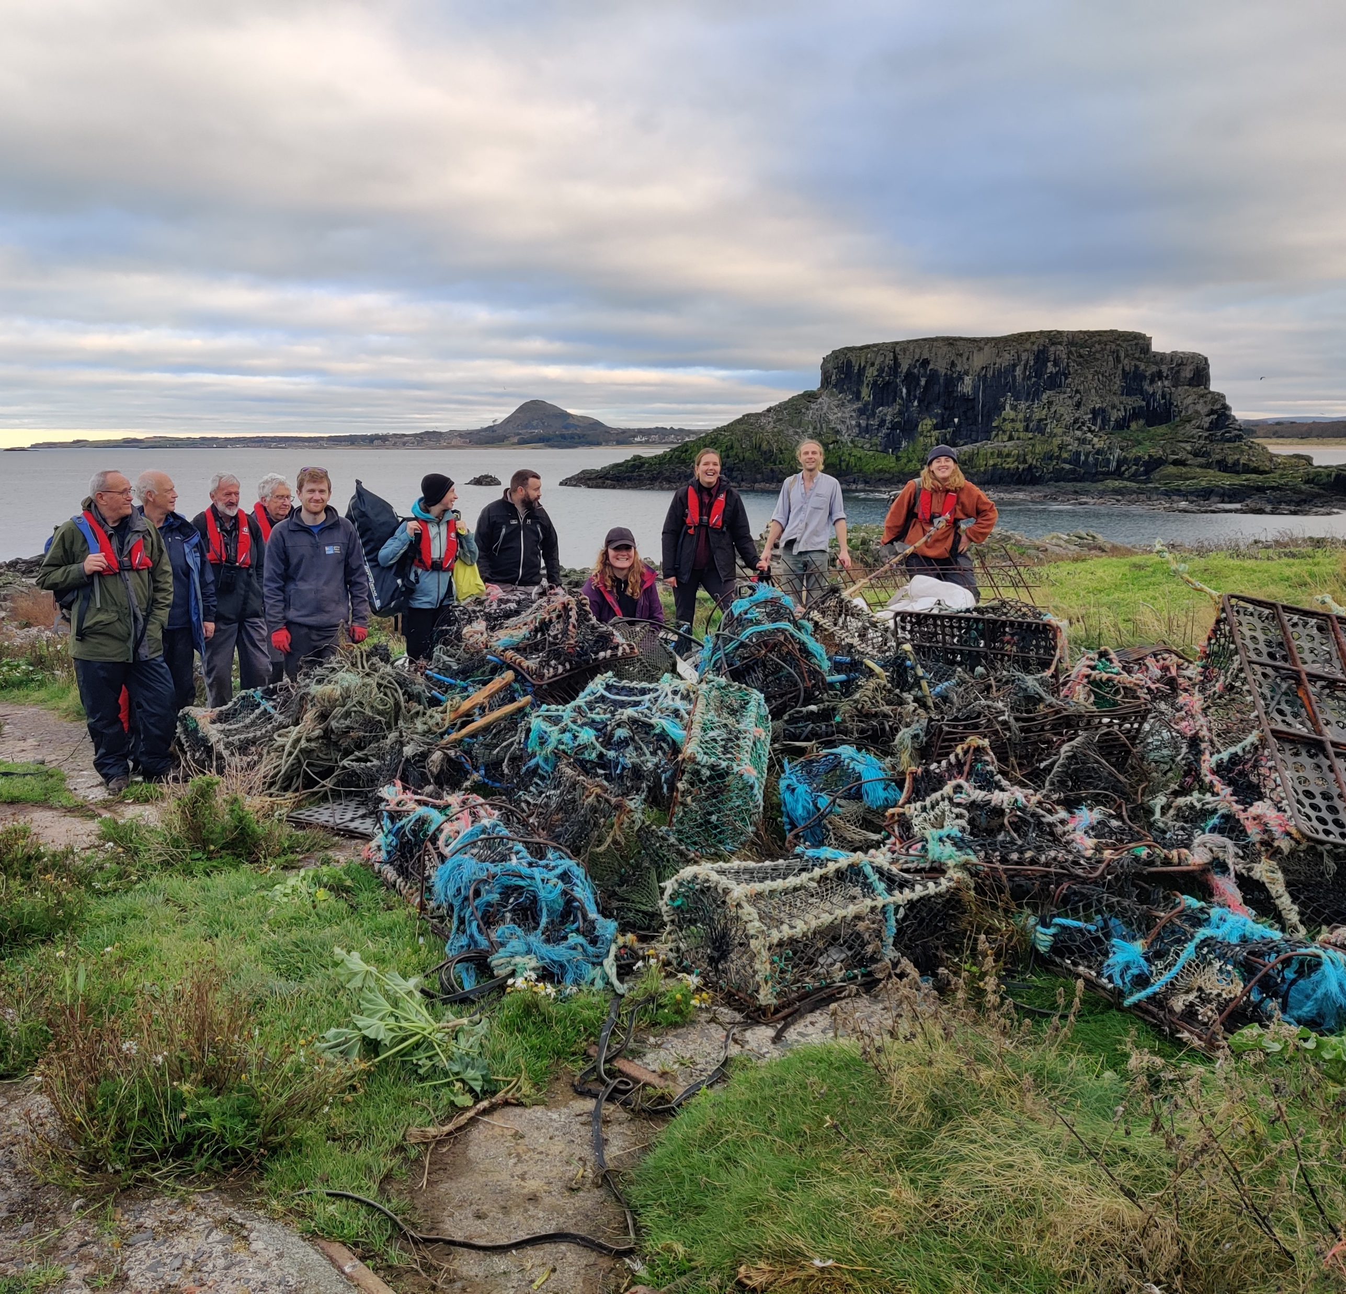
Pillars of our work
Image: Volunteers with a pile of discarded creels.
Conservation
Education
Community
Experience
© Kerry Flockhart

Slide 4
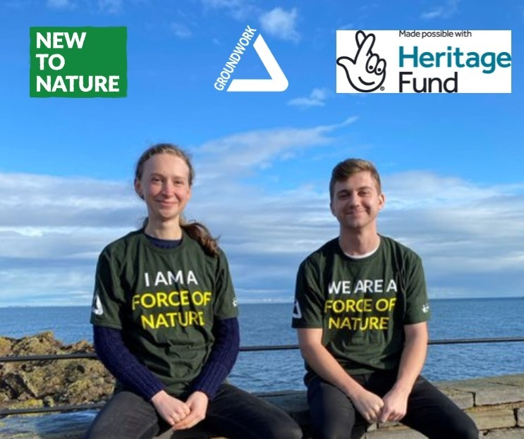
New to Nature Roles
Image: New to Nature trainees Emma and Jamie
Conservation Assistant
Communications Assistant
© Emily Burton

Slide 5
.
Conservation Assistant
Image: Emma checking biosecurity box on an island.
Beach clean-up and citizen science activities for volunteers.
Habitat management projects on our local seabird islands.
Wildlife tours along the local coastline.
Blogs, video content, and social media.
© Kerry Flockhart

Slide 6
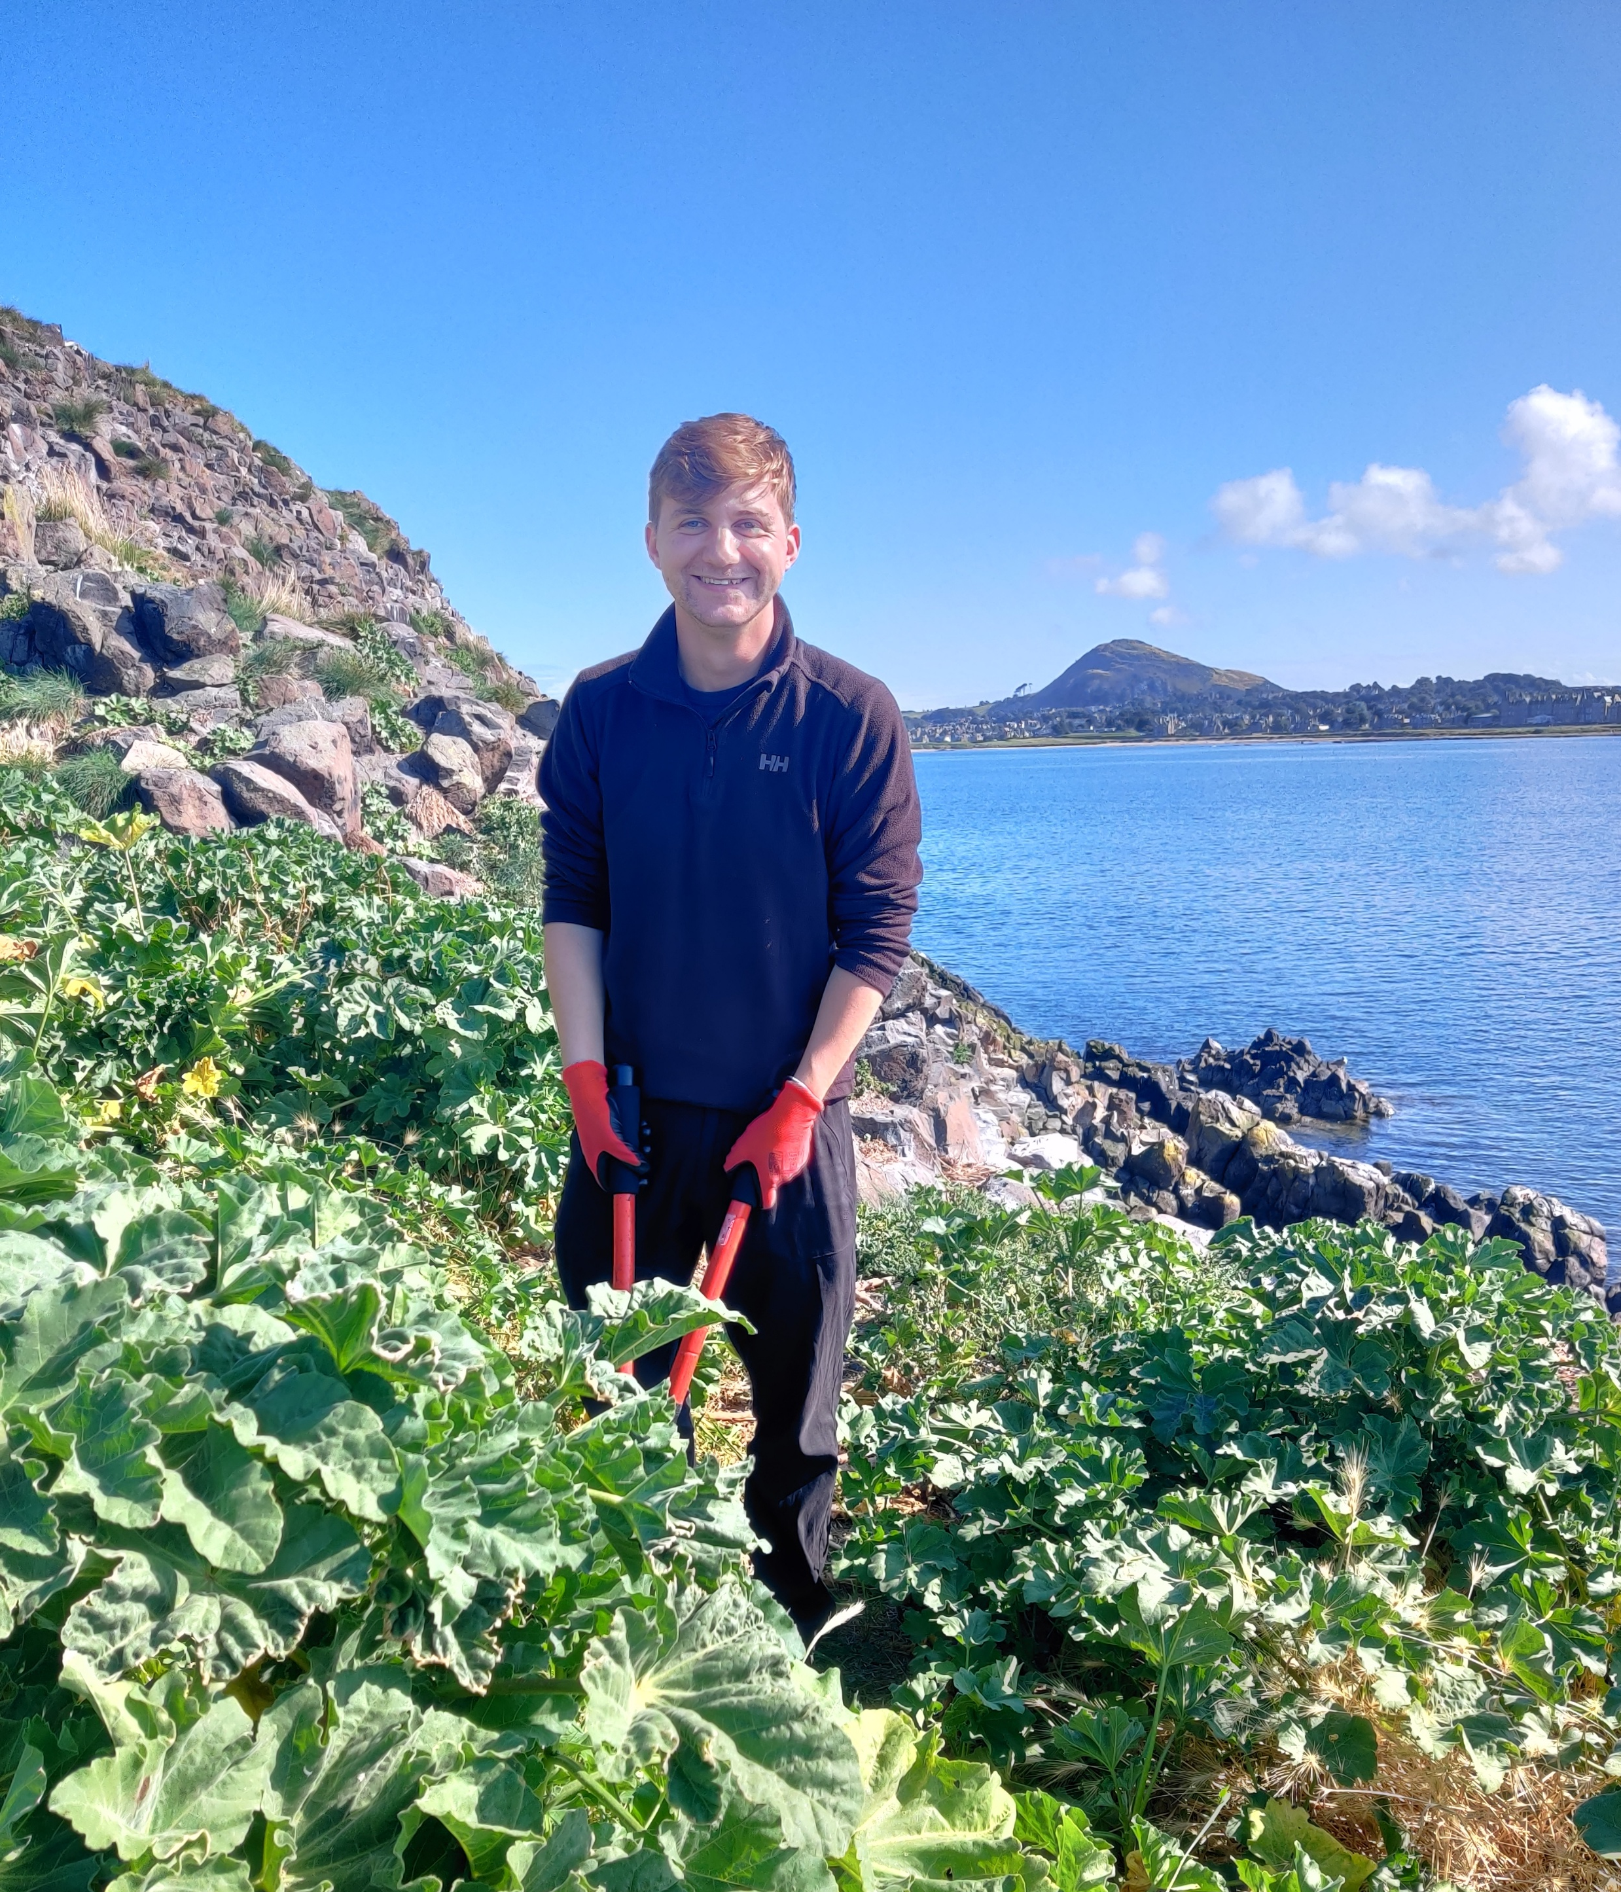
.
Communications Assistant
Image: Jamie tackling invasive plants on an island.
Creative social media content.
Newsletters, blogs, website, events promotion and press releases.
Images and footage to celebrate our wildlife and our work.
© Emily Burton

Slide 7
Recruitment
Key lessons learned
Image: Guillemot
Reducing bias throughout recruitment.
Racial Equity in Nature – Toolkit
Writing the role and considering reasonable adjustments.
Creating an application focused on a few essential questions, with options to apply in different formats.
© Emily Burton

Slide 8
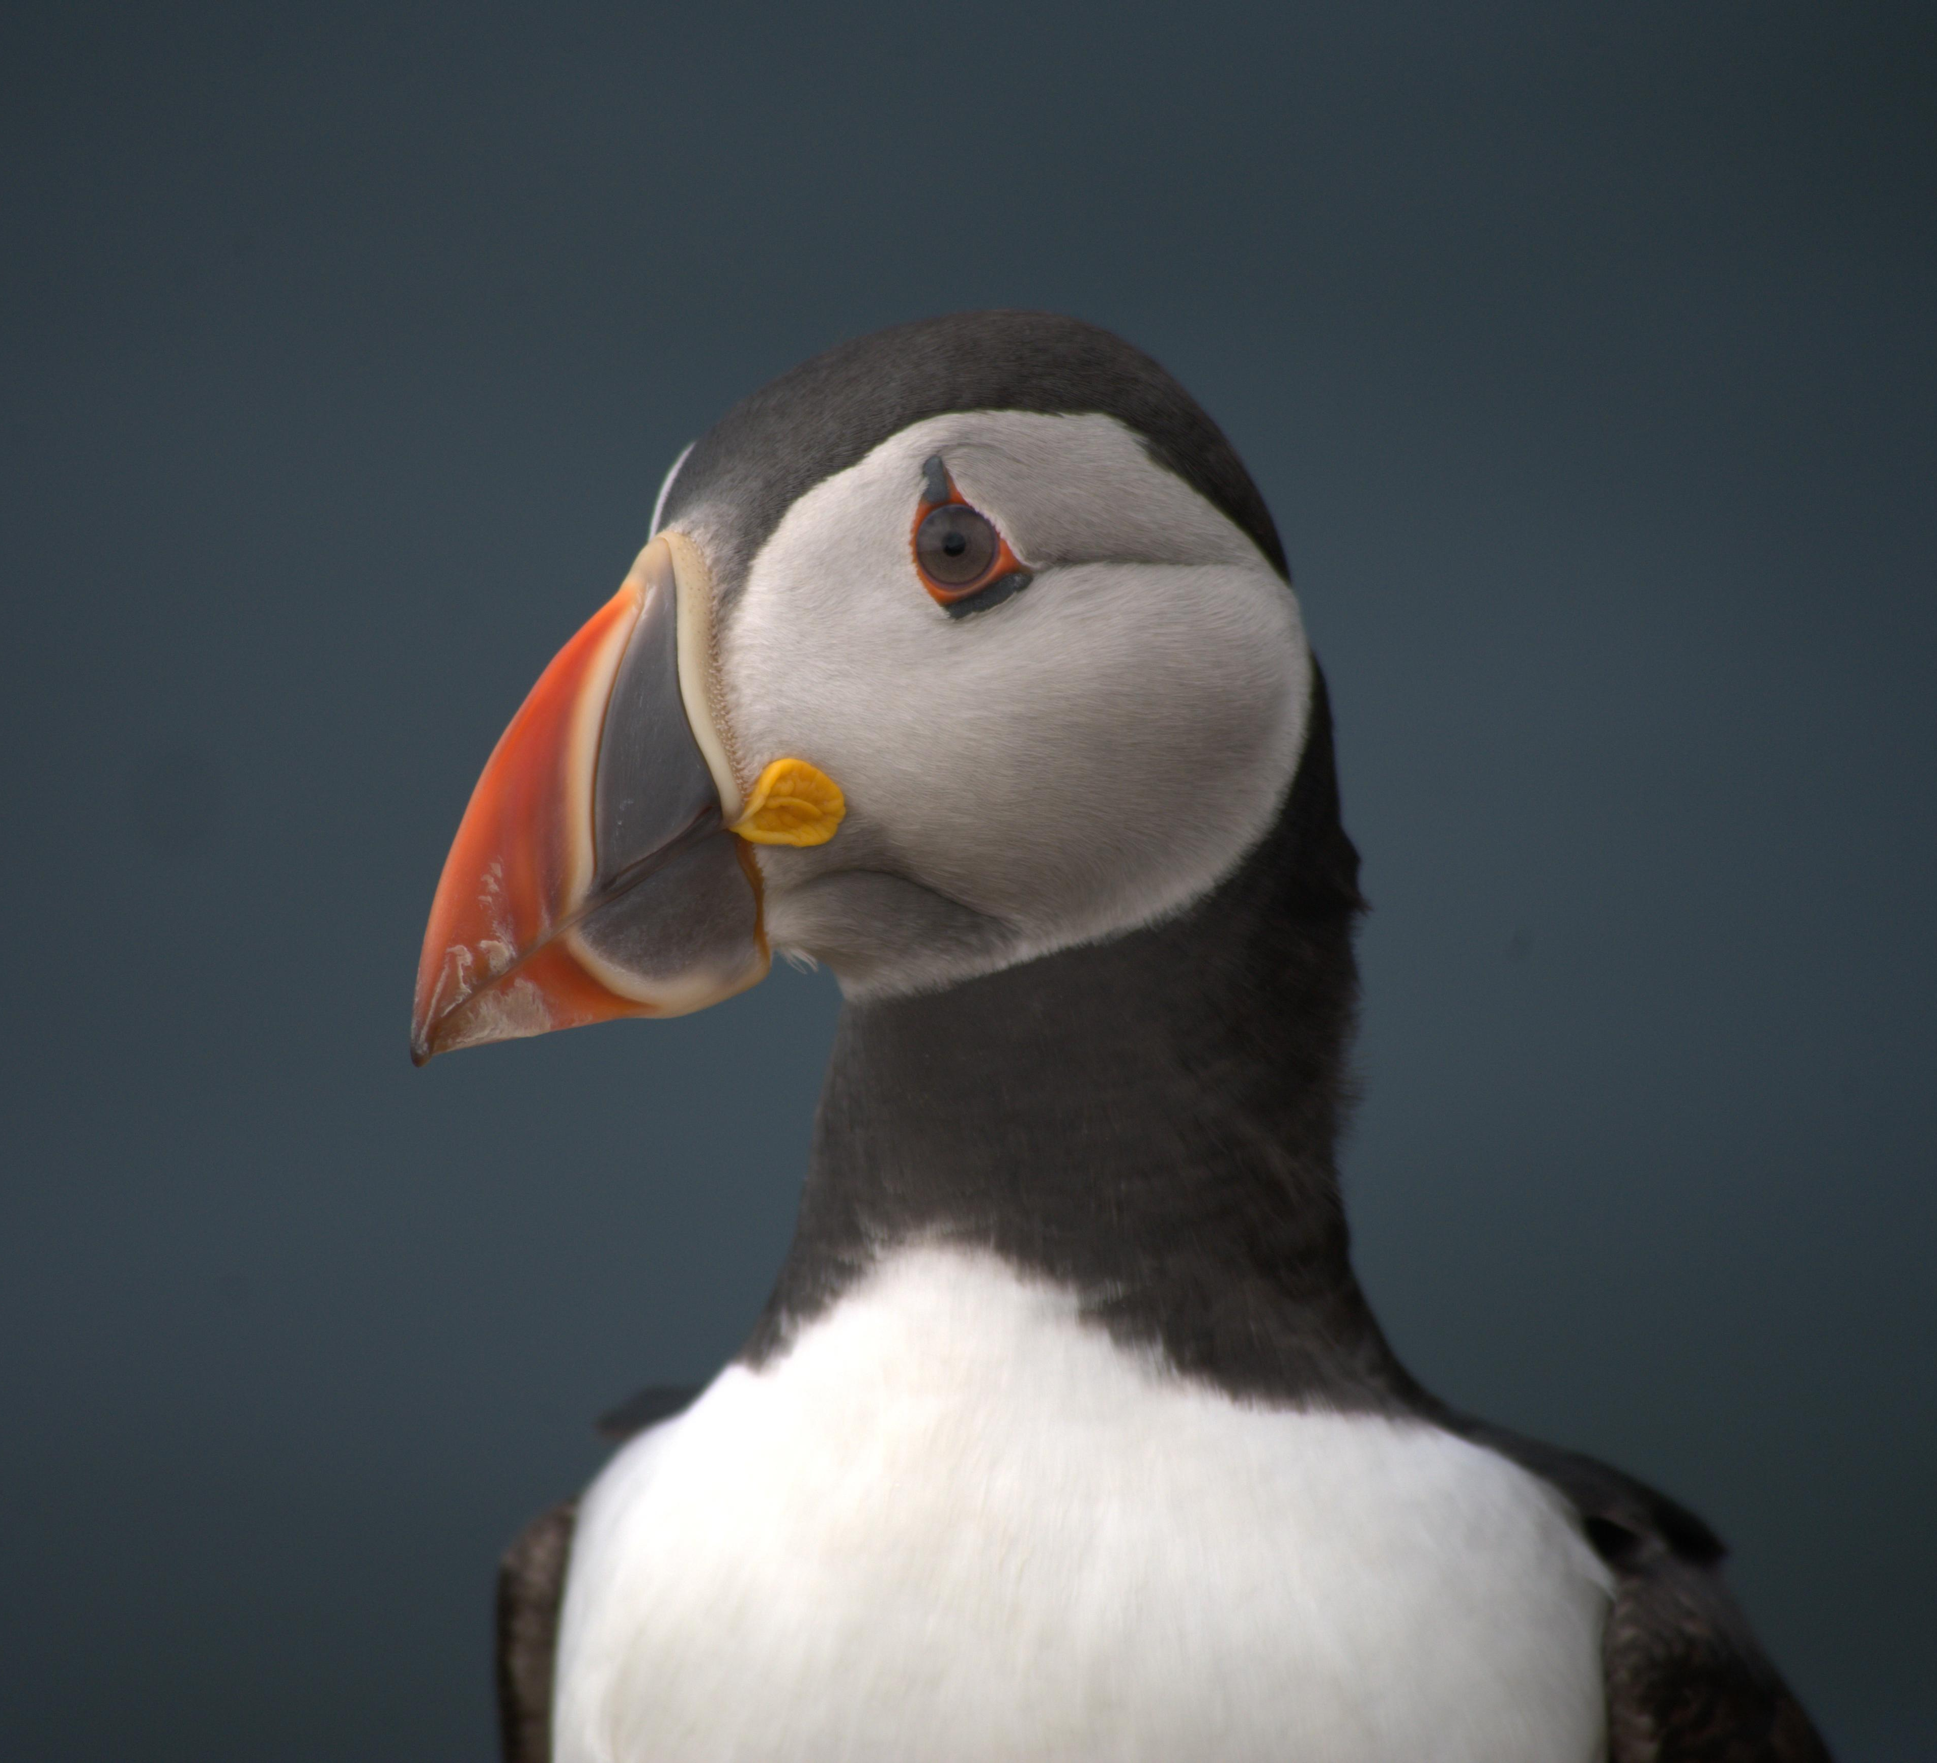
Recruitment
Key lessons learned
Image: Puffin
Positive action during promotion of the role.
Shortlisting
An informal and flexible interview process.
© Emily Burton

Slide 9
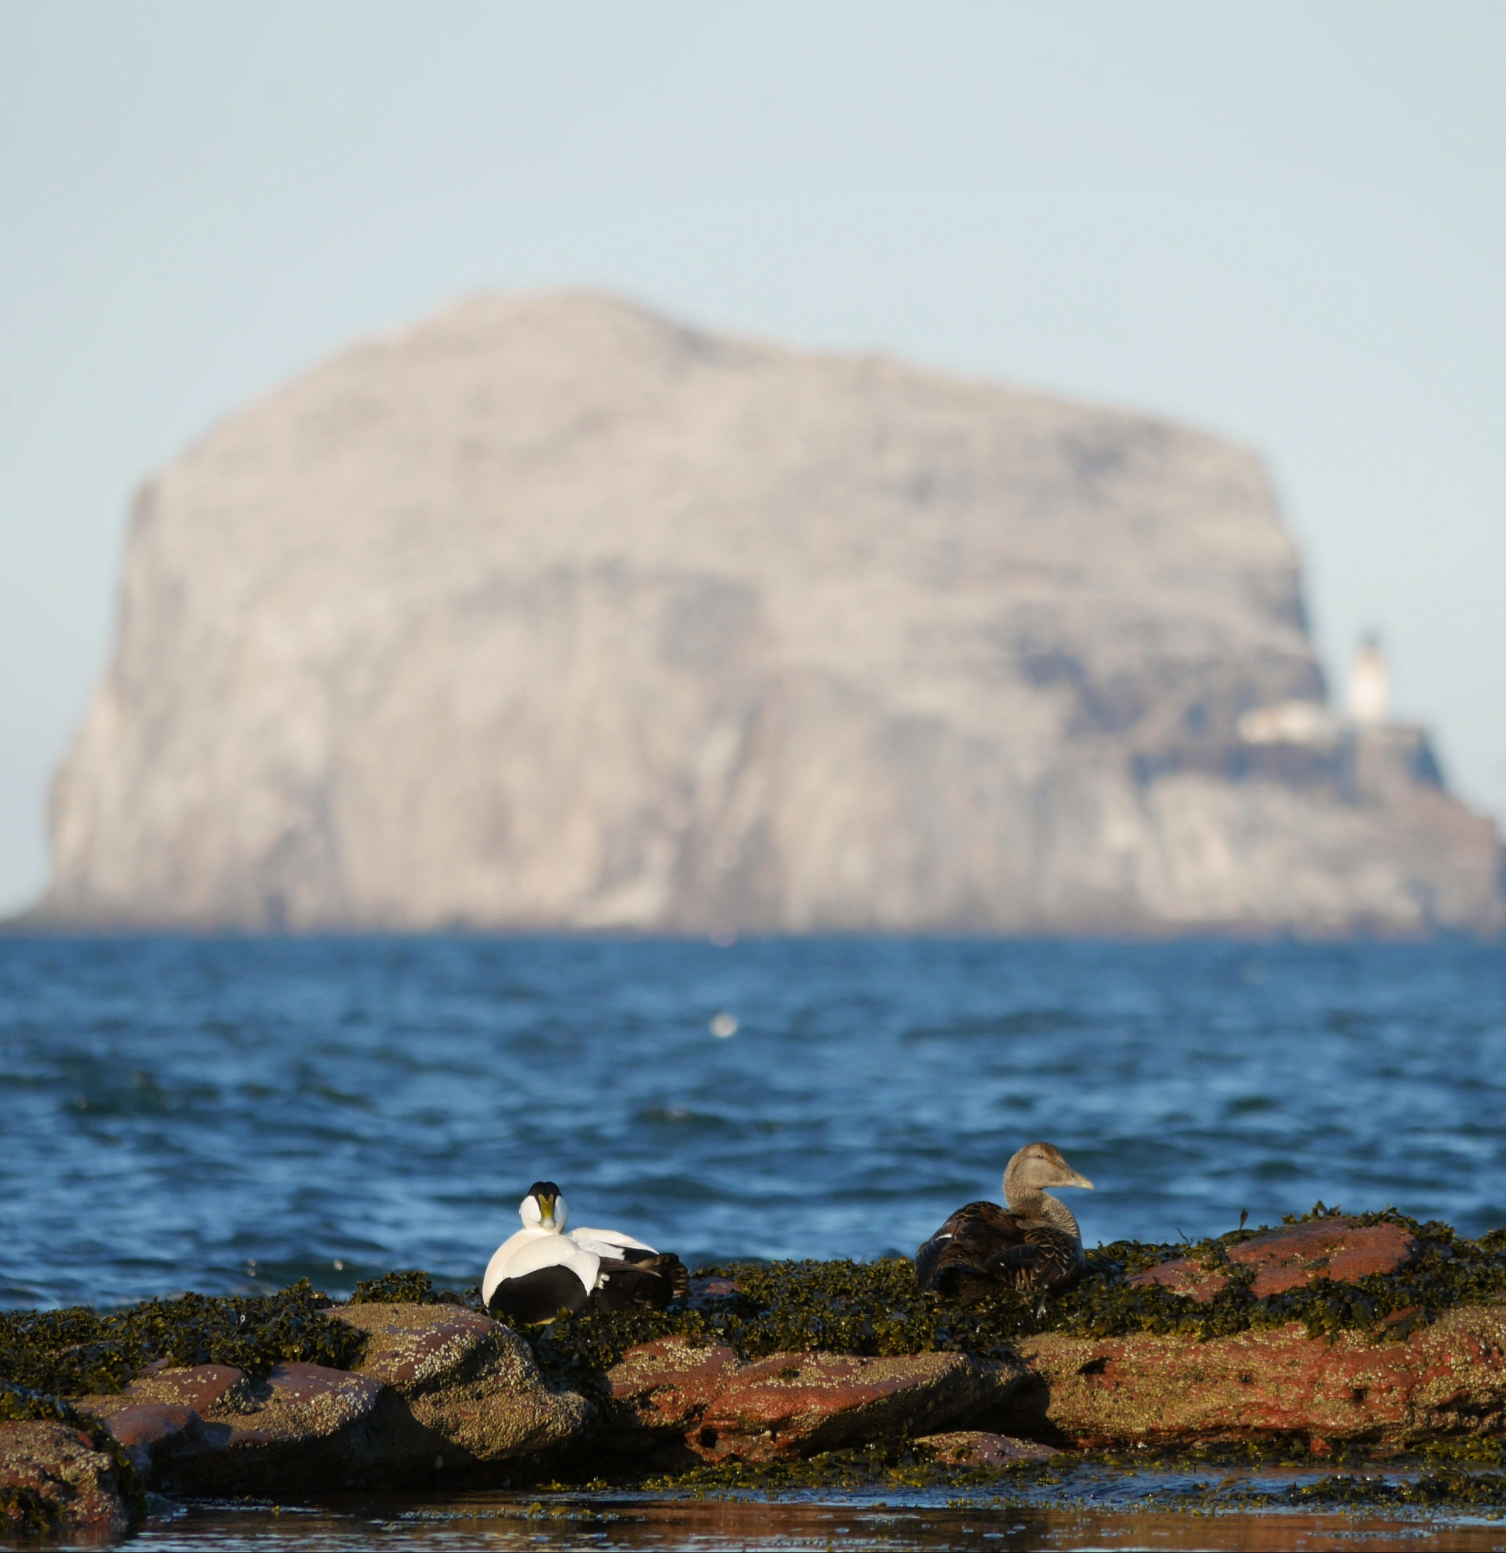
Key lessons learned
Image: Two eider ducks in front of Bass Rock
A more structured induction.
Training for line manager and trainee throughout the placement.
Line management and support.
© Emily Burton

Slide 10
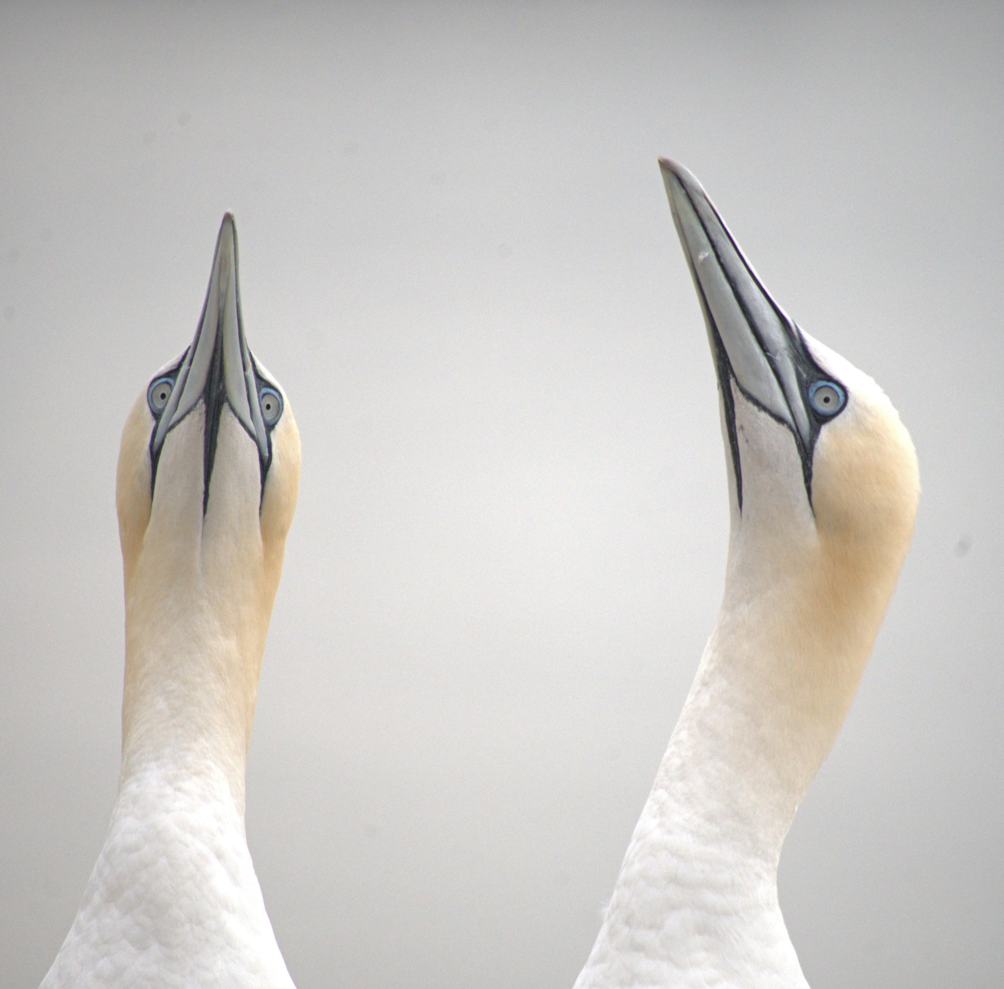
Key lessons learned
Image: Two Gannets
Challenges
Impact going forward
© Emily Burton

Slide 11
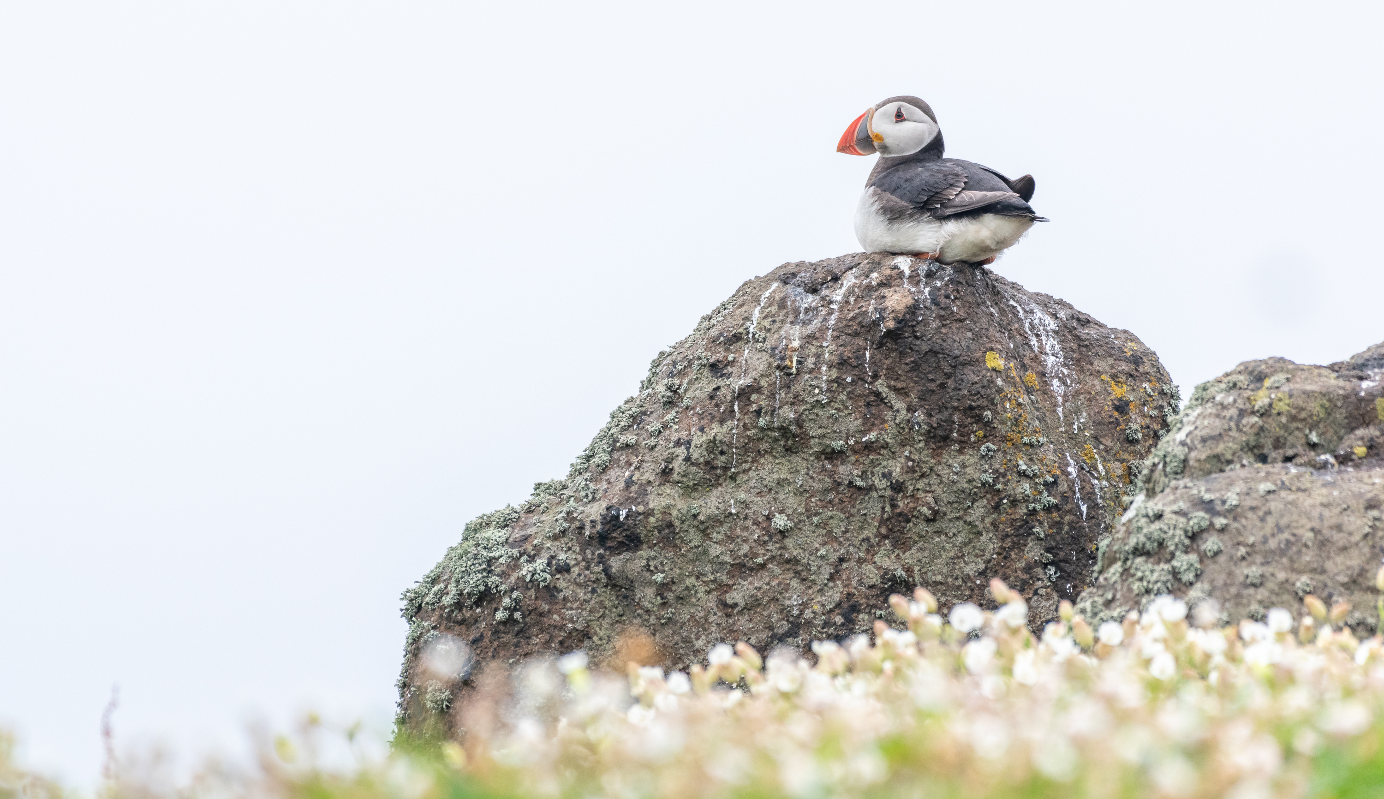
Thank you!
Any questions?
Image: Puffin on a rock.
© Jamie McDermaid

