Slide 1
Sponsoring Skilled Worker visas
The good, the bad, and the crazy!

Slide 2
Who I am
Immigration Advisor regulated by the government regulator ‘The Immigration Advice Authority’
Over 23 yrs experience – inside and out
Used to manage the Visa Section at the British Consulate in Chicago – had approx. 25,000 visa applications pass across my desk in 8 yrs!
Returned to the UK in 2009 and set up my own consultancy
I deal with a lot of companies and charities sponsoring work visas
Also family visas (family of British Citizens), students, visitors, and various other

Slide 3
What is sponsorship?
An agreement with the Home Office to share border control
Three layers of a cake…
3. Visa – the icing on
top!
2. Certificate of
Sponsorship (COS)
1. Sponsor License

Slide 4
Who can be sponsored?
Different types of Sponsor License:
Skilled Worker – regular employment
Charity Worker – 1 year voluntary work
Also Global Business Mobility, Ministers of Religion and various others
For Skilled Workers:
The role must be at school–leaver (Higher) level
The role must pay at least the minimum salary – see next slide…
English ability must be sufficient (B1 level of CEFR)

Slide 5
The bad….the sponsor’s fees
There are fees for you as a sponsor to pay, in addition to the salary:
Sponsor license application fee - £574 for small companies/charities
Fee to assign a Certificate of Sponsorship (COS) - £525
Immigration Skills Charge – for small companies/charities this is £364 per year of sponsorship, paid in full when assigning a COS
E.g. if assigning a COS for 3 yrs initially, you will pay £1617

Slide 6
Additional fees to expedite processes, e.g. the license application, or to quickly obtain a spare COS to assign to a new worker
None of these costs can be passed on to a person you are sponsoring

Slide 7
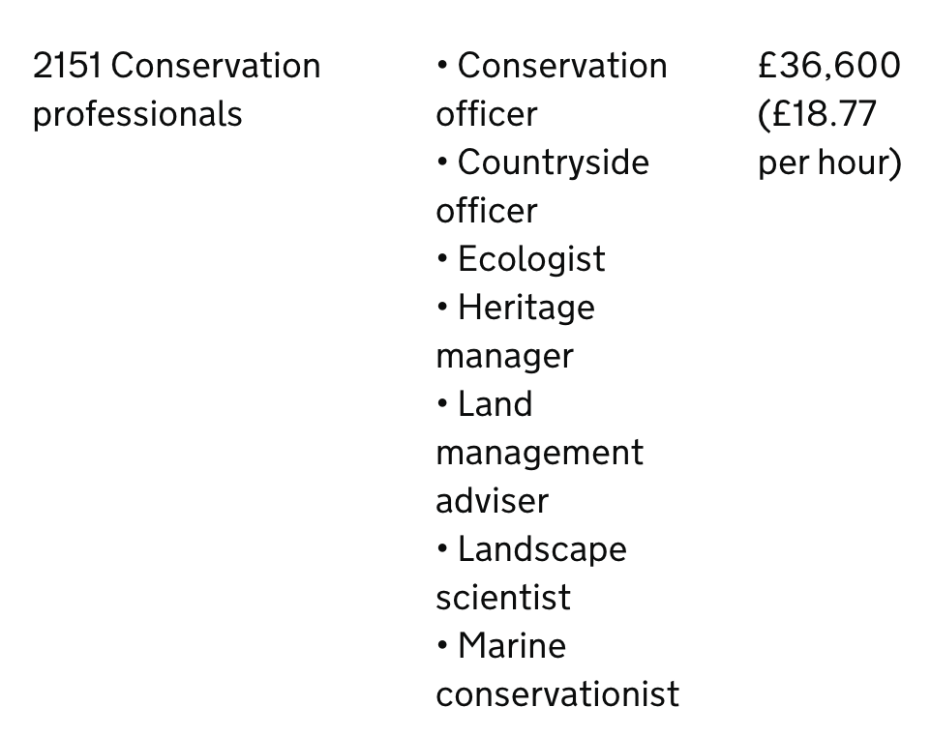
The bad…minimum salaries
Salary requirement for Skilled Workers:
The starting point is the 50th percentile of salaries for that role in the UK e.g.
In addition there is an
‘absolute minimum’ which in
most circumstances will be
£38,700

Slide 8
The good…
There are some exceptions to the previous minimum salaries:
Those here on a Student Visa or Graduate Visa, switching to this Skilled Worker visa - £30,960 and 70% of the going rate for the role
Those age 25 or under - as above
Roles requiring a PhD – varies dependent on subject
Roles that are in shortage (small list, nothing environmental per se, closest is jobs in the fishing industry)- £30,960 and full going rate for role
https://www.gov.uk/guidance/immigration-rules/immigration-rules-appendix-immigration-salary-list

Slide 9
The other good thing is that we used to have to advertise the role first, to demonstrate there was no-one in the existing UK labour market – after Brexit no longer needed

Slide 10
The crazy!...visa fees
Visa fees are very high for the people you sponsor:
Visa application fee - £769 if applying outside the UK, £885 from within the UK (for up to 3 yrs)
Immigration Health Surcharge (essentially health insurance, to be able to use the NHS) - £1035 per year for adults, £776 for kids, payable in full up front
E.g.
An initial 3 yr visa applying from outside the UK - £3874
Extension of 2 more years - £2955
Indefinite Leave to Remain (permanent residence) after 5 yrs - £3029
Total over 5 yrs: £9858 PER PERSON, plus any expediting

Slide 11
The process: Sponsor License application
Involves:
4 docs to demonstrate you are legally operating in the UK
2 application forms
HR procedures set up – how to monitor your sponsored workers
Policy Guidances to read
Possible audit

Slide 12
Steps:
Apply for sponsor license
Assign COS
Manage the sponsorship using the above HR procedures and Policy Guidances
If audited, it is number 3 they are questioning you on

Slide 13
Questions??

